Slide 1
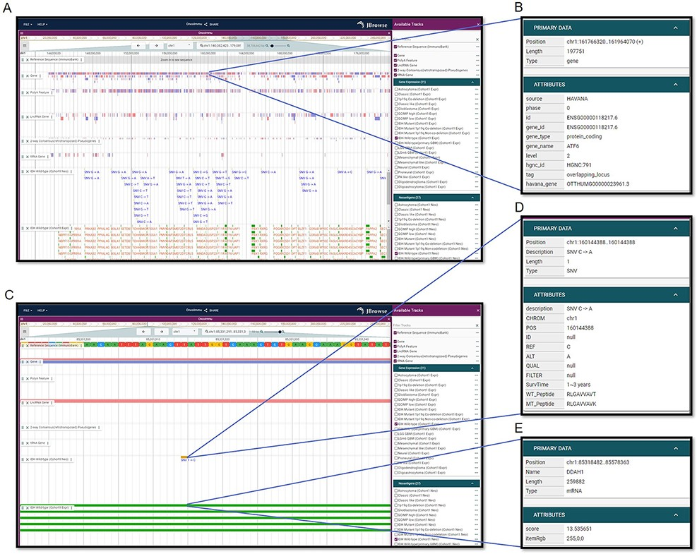
Figure 3. Visualization interfaces in GNIFdb. (A) Overview of the tracks corresponding to gene, mutation and ...
Notes:
Figure 3. Visualization interfaces in GNIFdb. (A) Overview of the tracks corresponding to gene, mutation and neoantigens in a specified glioma subtype (IDH wild-type, Cohort 1 in this example). (B) The gene information includes gene symbol, gene length, location and gene type. (C) Zoomed-in tracks of mutation and gene expression shows the details of mutations and corresponding neoantigens (D) and gene expression (E).
Unless provided in the caption above, the following copyright applies to the content of this slide: © The Author(s) 2022. Published by Oxford University Press.This is an Open Access article distributed under the terms of the Creative Commons Attribution License (https://creativecommons.org/licenses/by/4.0/), which permits unrestricted reuse, distribution, and reproduction in any medium, provided the original work is properly cited.

