Slide 1
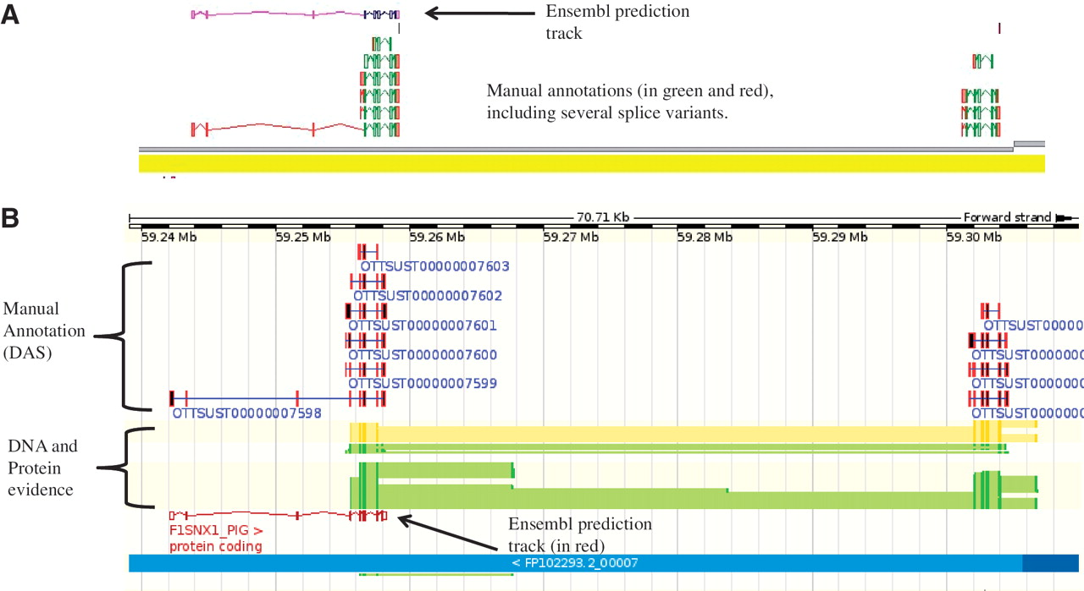
Figure 3. An example of manually annotated genes viewed in ZMap and also displayed as a DAS track in Ensembl. (A) ZMap ...
Notes:
Figure 3. An example of manually annotated genes viewed in ZMap and also displayed as a DAS track in Ensembl. (A) ZMap view of copies of the REG3G gene in pig. The automated Ensembl track predicts one copy of the gene, whilst the manual annotation can resolve two copies in this section of the genome. (B) Ensembl view of the same region displaying the manual annotation DAS track.
Unless provided in the caption above, the following copyright applies to the content of this slide: © The Author(s) 2012. Published by Oxford University Press.This is an Open Access article distributed under the terms of the Creative Commons Attribution Non-Commercial License (http://creativecommons.org/licenses/by-nc/3.0), which permits unrestricted non-commercial use, distribution, and reproduction in any medium, provided the original work is properly cited.

