Slide 1
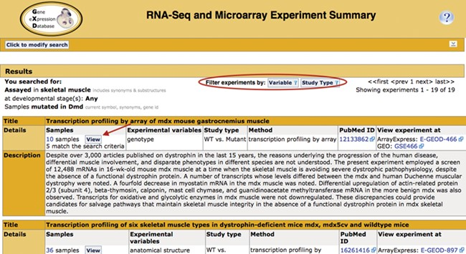
Figure 2 Search return. Pictured is the return for the search in Figure 1. Filters that allow for further refinement ...
Notes:
Figure 2 Search return. Pictured is the return for the search in Figure 1. Filters that allow for further refinement of the return are circled. The red arrow indicates the button to access the pop-up sample table (Figure 3; discussed below). The display also includes the annotated experimental variable(s) and study type, as well as link-outs to the data at ArrayExpress and GEO and the publication at PubMed.
Unless provided in the caption above, the following copyright applies to the content of this slide: © The Author(s) 2020. Published by Oxford University Press.This is an Open Access article distributed under the terms of the Creative Commons Attribution License (http://creativecommons.org/licenses/by/4.0/), which permits unrestricted reuse, distribution, and reproduction in any medium, provided the original work is properly cited.

