Slide 1
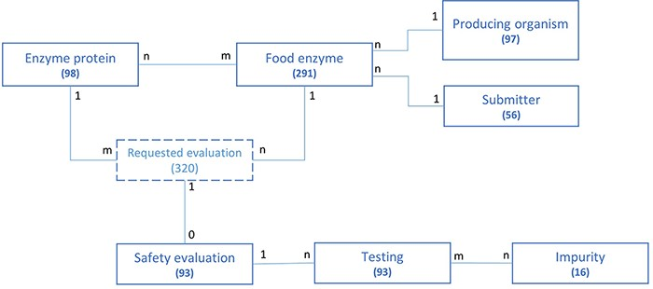
Figure 2. Schematic representation of the underlying data model structure of the web application, representing the ...
Notes:
Figure 2. Schematic representation of the underlying data model structure of the web application, representing the relationships between the different model objects. For each entity, the total number of corresponding entries in the database is given (valid at the time of submission). The numbers at each association indicate cardinalities.
Unless provided in the caption above, the following copyright applies to the content of this slide: © The Author(s) 2021. Published by Oxford University Press.This is an Open Access article distributed under the terms of the Creative Commons Attribution License (https://creativecommons.org/licenses/by/4.0/), which permits unrestricted reuse, distribution, and reproduction in any medium, provided the original work is properly cited.

