Slide 1
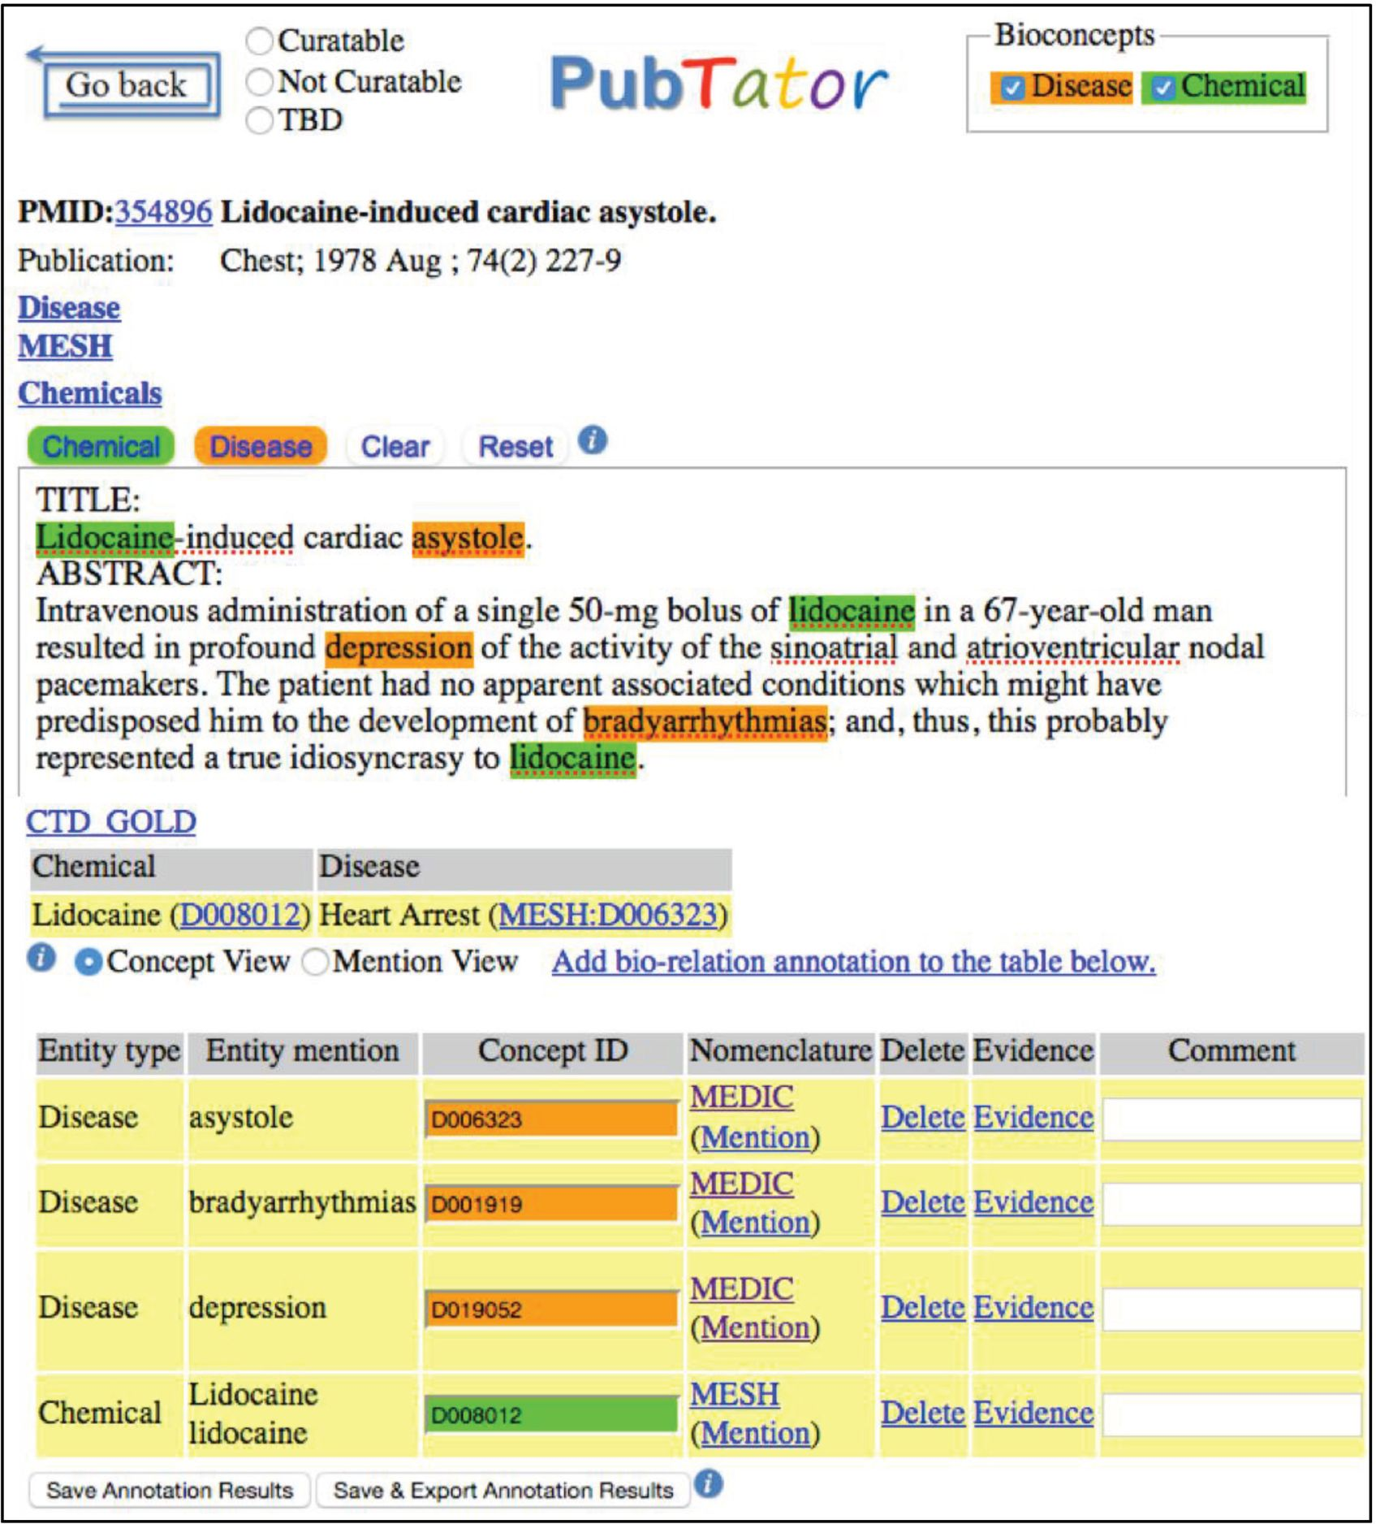
Figure 1. Annotation example shown in our annotation tool, PubTator.
Notes:
Figure 1. Annotation example shown in our annotation tool, PubTator.
Unless provided in the caption above, the following copyright applies to the content of this slide: Published by Oxford University Press 2016. This work is written by US Government employees and is in the public domain in the United States.

Slide 2
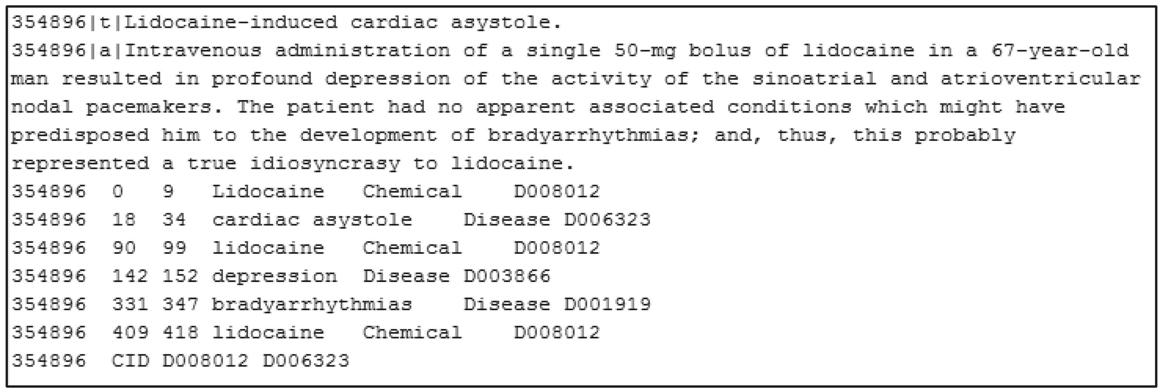
Figure 2. PubTator format annotation (PMID: 354896).
Notes:
Figure 2. PubTator format annotation (PMID: 354896).
Unless provided in the caption above, the following copyright applies to the content of this slide: Published by Oxford University Press 2016. This work is written by US Government employees and is in the public domain in the United States.

Slide 3
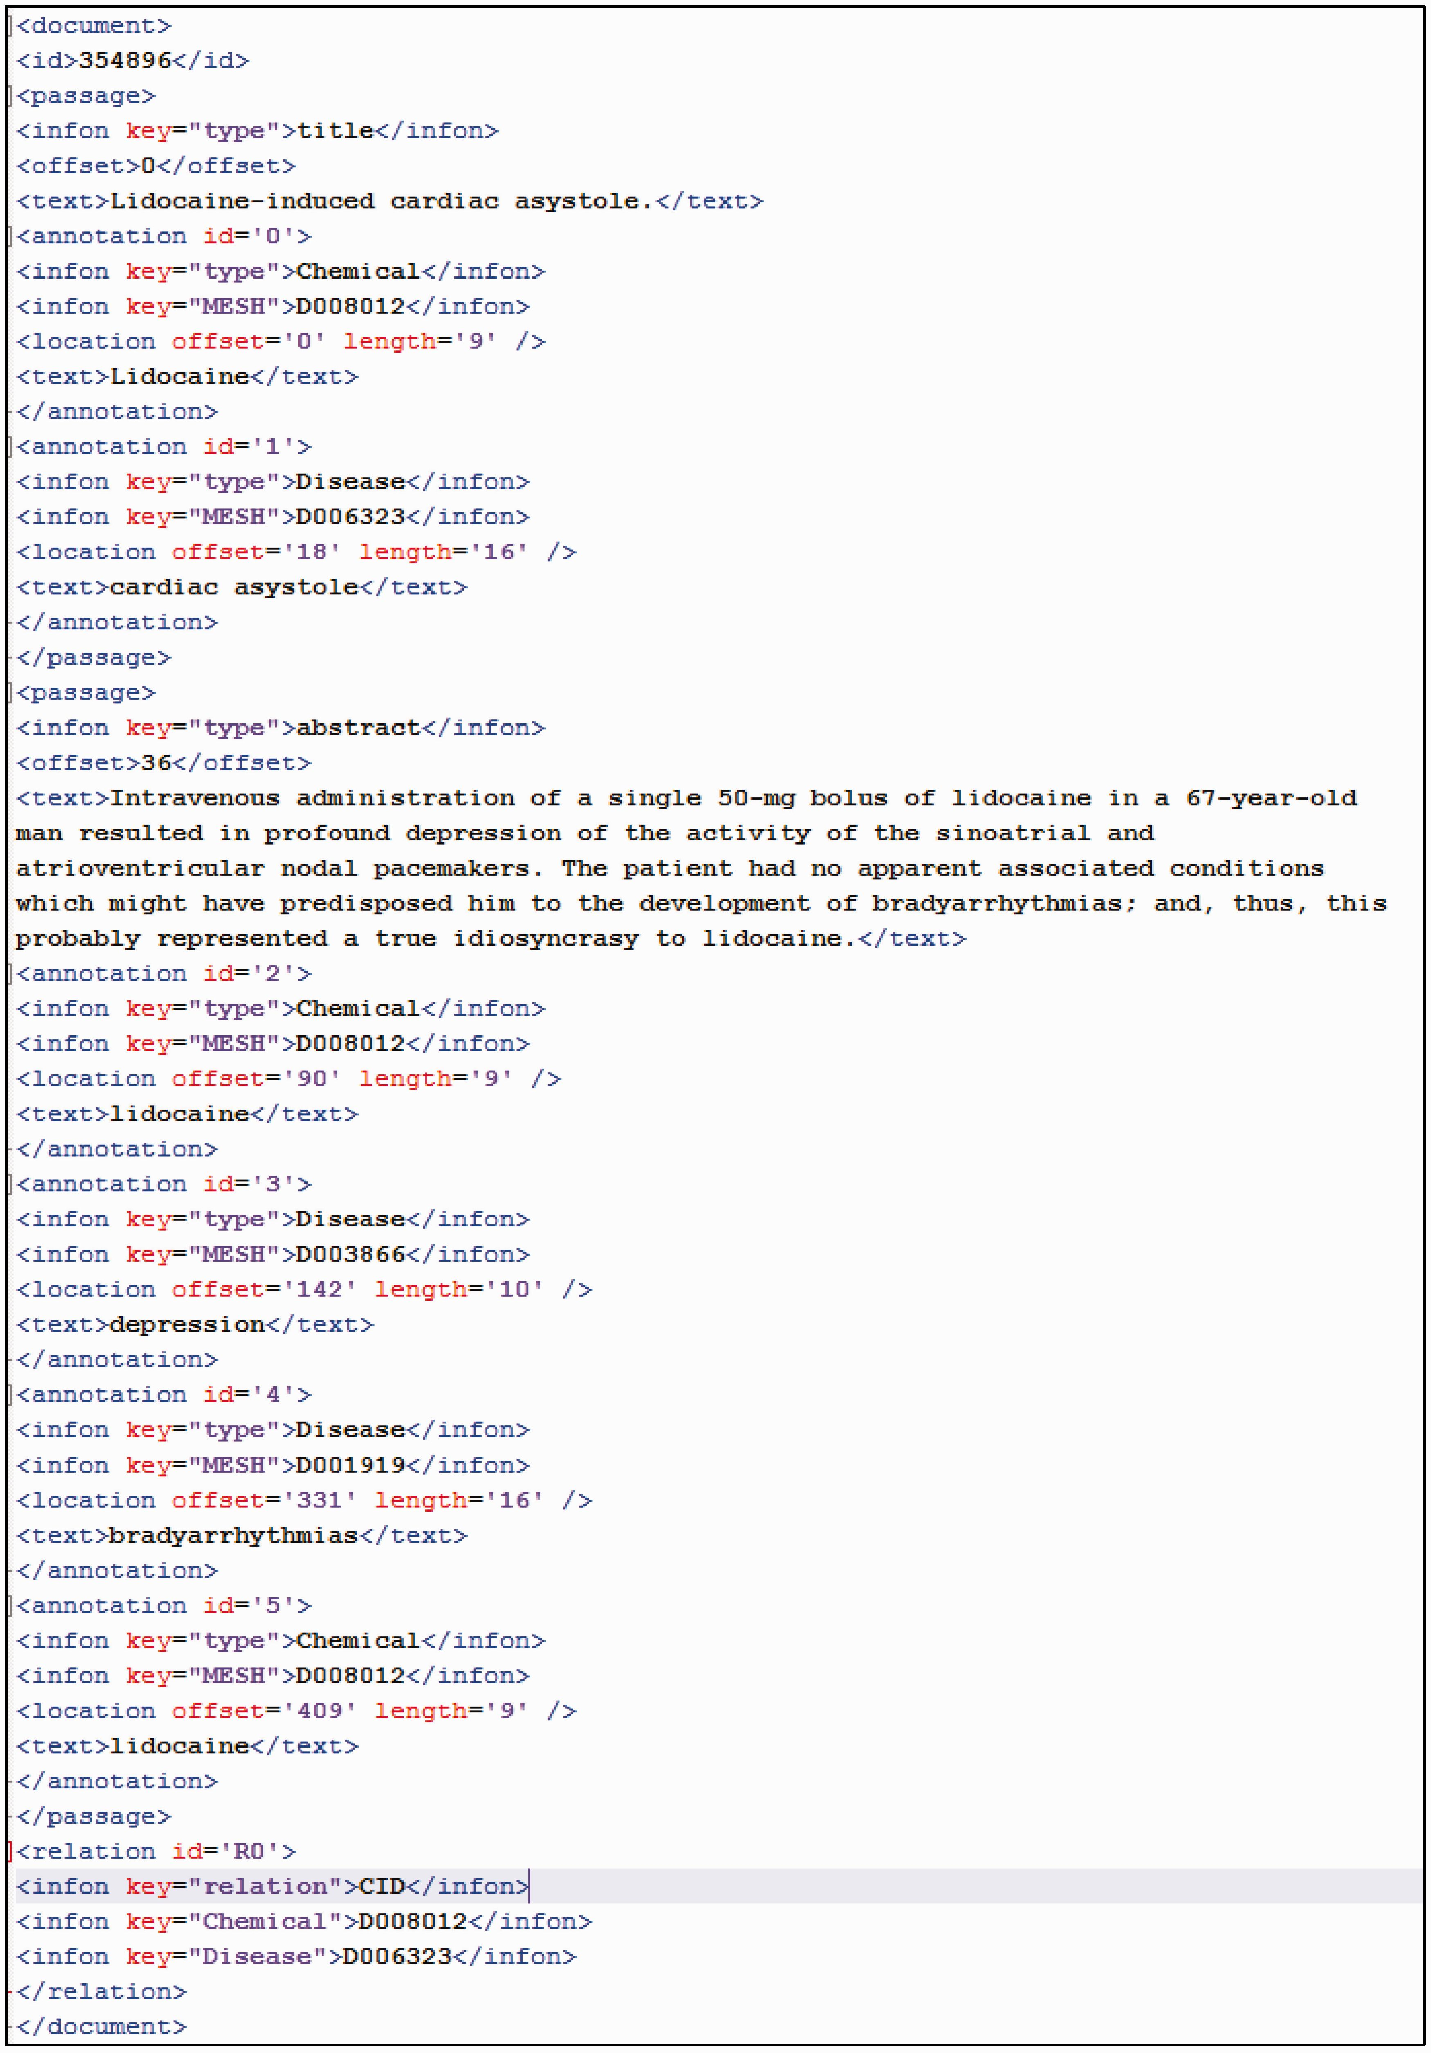
Figure 3. BioC format annotation (PMID: 354896).
Notes:
Figure 3. BioC format annotation (PMID: 354896).
Unless provided in the caption above, the following copyright applies to the content of this slide: Published by Oxford University Press 2016. This work is written by US Government employees and is in the public domain in the United States.

Slide 4
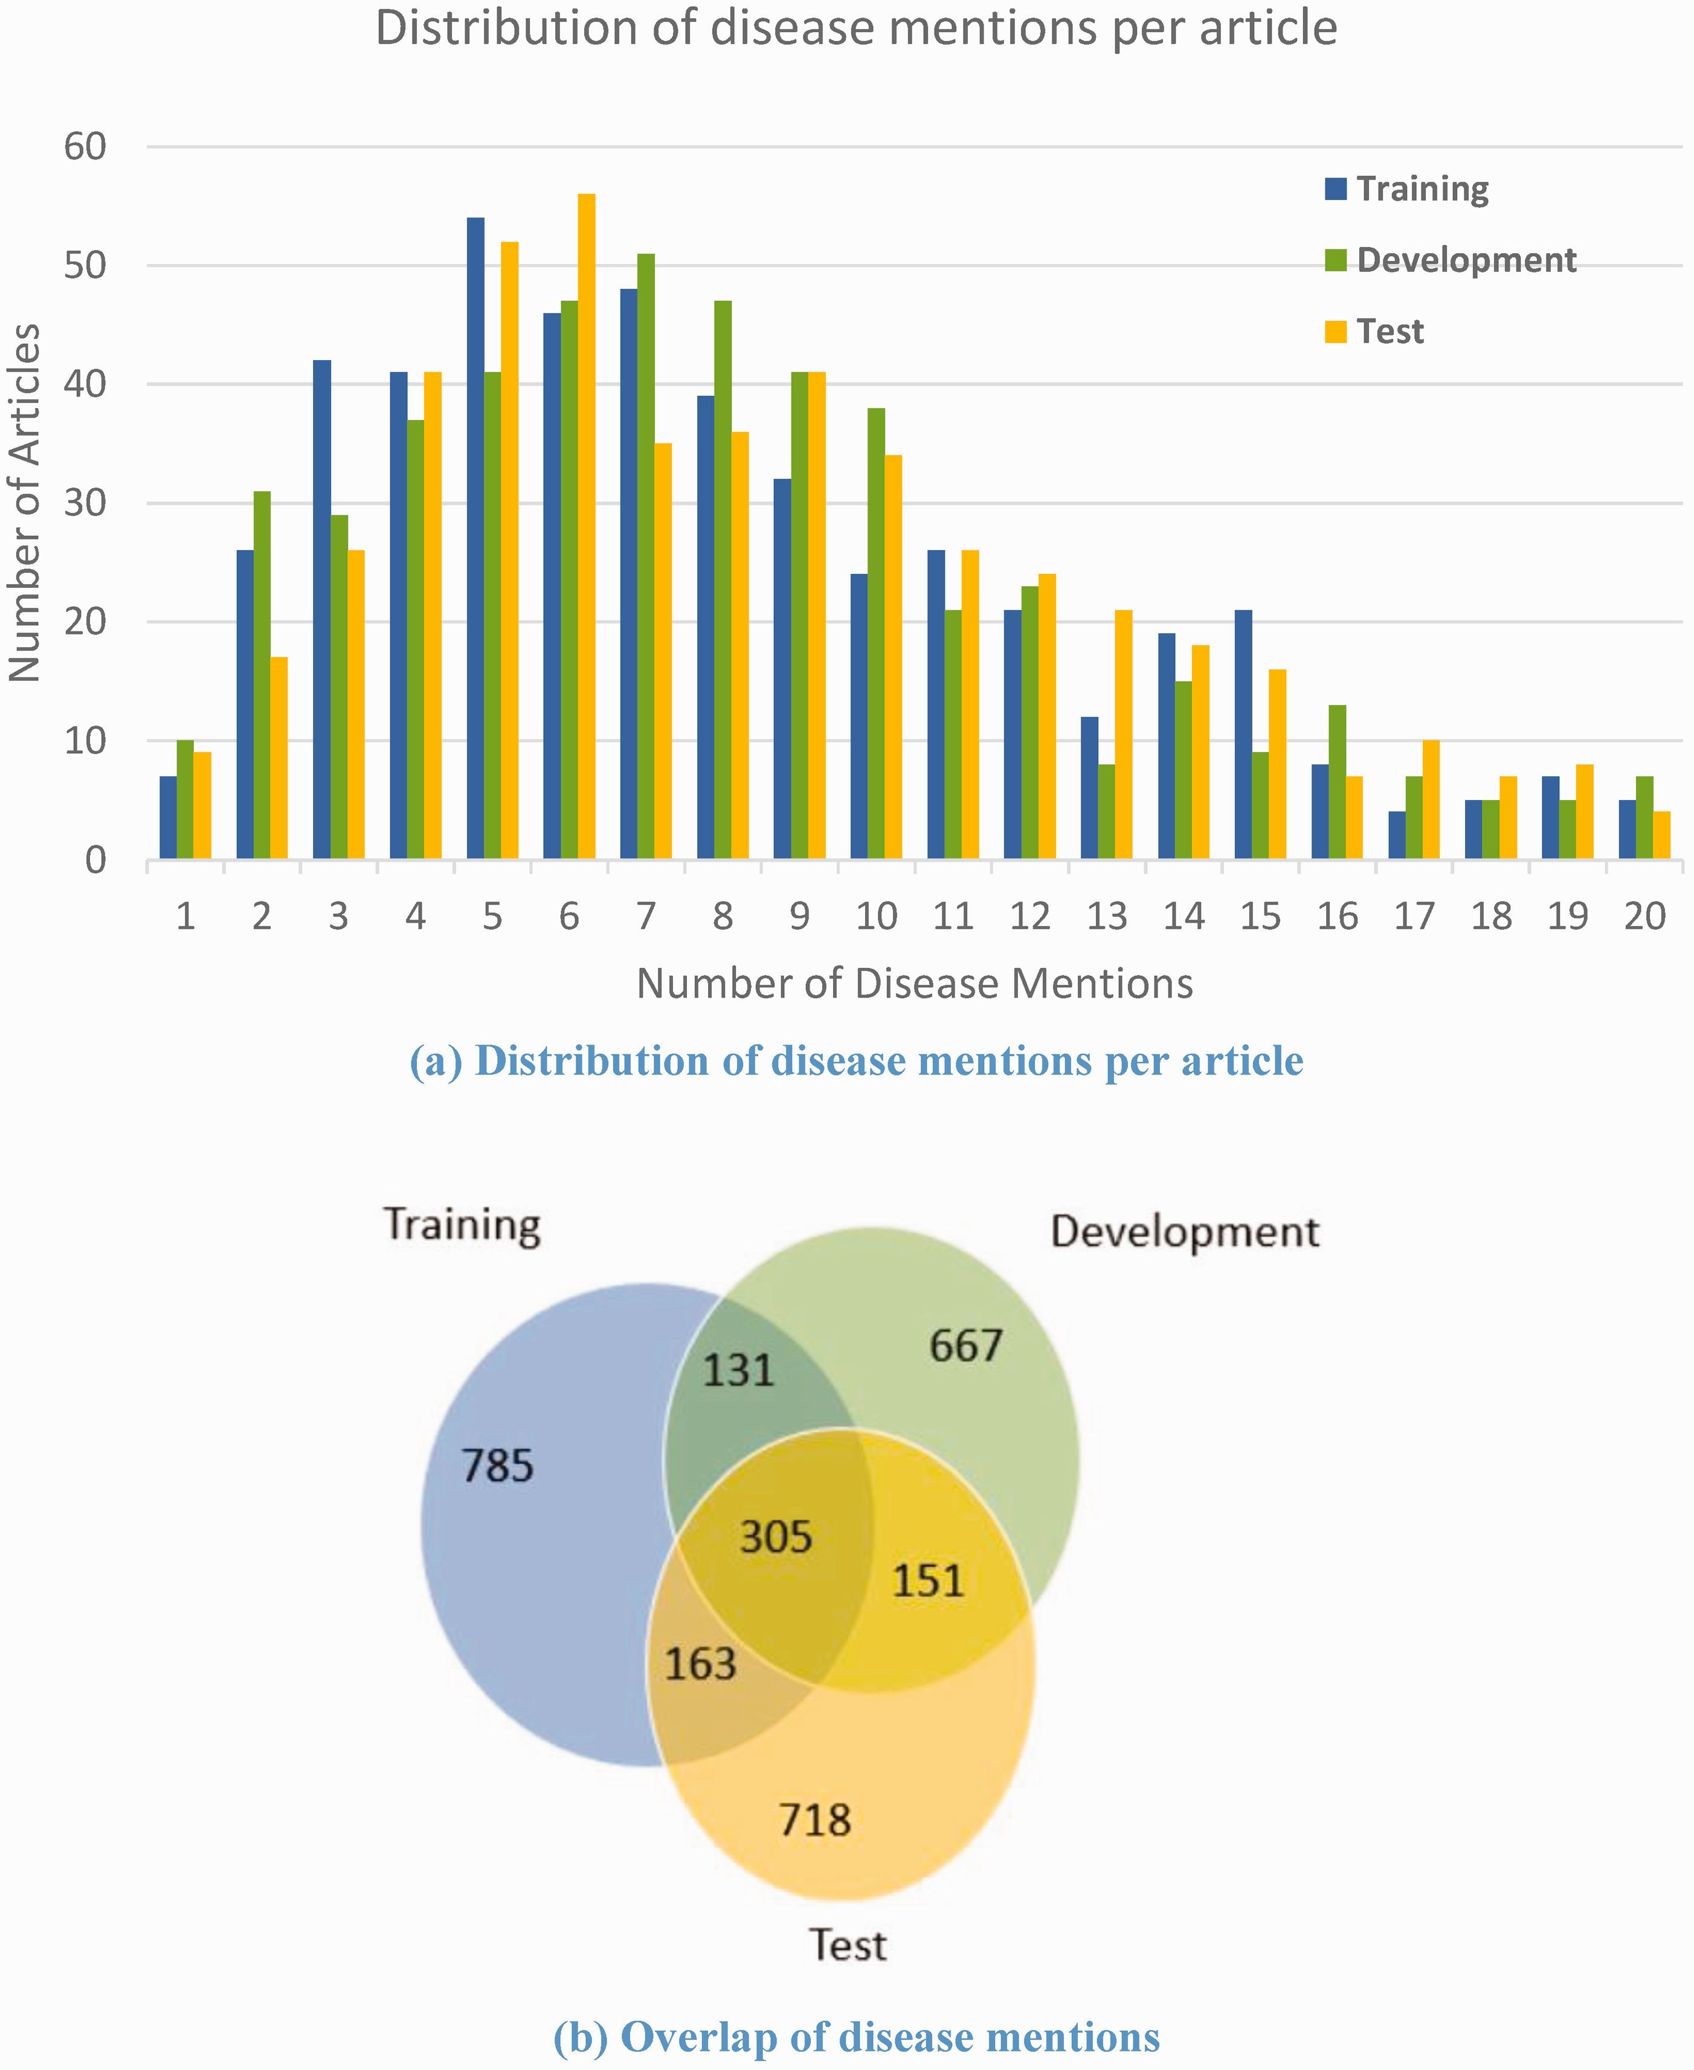
Figure 5. Distribution of disease mentions in the corpus.
Notes:
Figure 5. Distribution of disease mentions in the corpus.
Unless provided in the caption above, the following copyright applies to the content of this slide: Published by Oxford University Press 2016. This work is written by US Government employees and is in the public domain in the United States.

Slide 5
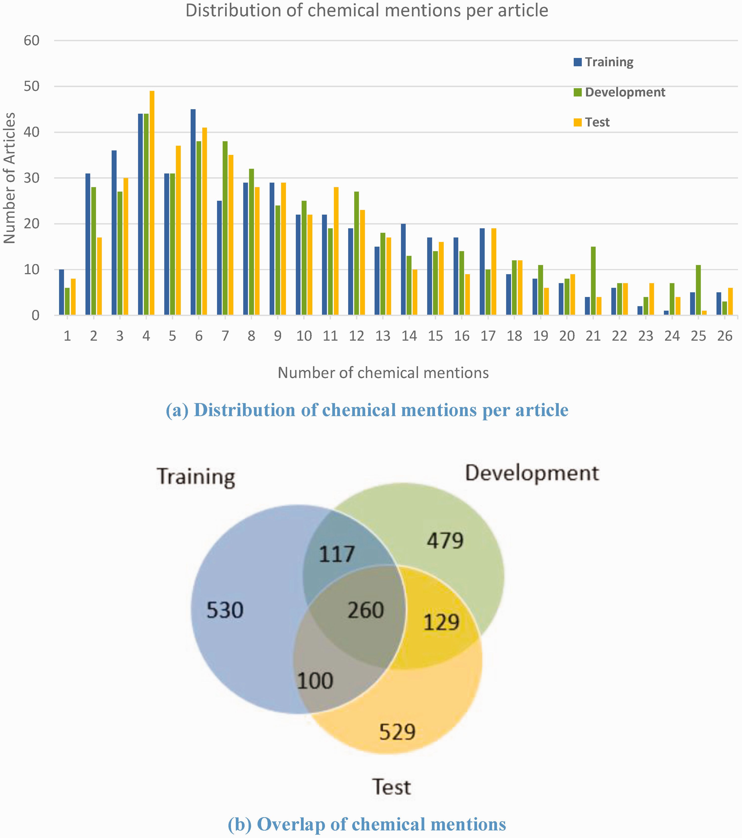
Figure 6. Distribution of chemical mentions in the corpus.
Notes:
Figure 6. Distribution of chemical mentions in the corpus.
Unless provided in the caption above, the following copyright applies to the content of this slide: Published by Oxford University Press 2016. This work is written by US Government employees and is in the public domain in the United States.

Slide 6
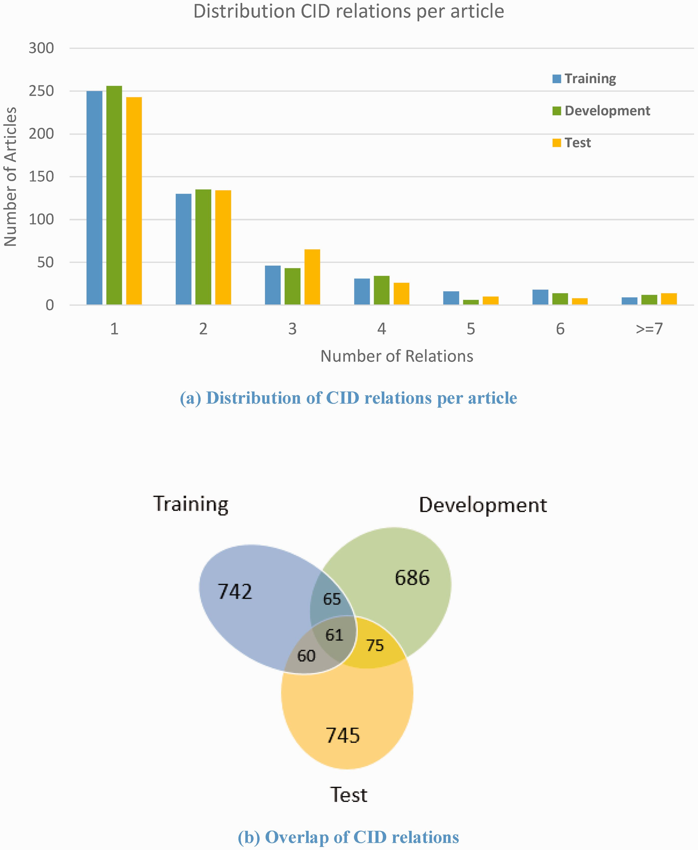
Figure 7. Distribution of chemical-induced disease relations in the corpus.
Notes:
Figure 7. Distribution of chemical-induced disease relations in the corpus.
Unless provided in the caption above, the following copyright applies to the content of this slide: Published by Oxford University Press 2016. This work is written by US Government employees and is in the public domain in the United States.

Slide 7
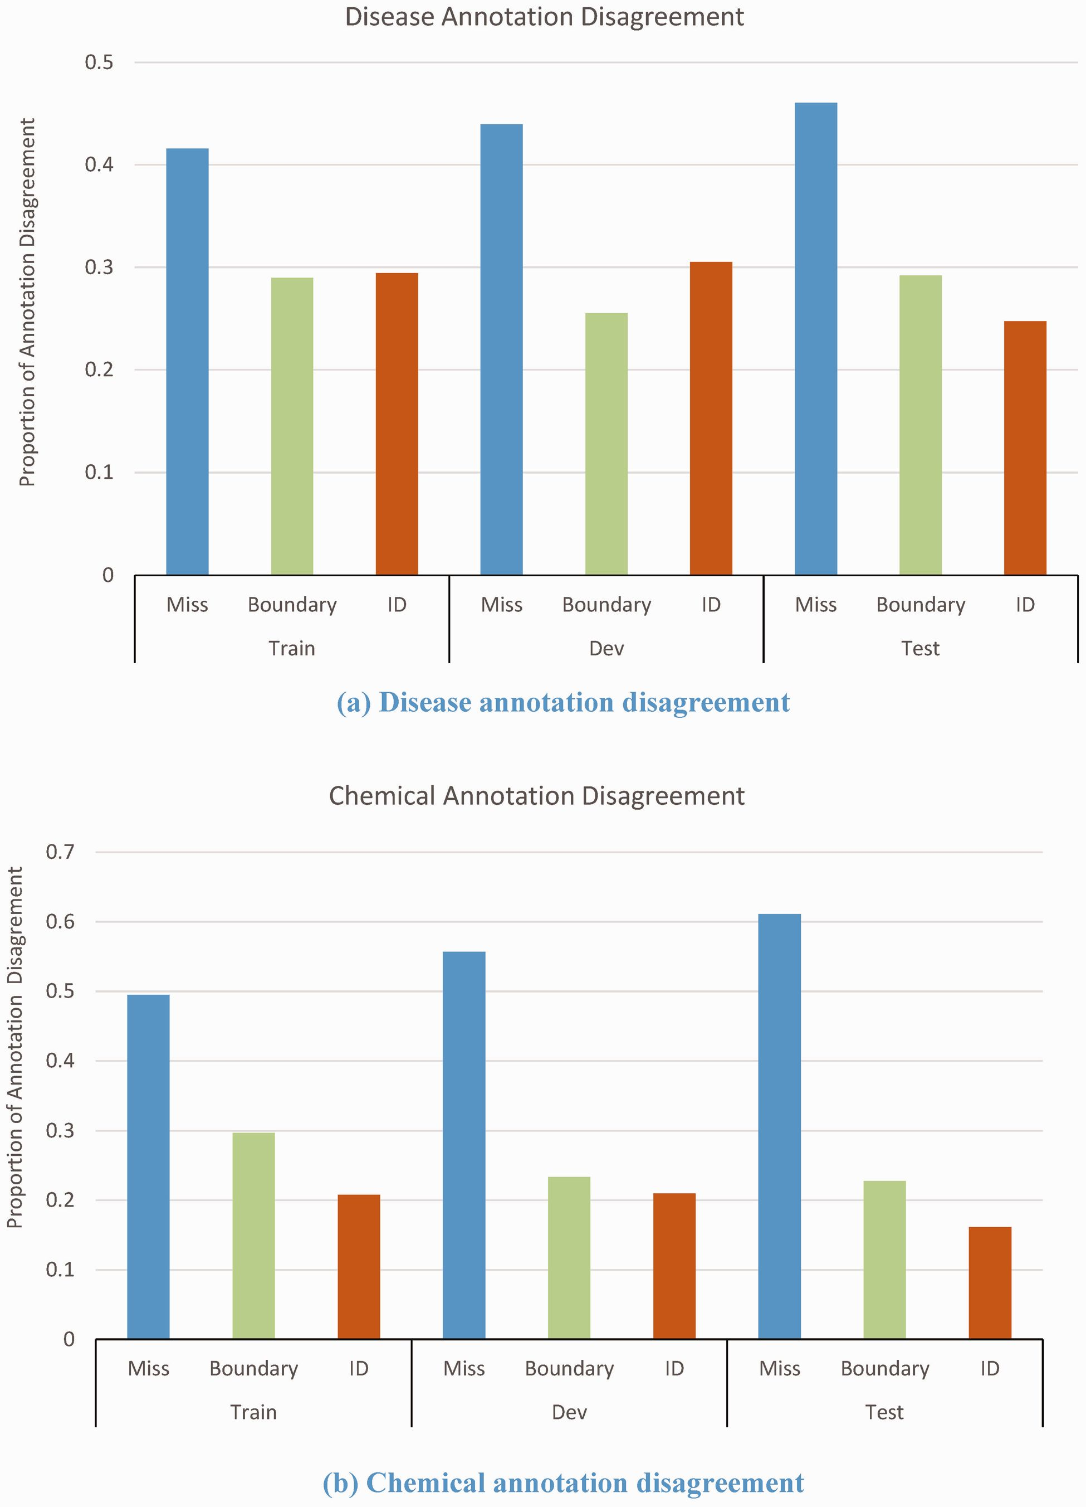
Figure 4.. Disagreements of disease and chemical annotations.
Notes:
Figure 4.. Disagreements of disease and chemical annotations.
Unless provided in the caption above, the following copyright applies to the content of this slide: Published by Oxford University Press 2016. This work is written by US Government employees and is in the public domain in the United States.

