Slide 1
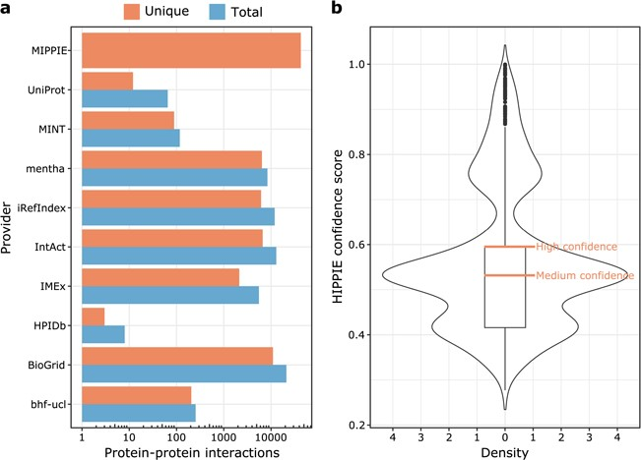
Figure 1 (a) MIPPIE stores 42 610 unique PPIs that originate from nine different molecular interaction providers. Some ...
Notes:
Figure 1 (a) MIPPIE stores 42 610 unique PPIs that originate from nine different molecular interaction providers. Some PPIs are reported by more than one provider, so the plot shows the total and unique number of interactions contributed by each one. (b) Distribution of confidence scores assigned to the 42 610 PPIs in MIPPIE. Interactions with scores above the median of the distribution are a mix of medium and high-quality PPIs, whereas interactions with scores above the upper quartile of the distribution are high quality PPIs only.
Unless provided in the caption above, the following copyright applies to the content of this slide: © The Author(s) 2020. Published by Oxford University Press.This is an Open Access article distributed under the terms of the Creative Commons Attribution License (http://creativecommons.org/licenses/by/4.0/), which permits unrestricted reuse, distribution, and reproduction in any medium, provided the original work is properly cited.

Slide 2
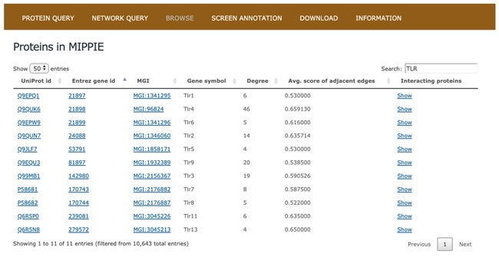
Figure 2 The BROWSE tab in MIPPIE shows a table with the proteome available in the database. Each protein in the table ...
Notes:
Figure 2 The BROWSE tab in MIPPIE shows a table with the proteome available in the database. Each protein in the table is listed with its UniProt, Entrez, MGI and Symbol identifiers, as well as its degree (number of interaction partners), the average MIPPIE score of the interactions in which the protein is involved and a link to explore the network around the protein.
Unless provided in the caption above, the following copyright applies to the content of this slide: © The Author(s) 2020. Published by Oxford University Press.This is an Open Access article distributed under the terms of the Creative Commons Attribution License (http://creativecommons.org/licenses/by/4.0/), which permits unrestricted reuse, distribution, and reproduction in any medium, provided the original work is properly cited.

Slide 3
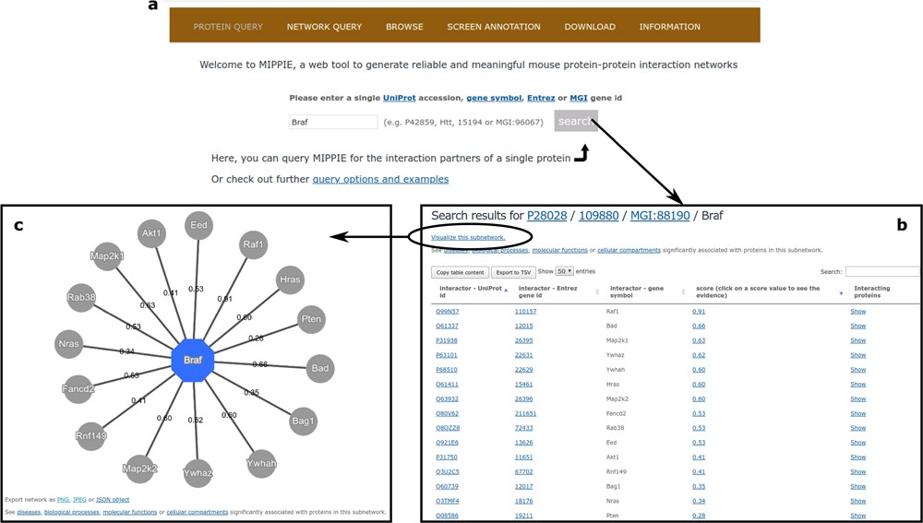
Figure 3 (a) On MIPPIE’s PROTEIN QUERY tab, users can enter a valid protein identifier to retrieve the interaction ...
Notes:
Figure 3 (a) On MIPPIE’s PROTEIN QUERY tab, users can enter a valid protein identifier to retrieve the interaction partners of that protein, if any. (b) MIPPIE generates a table with the query results and provides a link to generate a visual representation of the table (c).
Unless provided in the caption above, the following copyright applies to the content of this slide: © The Author(s) 2020. Published by Oxford University Press.This is an Open Access article distributed under the terms of the Creative Commons Attribution License (http://creativecommons.org/licenses/by/4.0/), which permits unrestricted reuse, distribution, and reproduction in any medium, provided the original work is properly cited.

Slide 4
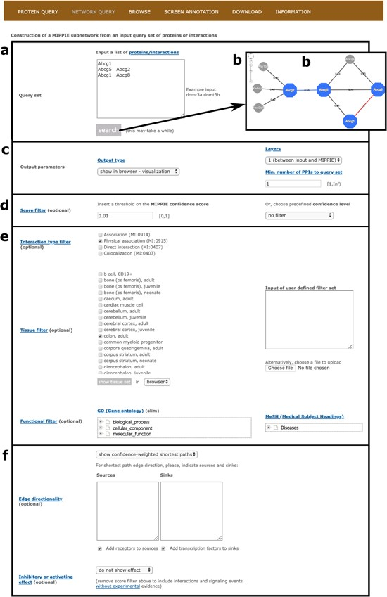
Figure 4 MIPPIE’s NETWORK QUERY tab offers the most advanced search and filtering options. (a, b) Users can type in or ...
Notes:
Figure 4 MIPPIE’s NETWORK QUERY tab offers the most advanced search and filtering options. (a, b) Users can type in or upload a list of proteins or protein pairs to quickly generate a visual representation of the network they form. (c) The results can be explored in a variety of output formats and constrained to 0-, 1-level neighbors or to a minimum number of interactions to the query set. (d) In addition, the quality of the output network can be fine-tuned with confidence score filters. (e, f) This tab also allows for the construction of tissue-, function- or disease-specific networks and for the prediction of interaction directionalities and/or effects.
Unless provided in the caption above, the following copyright applies to the content of this slide: © The Author(s) 2020. Published by Oxford University Press.This is an Open Access article distributed under the terms of the Creative Commons Attribution License (http://creativecommons.org/licenses/by/4.0/), which permits unrestricted reuse, distribution, and reproduction in any medium, provided the original work is properly cited.

Slide 5
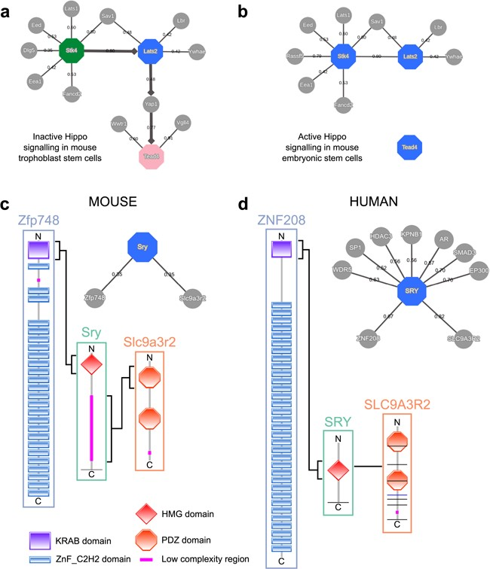
Figure 5 MIPPIE correctly reproduces the chain of Hippo signaling events that lead to (a) trophoblast specification or ...
Notes:
Figure 5 MIPPIE correctly reproduces the chain of Hippo signaling events that lead to (a) trophoblast specification or (b) pluripotency maintenance via the construction of cell type-specific networks with directionality inference using the NETWORK QUERY tab. (c) Interaction partners of the mouse Sry and (d) the human SRY proteins as reported in MIPPIE and HIPPIE, respectively. The accompanying diagrams highlight the domains that mediate conserved interactions.
Unless provided in the caption above, the following copyright applies to the content of this slide: © The Author(s) 2020. Published by Oxford University Press.This is an Open Access article distributed under the terms of the Creative Commons Attribution License (http://creativecommons.org/licenses/by/4.0/), which permits unrestricted reuse, distribution, and reproduction in any medium, provided the original work is properly cited.

