Slide 1
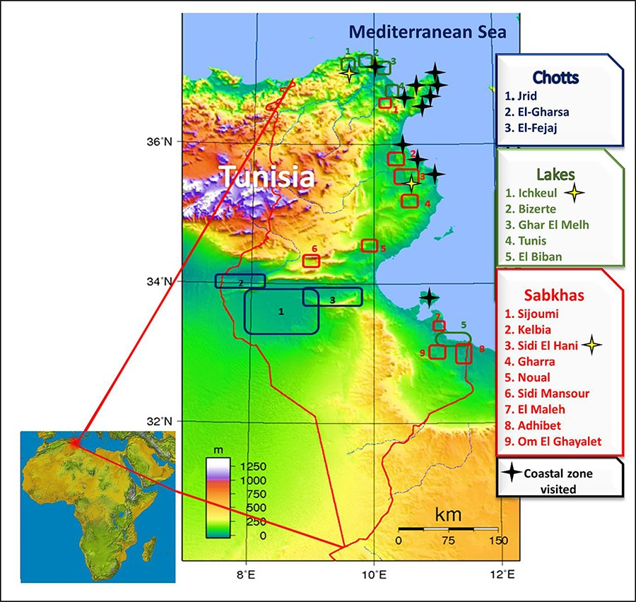
Figure 1. Strategic geographical location of Tunisia in the Mediterranean basin and map of the main potential halophyte ...
Notes:
Figure 1. Strategic geographical location of Tunisia in the Mediterranean basin and map of the main potential halophyte locations in Tunisia (Chotts, lakes, Sabkhas and coastal zones).
Unless provided in the caption above, the following copyright applies to the content of this slide: © The Author(s) 2022. Published by Oxford University Press.This is an Open Access article distributed under the terms of the Creative Commons Attribution License (https://creativecommons.org/licenses/by/4.0/), which permits unrestricted reuse, distribution, and reproduction in any medium, provided the original work is properly cited.

