Slide 1
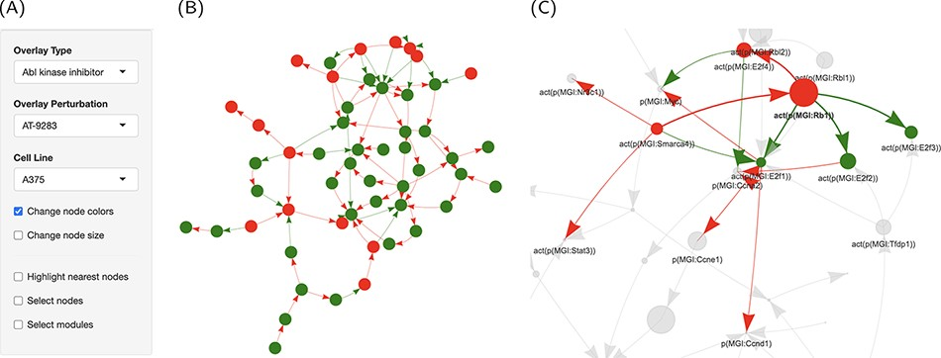
Figure 5. Graph representation of the network perturbations. (A) Input panel to search and select from the main inputs ...
Notes:
Figure 5. Graph representation of the network perturbations. (A) Input panel to search and select from the main inputs for individual perturbations to visualize on the network graph. (B) The ‘cell cycle’ network shown as a graph overlaid with the effect of ‘AT-9283’ in the ‘A375’ cell line. (C) The same with the highlighted cluster. Nodes are colored by the direction of regulation in response to the drug treatment (red, up, and green, down-regulated). Edges are colored by regulation direction between the nodes (red, increase; and green, decrease).
Unless provided in the caption above, the following copyright applies to the content of this slide: © The Author(s) 2021. Published by Oxford University Press.This is an Open Access article distributed under the terms of the Creative Commons Attribution License (http://creativecommons.org/licenses/by/4.0/), which permits unrestricted reuse, distribution, and reproduction in any medium, provided the original work is properly cited.

