Slide 1
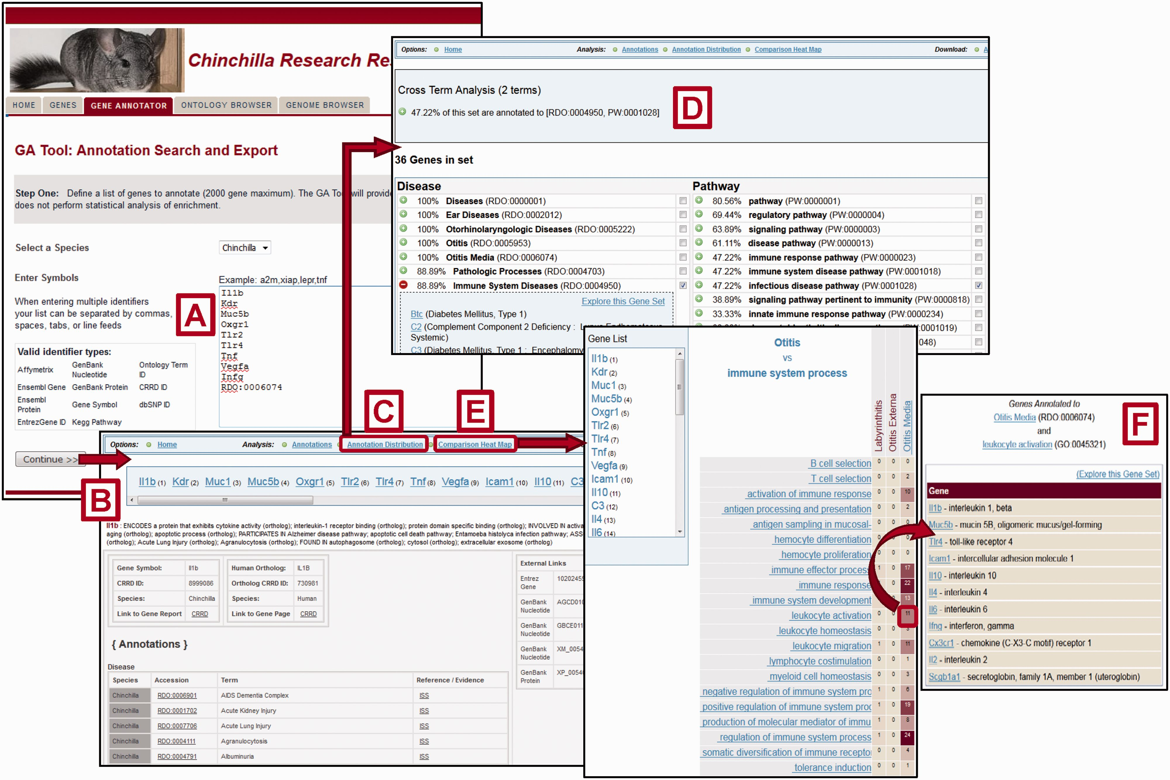
Figure 4. Gene Annotator Tool. The CRRD Gene Annotator (GA) Tool takes a list of gene symbols, CRRD IDs, nucleotide ...
Notes:
Figure 4. Gene Annotator Tool. The CRRD Gene Annotator (GA) Tool takes a list of gene symbols, CRRD IDs, nucleotide and protein accession numbers, NCBI Gene IDs or Ontology IDs ( A ) and returns the corresponding list of chinchilla or human genes. Results are shown as reports for individual genes ( B ), including functional annotations for the gene and its ortholog, and a list of external database IDs with links to the information at those sites. The Annotation Distribution function ( C ) displays the percentage of genes from the input list which have annotations to categories and/or specific terms in each functional domain (i.e. disease, pathway, biological process, etc.). Select a term, such as ‘Immune System Diseases’, to see the genes from your list that are annotated to that term or to a more specific child term, or select multiple terms to see the genes annotated to all selected terms. Here the terms ‘Immune System Diseases’ and ‘infectious disease pathway’ were selected using the check boxes in the term lists. The Cross Term Analysis results ( D ) show that 47.22% of the list (17/36 genes) are annotated to both. Options are given to explore these gene subsets further. The GA Tool's Comparison Heat Map function ( E ) allows users to browse through two ontologies to see the genes at the intersection of these ontologies at multiple levels. The darker the square in the display, the more genes in the list which have annotations from the ontology branches represented by that column and row. Click a square to see the list of genes represented. The example here shows the list of 11 chinchilla genes which are annotated to both the disease term ‘Otitis Media’ and the Gene Ontology term ‘leukocyte activation’ ( F ).
Unless provided in the caption above, the following copyright applies to the content of this slide: © The Author(s) 2016. Published by Oxford University Press. This is an Open Access article distributed under the terms of the Creative Commons Attribution License ( http://creativecommons.org/licenses/by/4.0/ ), which permits unrestricted reuse, distribution, and reproduction in any medium, provided the original work is properly cited.

Slide 2
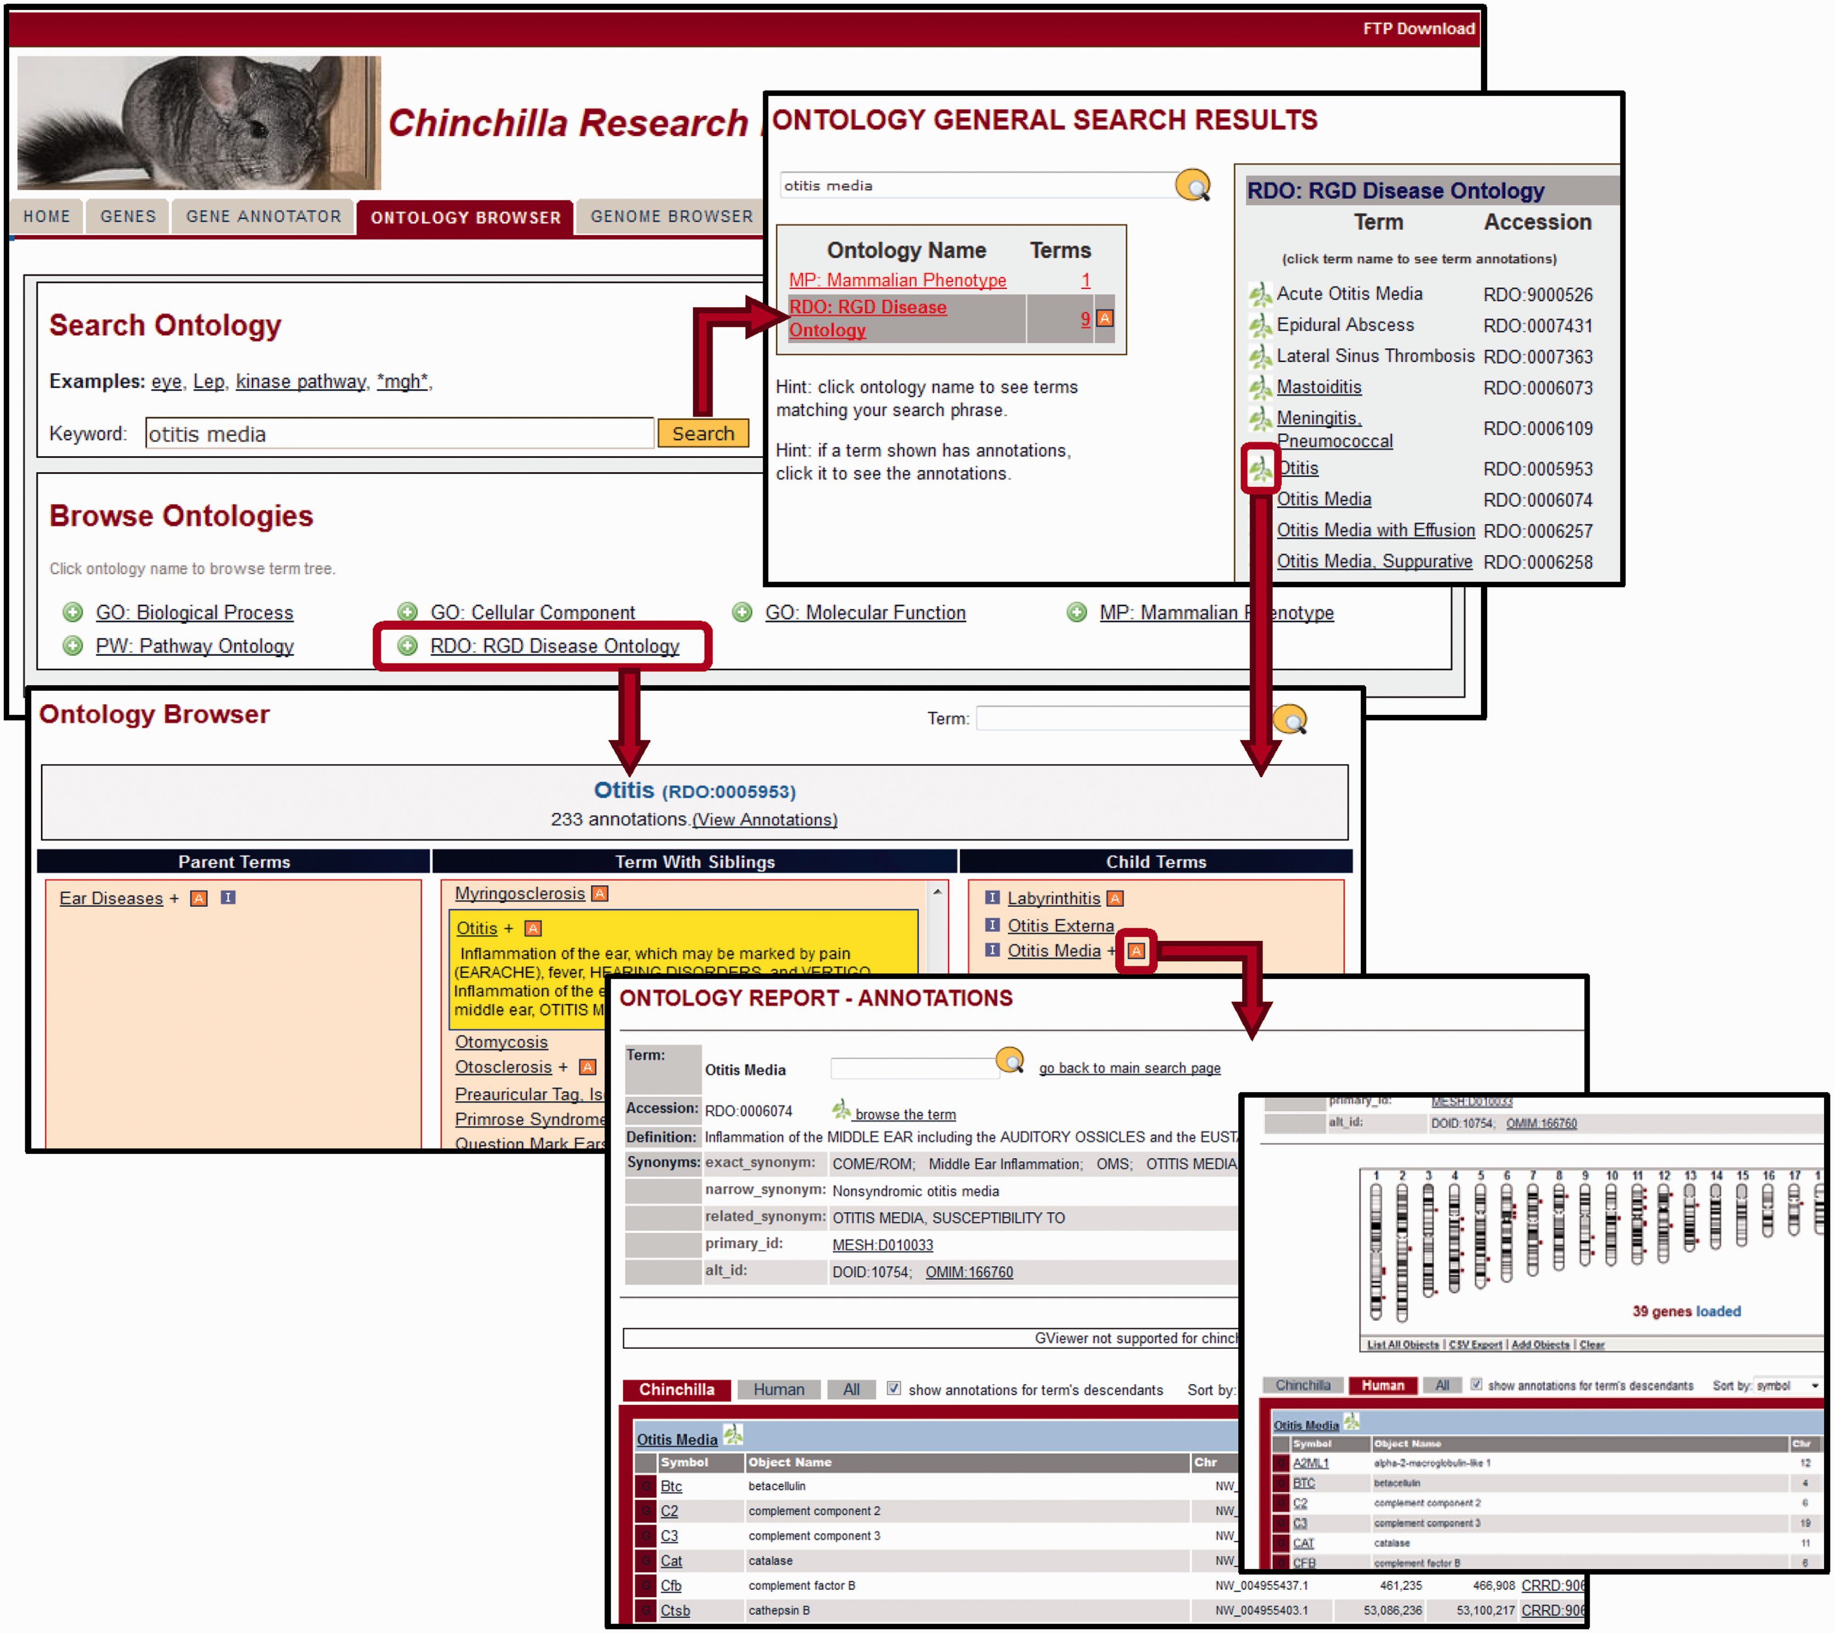
Figure 3. Ontology Browser and Search. Genes with related functional attributes can be retrieved using the CRRD ...
Notes:
Figure 3. Ontology Browser and Search. Genes with related functional attributes can be retrieved using the CRRD Ontology Browser and Search Tool. A keyword search in the tool will return a scoreboard listing the ontologies with matching terms (top). Select an ontology to see the list of matched terms, to access an ontology report or to begin browsing at a specific term. Alternatively, users can utilize the ontology browser, accessed from the name of the ontology on the main search page or by clicking a leaf icon on the search results page, to navigate up or down the tree to find their term of interest (middle). CRRD Ontology Report pages, accessed via the ‘A’ icon in the browser or the term in the search results, display details of the selected term (bottom left) as well as lists of chinchilla, human or all genes annotated to the selected term and/or its more specific child terms. In addition to the gene list, human genes are graphically displayed at their positions relative to the human karyotype (bottom right) in a whole-genome display on the human-specific results page.
Unless provided in the caption above, the following copyright applies to the content of this slide: © The Author(s) 2016. Published by Oxford University Press. This is an Open Access article distributed under the terms of the Creative Commons Attribution License ( http://creativecommons.org/licenses/by/4.0/ ), which permits unrestricted reuse, distribution, and reproduction in any medium, provided the original work is properly cited.

Slide 3
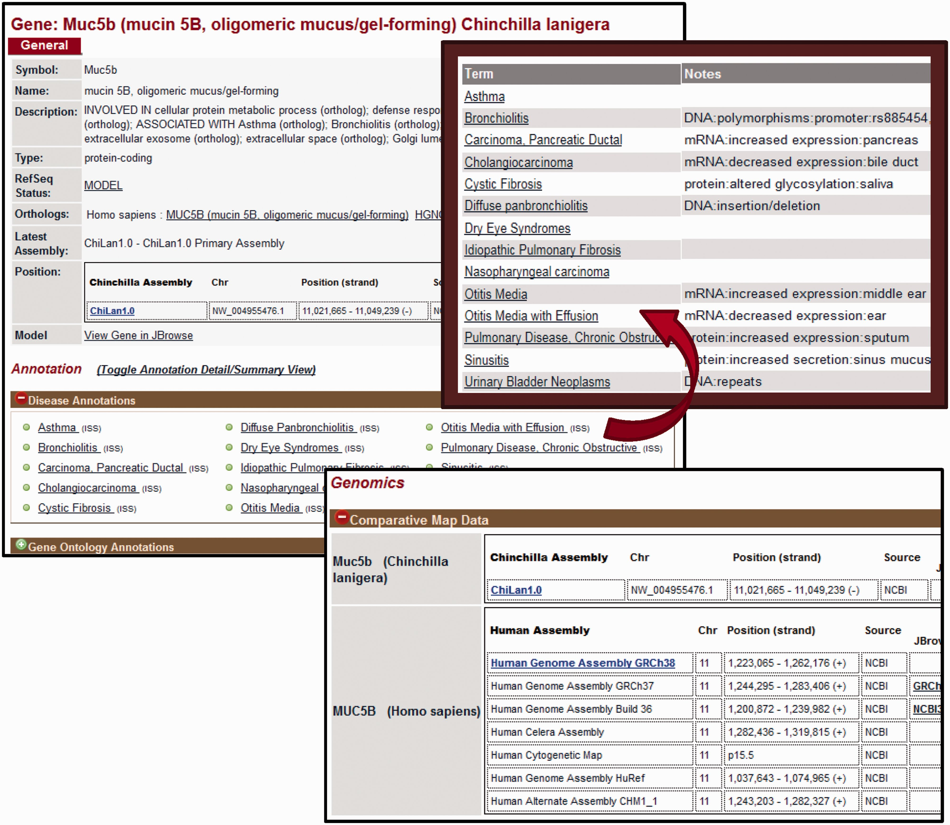
Figure 2. Gene Report Page for Chinchilla. CRRD gene reports display basic information about the gene including the ...
Notes:
Figure 2. Gene Report Page for Chinchilla. CRRD gene reports display basic information about the gene including the symbol and name of the gene, a description based on the functional annotations for that gene, the gene type as assigned by NCBI and the RefSeq status of the gene. In addition, a link is given to the human ortholog (top left). The Annotations section includes Gene Ontology (GO), Disease and Pathway annotations inferred to chinchilla genes from their human orthologs. When viewing the list of annotated terms, the ‘Toggle Annotation Detail/Summary View’ link can be used to show additional details (top right). Comparative map data includes the scaffold positions for chinchilla genes and positions on multiple assemblies for human (bottom).
Unless provided in the caption above, the following copyright applies to the content of this slide: © The Author(s) 2016. Published by Oxford University Press. This is an Open Access article distributed under the terms of the Creative Commons Attribution License ( http://creativecommons.org/licenses/by/4.0/ ), which permits unrestricted reuse, distribution, and reproduction in any medium, provided the original work is properly cited.

Slide 4
Figure 1. The Chinchilla Research Resource Database (CRRD) Home Page. The CRRD home page gives easy access to keyword ...
Notes:
Figure 1. The Chinchilla Research Resource Database (CRRD) Home Page. The CRRD home page gives easy access to keyword ( A ) and gene-specific ( B , C ) searches, to the Chinchilla JBrowse Genome Browser ( D ), to the Ontology Browser and Search Tool ( E ), to the Gene Annotator (GA) Tool ( F ) and to the FTP site for bulk data downloads ( G ).
Unless provided in the caption above, the following copyright applies to the content of this slide: © The Author(s) 2016. Published by Oxford University Press. This is an Open Access article distributed under the terms of the Creative Commons Attribution License ( http://creativecommons.org/licenses/by/4.0/ ), which permits unrestricted reuse, distribution, and reproduction in any medium, provided the original work is properly cited.

Slide 5
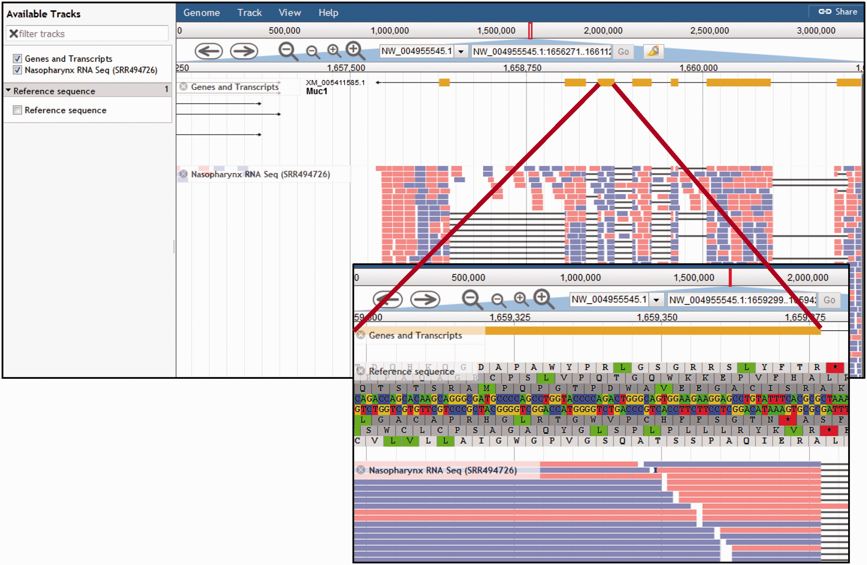
Figure 5. Chinchilla Genome Browser. The ‘Available tracks’ in the CRRD JBrowse genome browser include ‘Genes and ...
Notes:
Figure 5. Chinchilla Genome Browser. The ‘Available tracks’ in the CRRD JBrowse genome browser include ‘Genes and Transcripts’, an RNA-Seq BAM alignment for nasopharynx, and the genomic reference sequence. Users can search for a scaffold position or for a gene symbol to navigate to that region of the genome. Navigation buttons allow the user to scroll through the region and zoom in or out to refine their view. The genes and transcripts track shows the intron/exon structure of the gene and, where applicable, any predicted splice variants. The RNA-Seq track displays the BAM alignments for short read RNA sequences from chinchilla nasopharynx. When zoomed in sufficiently, the ‘Reference Sequence’ track shows the reference DNA sequence and the corresponding predicted amino acid sequences in all six reading frames (insert).
Unless provided in the caption above, the following copyright applies to the content of this slide: © The Author(s) 2016. Published by Oxford University Press. This is an Open Access article distributed under the terms of the Creative Commons Attribution License ( http://creativecommons.org/licenses/by/4.0/ ), which permits unrestricted reuse, distribution, and reproduction in any medium, provided the original work is properly cited.

