Slide 1
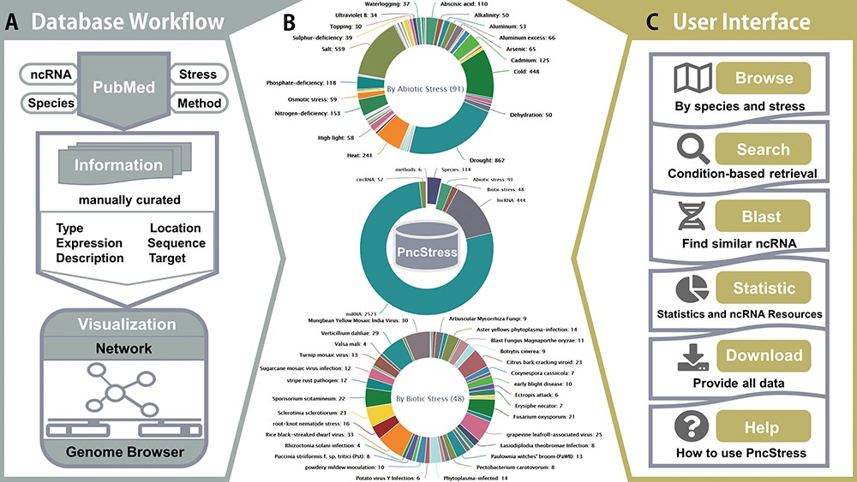
Figure 1 The architecture and statistics of PncStress.
Notes:
Figure 1 The architecture and statistics of PncStress.
Unless provided in the caption above, the following copyright applies to the content of this slide: © The Author(s) 2020. Published by Oxford University Press.This is an Open Access article distributed under the terms of the Creative Commons Attribution License (http://creativecommons.org/licenses/by/4.0/), which permits unrestricted reuse, distribution, and reproduction in any medium, provided the original work is properly cited.

Slide 2
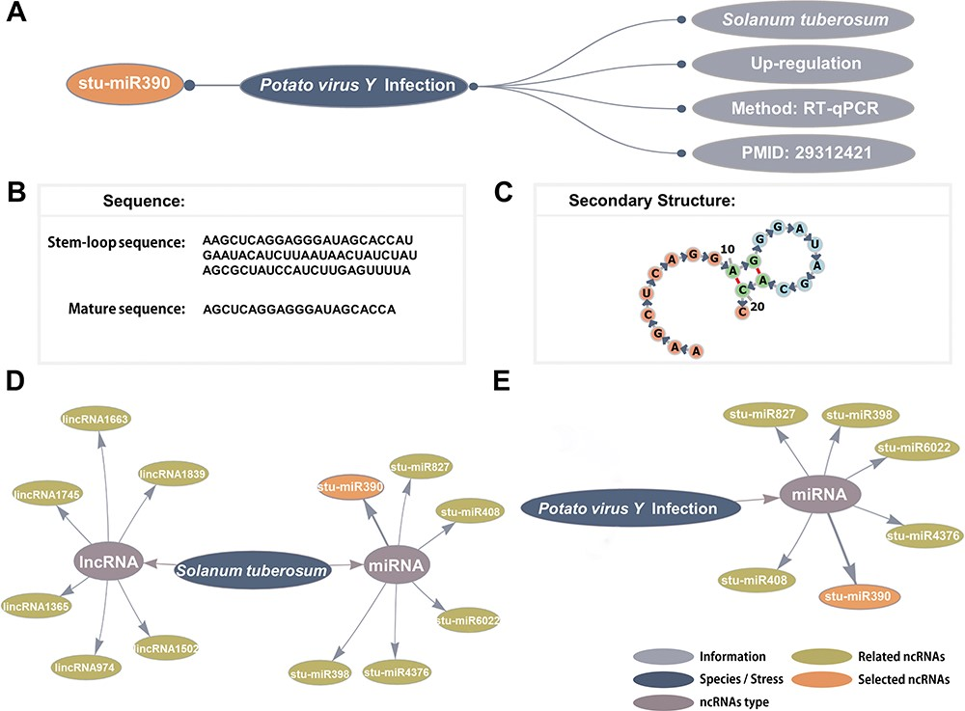
Figure 2 Detailed information and network visualization. (A) The basic information of stu-miR408. (B) The stem-loop ...
Notes:
Figure 2 Detailed information and network visualization. (A) The basic information of stu-miR408. (B) The stem-loop sequence and mature sequence of stu-miR390. (C) The secondary structure of stu-miR390. (D) The S. tuberosum–ncRNAs network. (E) The Potato virus Y infection–ncRNAs network.
Unless provided in the caption above, the following copyright applies to the content of this slide: © The Author(s) 2020. Published by Oxford University Press.This is an Open Access article distributed under the terms of the Creative Commons Attribution License (http://creativecommons.org/licenses/by/4.0/), which permits unrestricted reuse, distribution, and reproduction in any medium, provided the original work is properly cited.

Slide 3
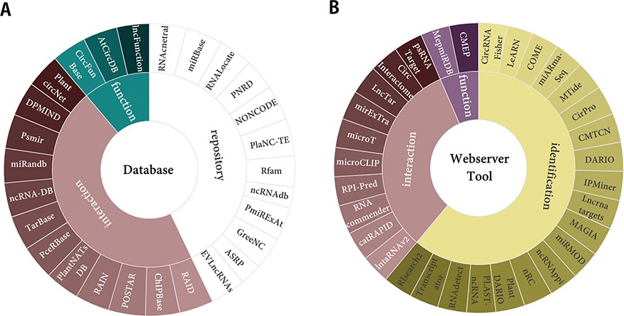
Figure 3 Plant ncRNAs research resources. (A) The 27 popular databases of ncRNAs. (B) The 31 useful webservers and ...
Notes:
Figure 3 Plant ncRNAs research resources. (A) The 27 popular databases of ncRNAs. (B) The 31 useful webservers and tools of ncRNAs.
Unless provided in the caption above, the following copyright applies to the content of this slide: © The Author(s) 2020. Published by Oxford University Press.This is an Open Access article distributed under the terms of the Creative Commons Attribution License (http://creativecommons.org/licenses/by/4.0/), which permits unrestricted reuse, distribution, and reproduction in any medium, provided the original work is properly cited.

