Slide 1
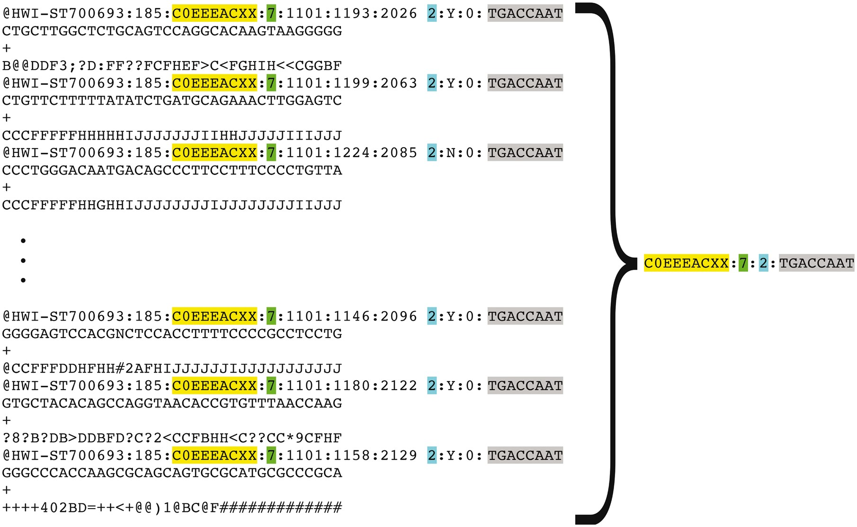
Figure 5. Representation of FASTQ file content by FASTQ signature. FASTQ signature is constructed using read name parts ...
Notes:
Figure 5. Representation of FASTQ file content by FASTQ signature. FASTQ signature is constructed using read name parts that are common for multiple reads within a single FASTQ file. Read name parts that are used for signature construction are color coded in the figure: flowcell identifier (yellow), flowcell lane number (green), read 1 or read 2 (turquoise) and index sequence (grey). Our condensation approach allows representation of multiple reads in FASTQ file by a single FASTQ signature, as it is exemplified in the figure.
Unless provided in the caption above, the following copyright applies to the content of this slide: © The Author(s) 2018. Published by Oxford University Press.This is an Open Access article distributed under the terms of the Creative Commons Attribution License (http://creativecommons.org/licenses/by/4.0/), which permits unrestricted reuse, distribution, and reproduction in any medium, provided the original work is properly cited.

