Slide 1
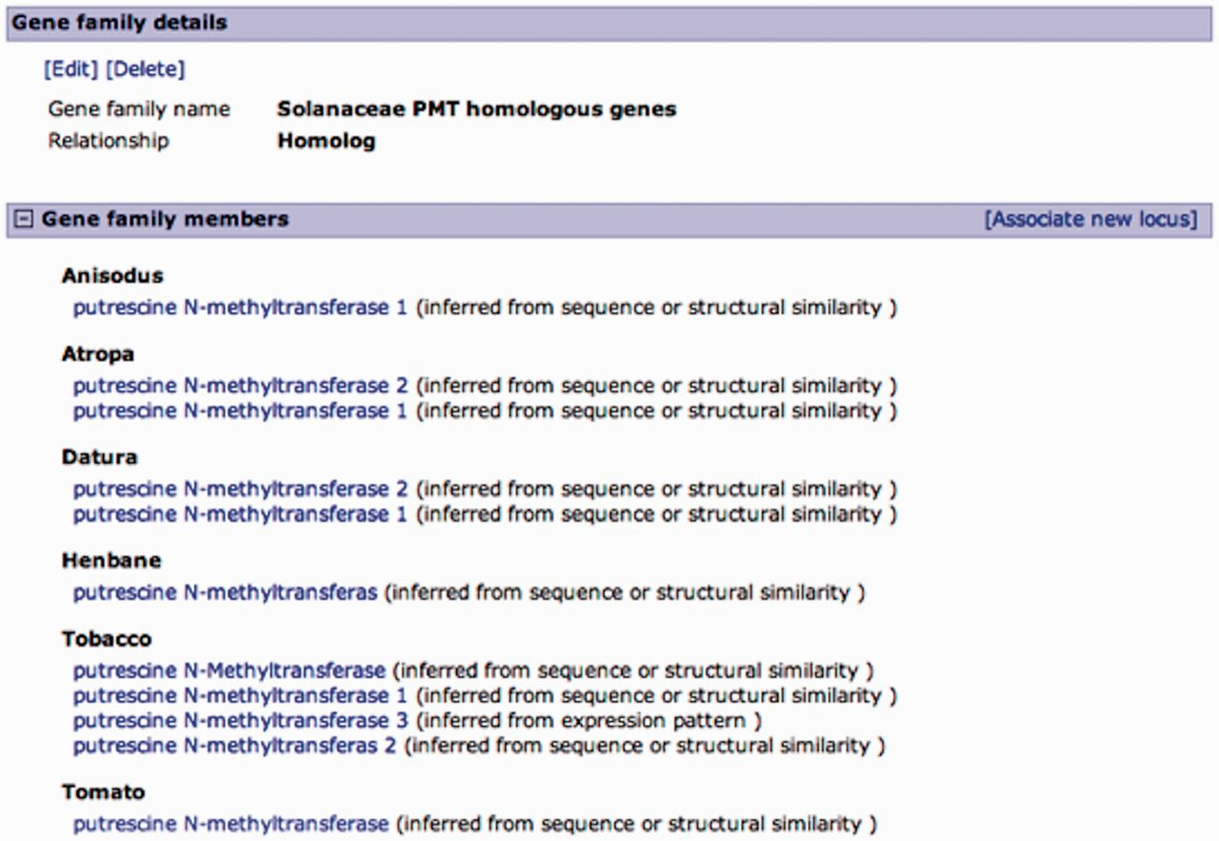
Figure 3. Curated gene family page. A family of putrescine N-methyltransferase (PMT) homologous genes from multiple ...
Notes:
Figure 3. Curated gene family page. A family of putrescine N-methyltransferase (PMT) homologous genes from multiple Solanaceae organisms. Gene family details are editable, and curators can add members to the family in a similar manner as associating loci from the locus page, except for the relationship type, which is predefined. Gene family members are listed by organism with an evidence code.
Unless provided in the caption above, the following copyright applies to the content of this slide: © The Author(s) 2013. Published by Oxford University Press.This is an Open Access article distributed under the terms of the Creative Commons Attribution Non-Commercial License (http://creativecommons.org/licenses/by-nc/3.0/), which permits unrestricted non-commercial use, distribution, and reproduction in any medium, provided the original work is properly cited.

