Slide 1
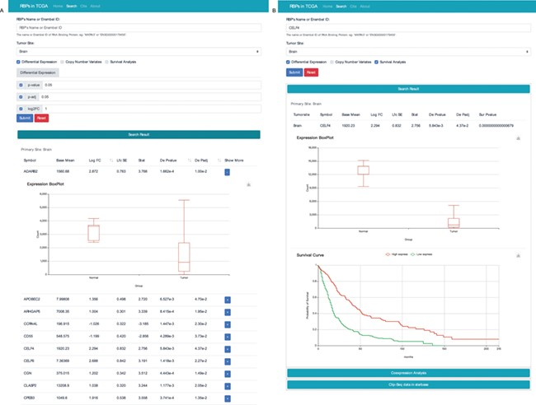
Figure 4 RBP result interface with two search modes. (A) Search the database according to tumour site, P value, p-adj ...
Notes:
Figure 4 RBP result interface with two search modes. (A) Search the database according to tumour site, P value, p-adj and/or log2FC. (B) Search the database according to the name of RBP and cancer type. To get more details, users can click the “+” button.
Unless provided in the caption above, the following copyright applies to the content of this slide: © The Author(s) 2020. Published by Oxford University Press.This is an Open Access article distributed under the terms of the Creative Commons Attribution License (http://creativecommons.org/licenses/by/4.0/), which permits unrestricted reuse, distribution, and reproduction in any medium, provided the original work is properly cited.

