Slide 1
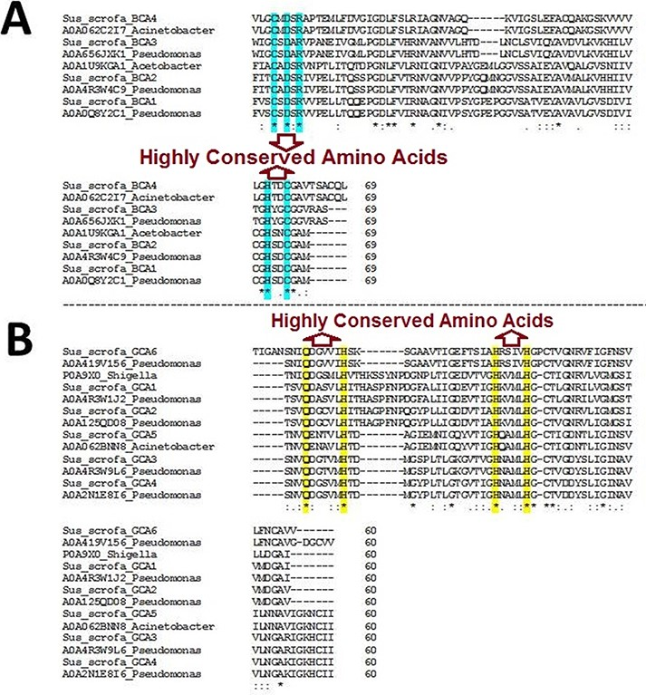
Figure 1. Multiple sequence alignment (MSA) of β- and γ-CA sequences. (A) MSA of β-CA sequences shows highly conserved ...
Notes:
Figure 1. Multiple sequence alignment (MSA) of β- and γ-CA sequences. (A) MSA of β-CA sequences shows highly conserved amino acids in cyan color; (B) MSA of γ-CA sequences shows highly conserved amino acids in yellow color.
Unless provided in the caption above, the following copyright applies to the content of this slide: © The Author(s) 2021. Published by Oxford University Press.This is an Open Access article distributed under the terms of the Creative Commons Attribution License (http://creativecommons.org/licenses/by/4.0/), which permits unrestricted reuse, distribution, and reproduction in any medium, provided the original work is properly cited.

Slide 2
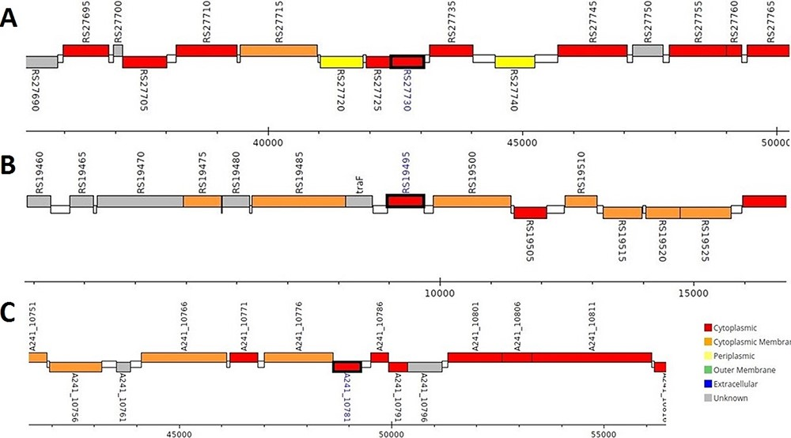
Figure 2. Genomic analysis of β-CA sequences from putative contaminants associated with Pseudomonas spp. The analysis ...
Notes:
Figure 2. Genomic analysis of β-CA sequences from putative contaminants associated with Pseudomonas spp. The analysis shows the presence of coding genes for β-CA from (A) Pseudomonas sp. (UniProt ID: A0A0Q8Y2C1), (B) Pseudomonas sp. LP_8_YM (UniProt ID: A0A4R3W4C9) and (C) Pseudomonas syringae pv. actinidiae ICMP 19096 (UniProt ID: A0A656JXK1).
Unless provided in the caption above, the following copyright applies to the content of this slide: © The Author(s) 2021. Published by Oxford University Press.This is an Open Access article distributed under the terms of the Creative Commons Attribution License (http://creativecommons.org/licenses/by/4.0/), which permits unrestricted reuse, distribution, and reproduction in any medium, provided the original work is properly cited.

Slide 3
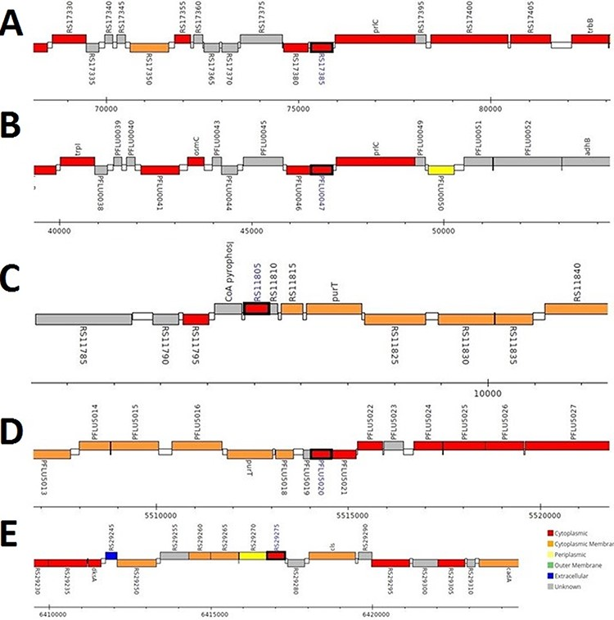
Figure 3. Genomic analysis of γ-CA sequences from putative contaminants associated with Pseudomonas spp. The analysis ...
Notes:
Figure 3. Genomic analysis of γ-CA sequences from putative contaminants associated with Pseudomonas spp. The analysis shows the presence of coding genes for γ-CA from (A) Pseudomonas sp. LP_8_YM (UniProt ID: A0A4R3W1J2), (B) Pseudomonas fluorescens (UniProt ID: A0A125QD08), (C) Pseudomonas sp. LP_8_YM (UniProt ID: A0A4R3W9L6), (D) Pseudomonas fluorescens (UniProt ID: A0A2N1E8I6) and (E) Pseudomonas synxantha (UniProt ID: A0A419V156).
Unless provided in the caption above, the following copyright applies to the content of this slide: © The Author(s) 2021. Published by Oxford University Press.This is an Open Access article distributed under the terms of the Creative Commons Attribution License (http://creativecommons.org/licenses/by/4.0/), which permits unrestricted reuse, distribution, and reproduction in any medium, provided the original work is properly cited.

Slide 4
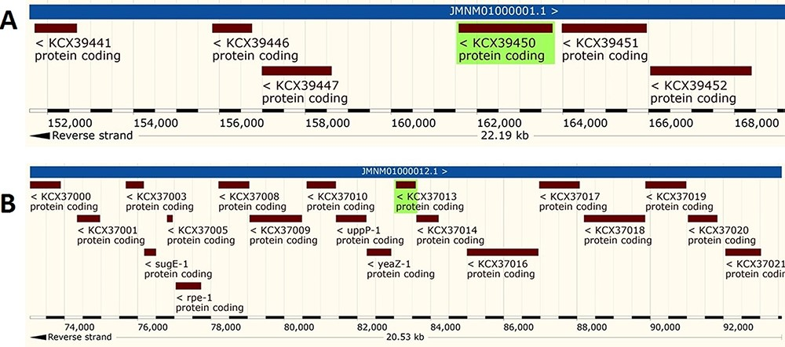
Figure 4. Genomic analysis of β- and γ-CA sequences from putative contaminants associated with Acinetobacter spp. The ...
Notes:
Figure 4. Genomic analysis of β- and γ-CA sequences from putative contaminants associated with Acinetobacter spp. The analysis shows the presence of coding genes for (A) β-CA from Acinetobacter sp. 263903-1 (UniProt ID: A0A062C2I7) and (B) γ-CA from Acinetobacter sp. 263903-1 (UniProt ID: A0A062BNN8).
Unless provided in the caption above, the following copyright applies to the content of this slide: © The Author(s) 2021. Published by Oxford University Press.This is an Open Access article distributed under the terms of the Creative Commons Attribution License (http://creativecommons.org/licenses/by/4.0/), which permits unrestricted reuse, distribution, and reproduction in any medium, provided the original work is properly cited.

Slide 5
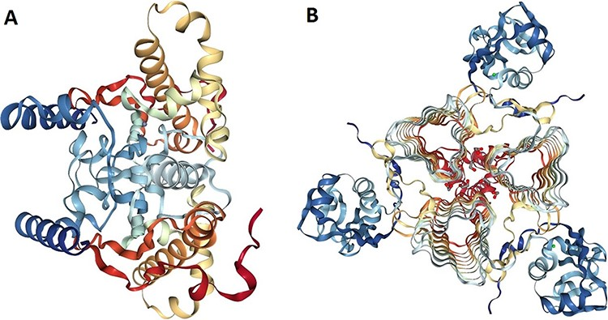
Figure 5. Protein structure analysis of β- and γ-CA protein sequences from bacterial contaminants. (A) Accession ID: ...
Notes:
Figure 5. Protein structure analysis of β- and γ-CA protein sequences from bacterial contaminants. (A) Accession ID: 5JJ8 crystal structure belongs to β-CA from P. aeruginosa, and (B) Accession ID: 3PMO crystal structure belongs to γ-CA from P. aeruginosa. A and B were obtained from the PDB database, which are the most similar crystalized structures to β- and γ-CAs from bacterial contaminants, respectively.
Unless provided in the caption above, the following copyright applies to the content of this slide: © The Author(s) 2021. Published by Oxford University Press.This is an Open Access article distributed under the terms of the Creative Commons Attribution License (http://creativecommons.org/licenses/by/4.0/), which permits unrestricted reuse, distribution, and reproduction in any medium, provided the original work is properly cited.

