Slide 1
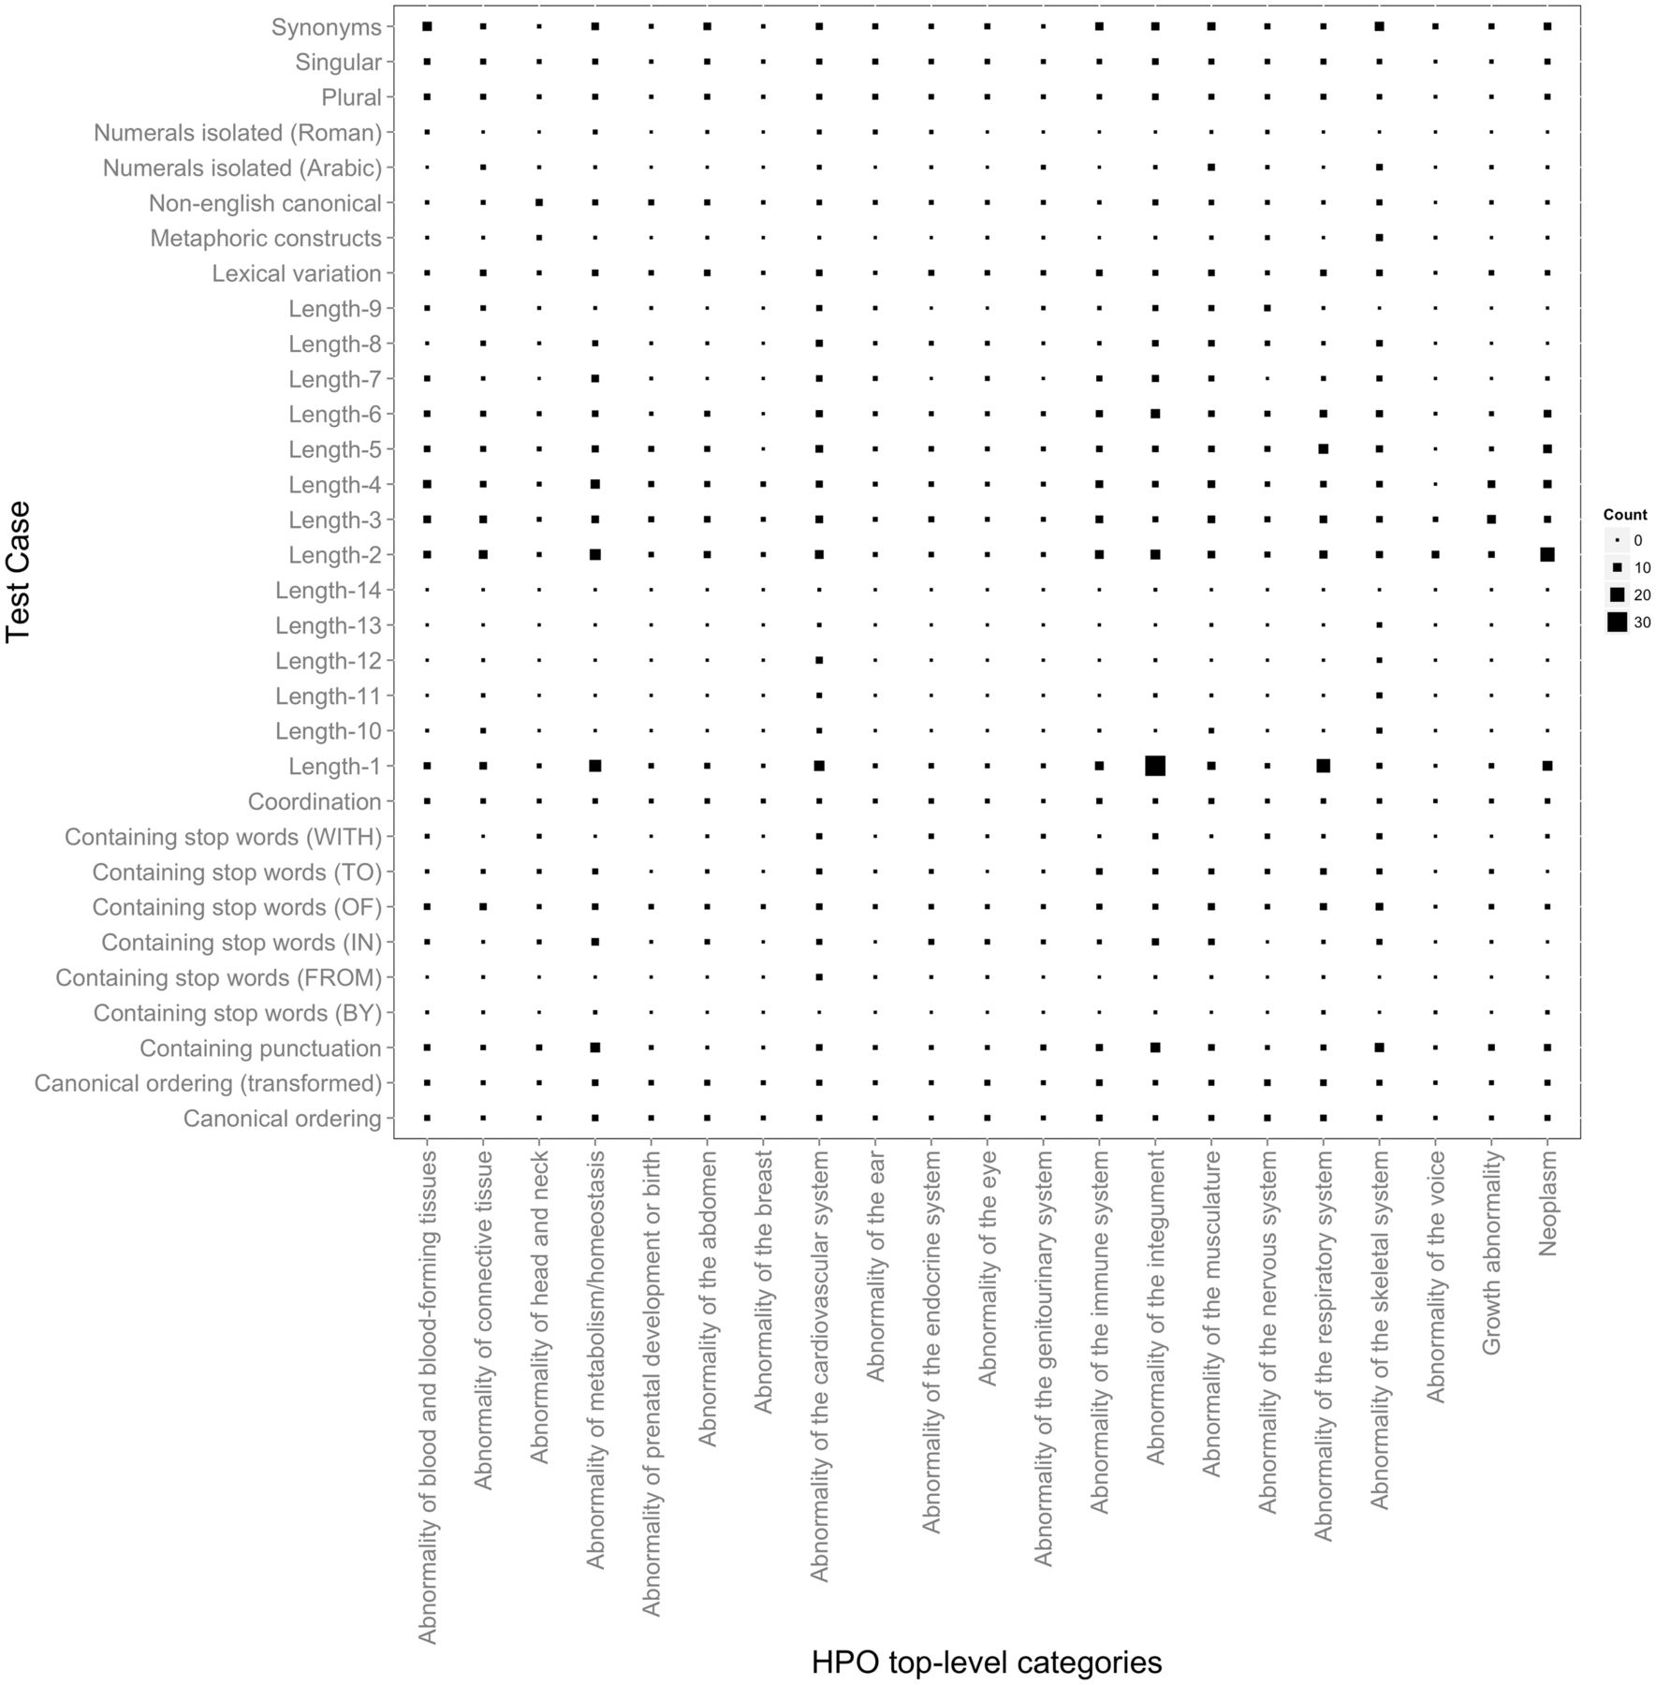
Figure 1. Distribution of HPO test cases according to their types mapped to the top-level HPO categories. The larger ...
Notes:
Figure 1. Distribution of HPO test cases according to their types mapped to the top-level HPO categories. The larger the symbol, the more test case entries the corresponding mapping has. For example, the largest number of test case entries of Length-1 is present in Abnormality of the integument. In addition to providing an overview on the test suite content, this figure also depicts a birds-eye view over the variation in terms of characteristics of the concept lexical representations in the different top-level HPO categories. We can observe, e.g. that only a very few top-level categories contain concept labels with a length greater than 10. Similarly, metaphoric constructs seem to be present only in skeletal abnormalities, which also dominate together with the abnormalities of the integument and of the metabolism the range of labels containing punctuation.
Unless provided in the caption above, the following copyright applies to the content of this slide: © The Author(s) 2015. Published by Oxford University Press.This is an Open Access article distributed under the terms of the Creative Commons Attribution License (http://creativecommons.org/licenses/by/4.0/), which permits unrestricted reuse, distribution, and reproduction in any medium, provided the original work is properly cited.

Slide 2
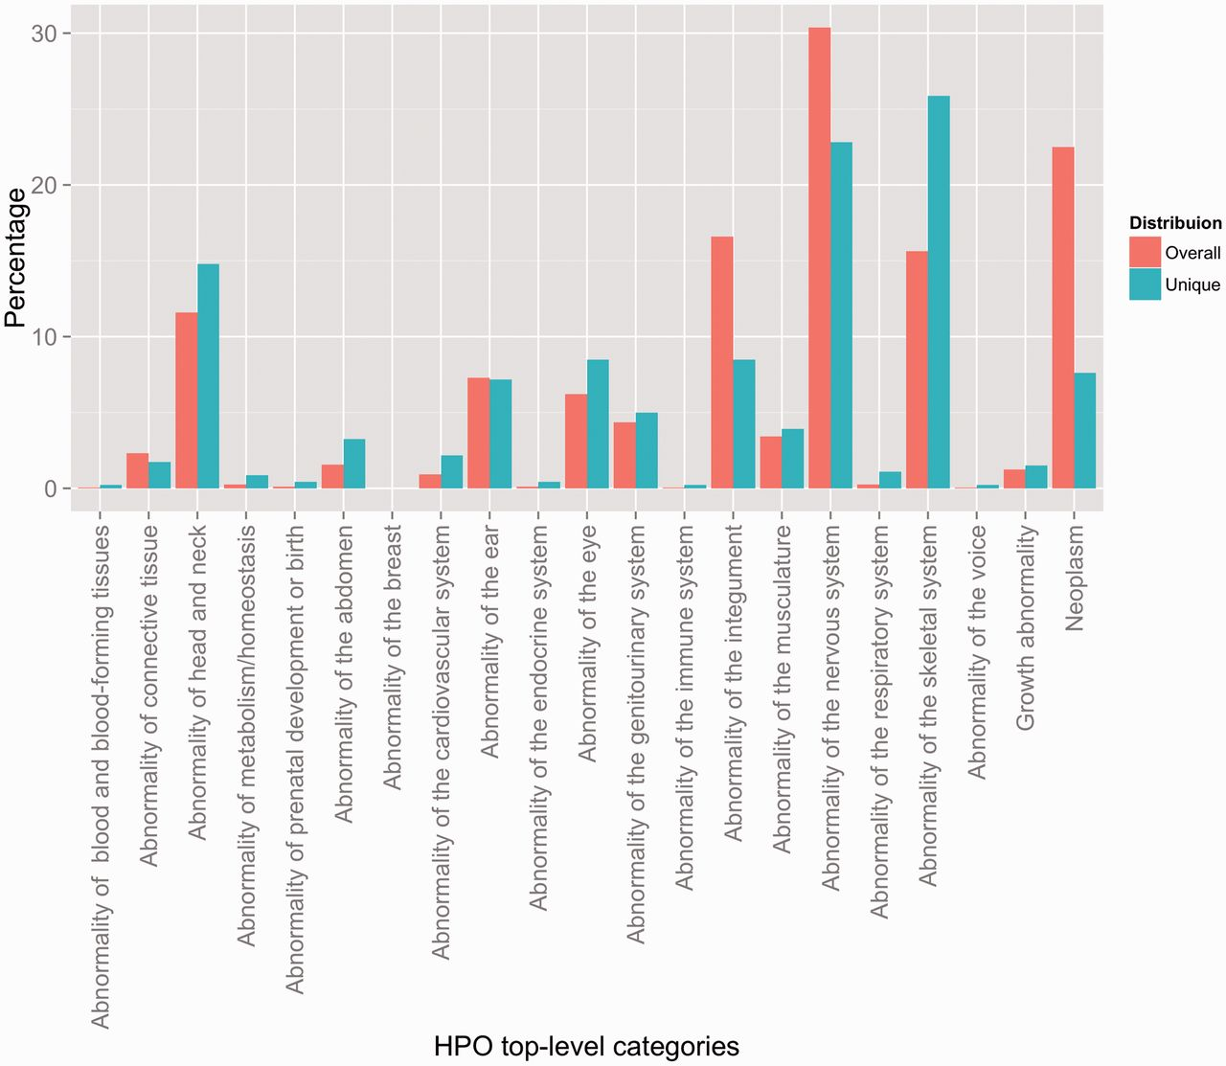
Figure 2. Distribution of HPO annotations according to the top-level HPO categories. Two distributions are shown: an ...
Notes:
Figure 2. Distribution of HPO annotations according to the top-level HPO categories. Two distributions are shown: an overall distribution that accounts for duplicate concept annotations (i.e. every instance of an annotation is counted), and a unique distribution that shows the counts of the unique concept annotations (i.e. every concept is counted a single time, indifferently of how many annotations exist in the corpus).
Unless provided in the caption above, the following copyright applies to the content of this slide: © The Author(s) 2015. Published by Oxford University Press.This is an Open Access article distributed under the terms of the Creative Commons Attribution License (http://creativecommons.org/licenses/by/4.0/), which permits unrestricted reuse, distribution, and reproduction in any medium, provided the original work is properly cited.

Slide 3
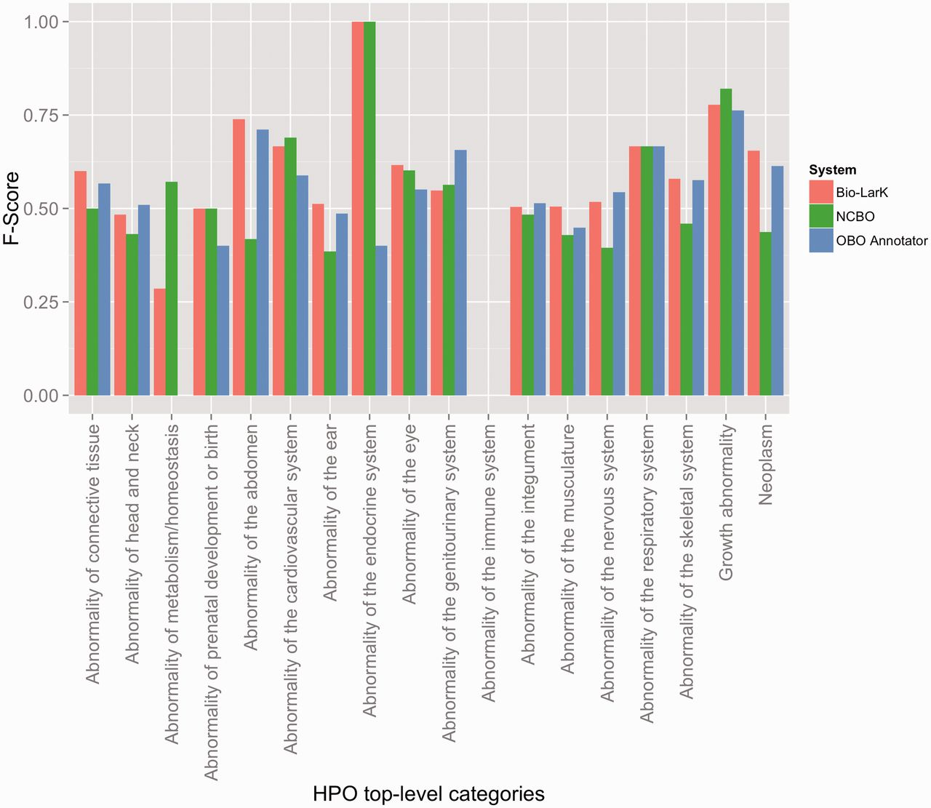
Figure 3. F-Score results achieved by the three systems on the HPO gold standard, distributed according to the HPO ...
Notes:
Figure 3. F-Score results achieved by the three systems on the HPO gold standard, distributed according to the HPO top-level category.
Unless provided in the caption above, the following copyright applies to the content of this slide: © The Author(s) 2015. Published by Oxford University Press.This is an Open Access article distributed under the terms of the Creative Commons Attribution License (http://creativecommons.org/licenses/by/4.0/), which permits unrestricted reuse, distribution, and reproduction in any medium, provided the original work is properly cited.

Slide 4
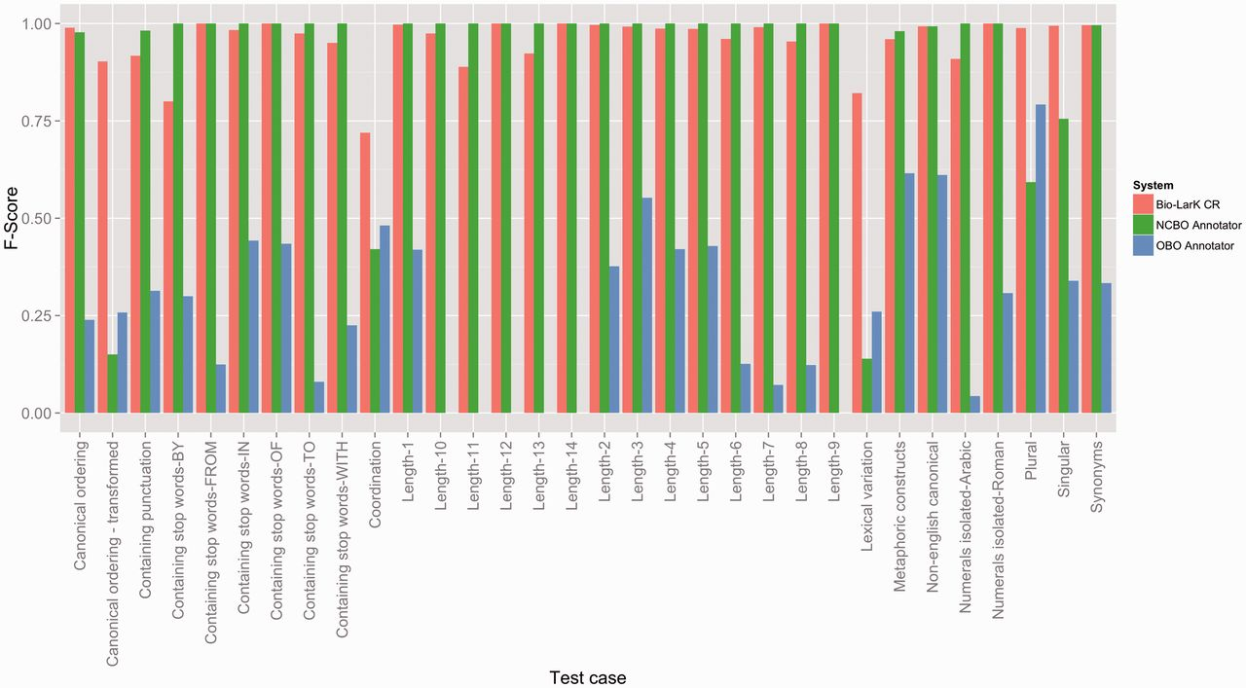
Figure 4. F-Score results achieved by the three systems on the HPO test suites, distributed according to the type of ...
Notes:
Figure 4. F-Score results achieved by the three systems on the HPO test suites, distributed according to the type of the test case.
Unless provided in the caption above, the following copyright applies to the content of this slide: © The Author(s) 2015. Published by Oxford University Press.This is an Open Access article distributed under the terms of the Creative Commons Attribution License (http://creativecommons.org/licenses/by/4.0/), which permits unrestricted reuse, distribution, and reproduction in any medium, provided the original work is properly cited.

