Slide 1
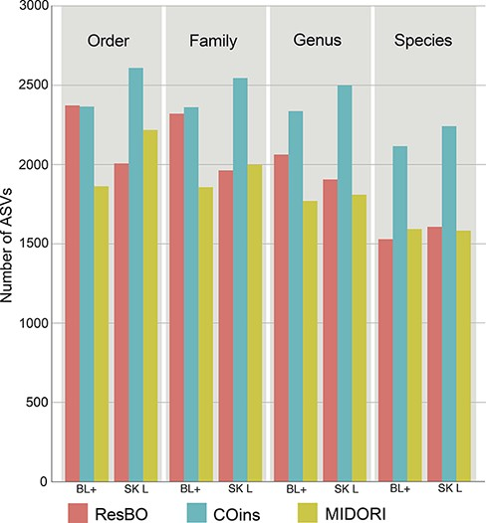
Figure 3. Number of ASVs assigned to the different taxonomic levels (from order to species) when using ResBO, COins and ...
Notes:
Figure 3. Number of ASVs assigned to the different taxonomic levels (from order to species) when using ResBO, COins and MIDORI as reference. Numbers of assignments obtained using the BLAST+ (BL+) and fit-classifier sklearn (SK L) algorithms are specified too.
Unless provided in the caption above, the following copyright applies to the content of this slide: © The Author(s) 2022. Published by Oxford University Press.This is an Open Access article distributed under the terms of the Creative Commons Attribution-NonCommercial License (https://creativecommons.org/licenses/by-nc/4.0/), which permits non-commercial re-use, distribution, and reproduction in any medium, provided the original work is properly cited. For commercial re-use, please contact journals.permissions@oup.com

