Slide 1
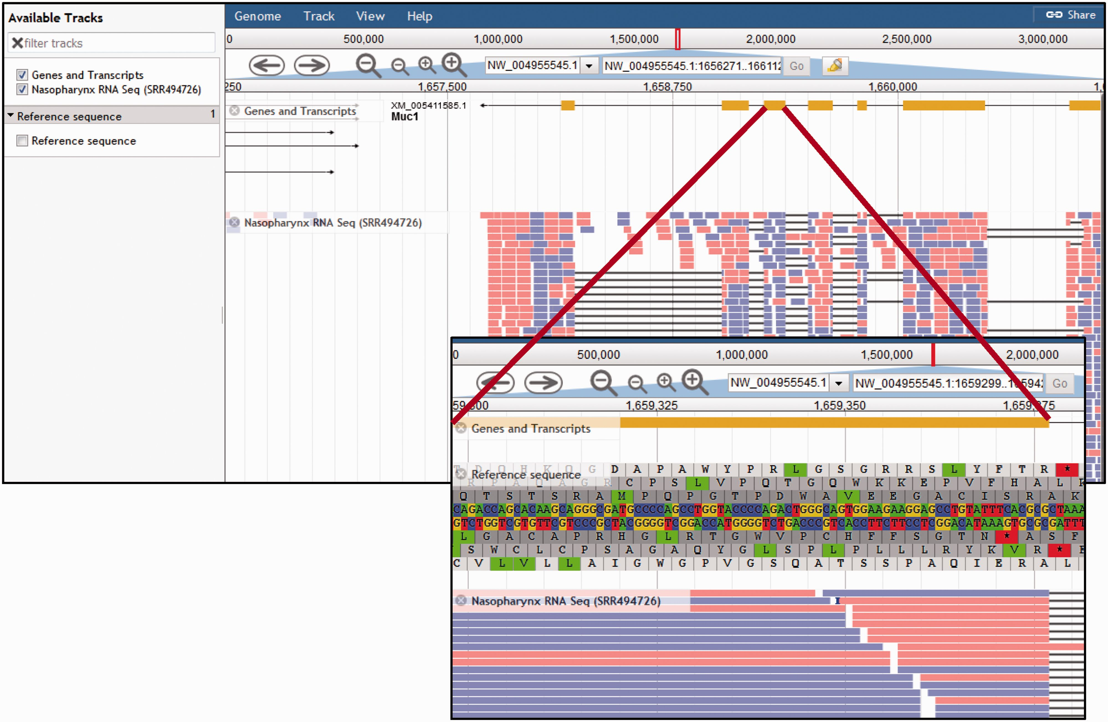
Figure 5. Chinchilla Genome Browser. The ‘Available tracks’ in the CRRD JBrowse genome browser include ‘Genes and ...
Notes:
Figure 5. Chinchilla Genome Browser. The ‘Available tracks’ in the CRRD JBrowse genome browser include ‘Genes and Transcripts’, an RNA-Seq BAM alignment for nasopharynx, and the genomic reference sequence. Users can search for a scaffold position or for a gene symbol to navigate to that region of the genome. Navigation buttons allow the user to scroll through the region and zoom in or out to refine their view. The genes and transcripts track shows the intron/exon structure of the gene and, where applicable, any predicted splice variants. The RNA-Seq track displays the BAM alignments for short read RNA sequences from chinchilla nasopharynx. When zoomed in sufficiently, the ‘Reference Sequence’ track shows the reference DNA sequence and the corresponding predicted amino acid sequences in all six reading frames (insert).
Unless provided in the caption above, the following copyright applies to the content of this slide: © The Author(s) 2016. Published by Oxford University Press. This is an Open Access article distributed under the terms of the Creative Commons Attribution License ( http://creativecommons.org/licenses/by/4.0/ ), which permits unrestricted reuse, distribution, and reproduction in any medium, provided the original work is properly cited.

