Slide 1
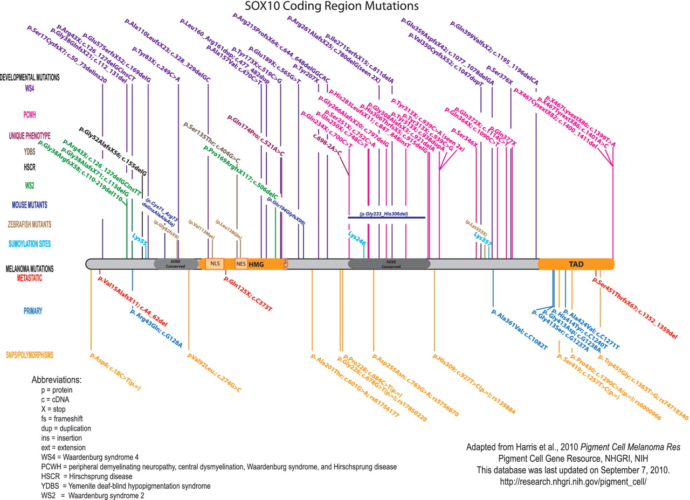
Figure 3. Published SOX10 coding region mutations and polymorphisms. For clarity, the mutations are color-coded based ...
Notes:
Figure 3. Published SOX10 coding region mutations and polymorphisms. For clarity, the mutations are color-coded based upon clinical phenotype/disorder. Human SOX10 developmental mutations are shown above the protein, and melanoma mutations and polymorphisms are shown below the protein. The orthologous changes to published mouse and zebrafish coding mutations are also shown. SOX10 nucleotide/amino acid numbering correlates with NP_008872. Mutation nomenclature is per Human Genome Variation Society guidelines (http://www.hgvs.org/mutnomen/).
Unless provided in the caption above, the following copyright applies to the content of this slide: Published by Oxford University Press 2010.This is Open Access article distributed under the terms of the Creative Commons Attribution Non-Commercial License (http://creativecommons.org/licenses/by-nc/2.5), which permits unrestricted non-commercial use, distribution, and reproduction in any medium, provided the original work is properly cited.

