Slide 1
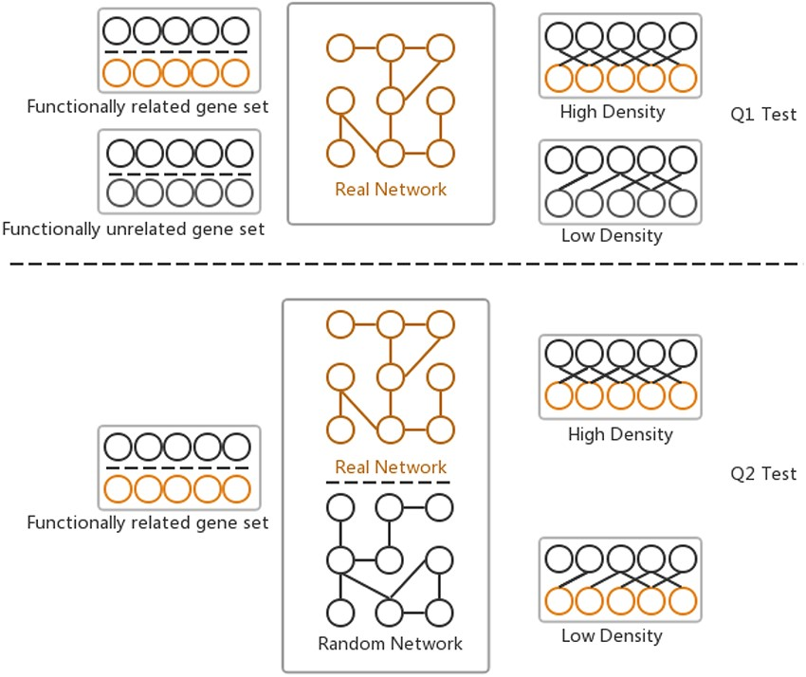
Figure 2. Two hypotheses of GSLA used to ensure that the identified significant functional associations between two ...
Notes:
Figure 2. Two hypotheses of GSLA used to ensure that the identified significant functional associations between two gene sets are biologically meaningful. Q1 tests whether the density of functional associations between two biologically meaningful gene sets is higher than that of random gene pairs. Q2 tests whether the strong functional associations observed between two gene sets can be observed only from the biologically correct network rather than from any random interactomes.
Unless provided in the caption above, the following copyright applies to the content of this slide: © The Author(s) 2021. Published by Oxford University Press.This is an Open Access article distributed under the terms of the Creative Commons Attribution License (http://creativecommons.org/licenses/by/4.0/), which permits unrestricted reuse, distribution, and reproduction in any medium, provided the original work is properly cited.

