Slide 1
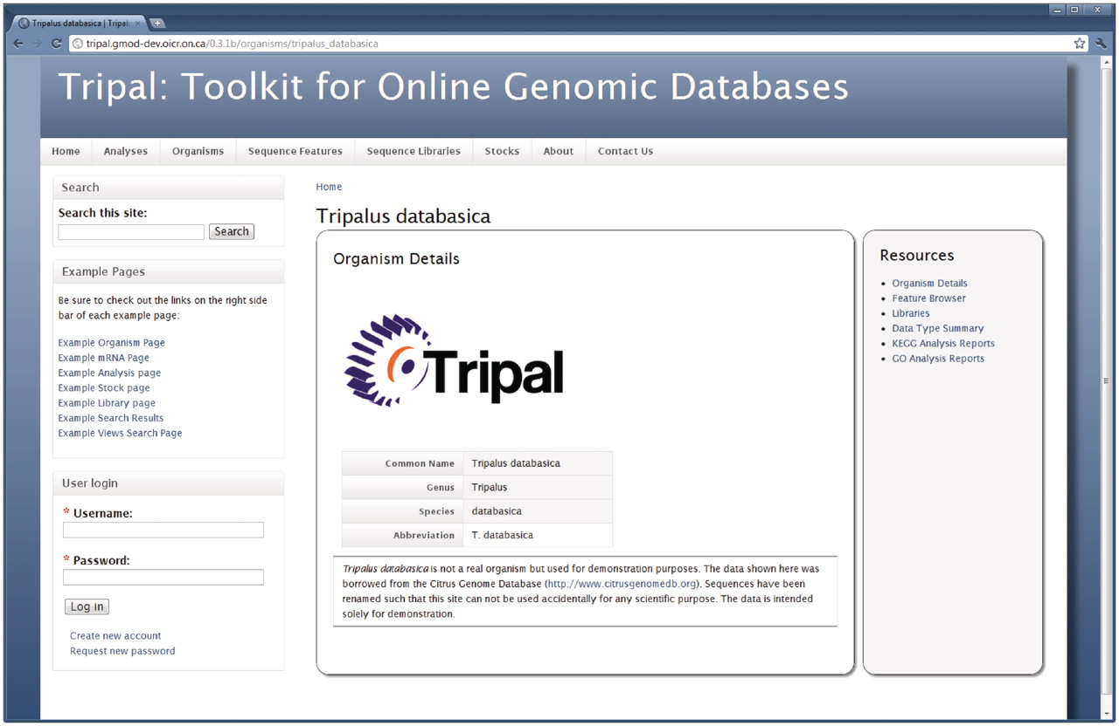
Figure 1. The Organism page. Details about an organism are presented first when visiting the Organism page. The right ...
Notes:
Figure 1. The Organism page. Details about an organism are presented first when visiting the Organism page. The right hand sidebar titled ‘Resources’ provides additional links for data related to this Organism. Through these links, visitors can use the feature browser to sort through a list of available genomic features (sequences) for this organism, view a list of feature libraries for this organism, and view reports of summarized data for the organism, including GO and KEGG reports. A search box in the top left-hand side is available for full-text searching of the site, and a login box is available for administrative and community logins. By customizing the Tripal template files, site administrators can add any number of links to the resources sidebar.
Unless provided in the caption above, the following copyright applies to the content of this slide: © The Author(s) 2011. Published by Oxford University Press.This is an Open Access article distributed under the terms of the Creative Commons Attribution Non-Commercial License (http://creativecommons.org/licenses/by-nc/3.0), which permits unrestricted non-commercial use, distribution, and reproduction in any medium, provided the original work is properly cited.

