Slide 1
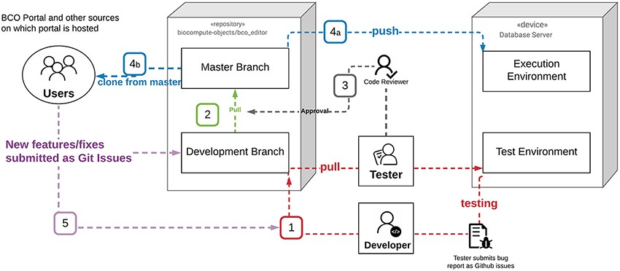
Figure 2. BCO portal deployment diagram.
Notes:
Figure 2. BCO portal deployment diagram. (1) Testing: the developer worked in the Development environment, and once a new version was ready for testing it was pushed from the development branch in GitHub to the Test Environment. In the event testing of the new code generated a bug report, a GitHub issue was created for each bug. The developer then addressed the GitHub issues in the development environment and closed issues with commits to the development branch, which was then tested again. This cycle repeated until no issues remained. (2) Pull Request: once the test code was free of bugs the developer assigned a version, rebased and made a pull request from the development branch to the master branch (the master was set as a protected branch). (3) Approval: all pull requests required the review and approval of two administrators, who checked the commit history, bug fixes, etc. Once a pull request was approved, the new version was assigned the appropriate number and listed as a new release. (4) a. The new stable release was pushed to the Execution Environment (biocomputeobject.org) and b. became available for others to clone into their own environments. (5) New features and potential fixes were submitted to GitHub as issues. These issues were triaged and if warranted, incorporated into the next round of development.
Unless provided in the caption above, the following copyright applies to the content of this slide: © Oxford University Press 2021.This is an Open Access article distributed under the terms of the Creative Commons Attribution License (http://creativecommons.org/licenses/by/4.0/), which permits unrestricted reuse, distribution, and reproduction in any medium, provided the original work is properly cited.

