Slide 1
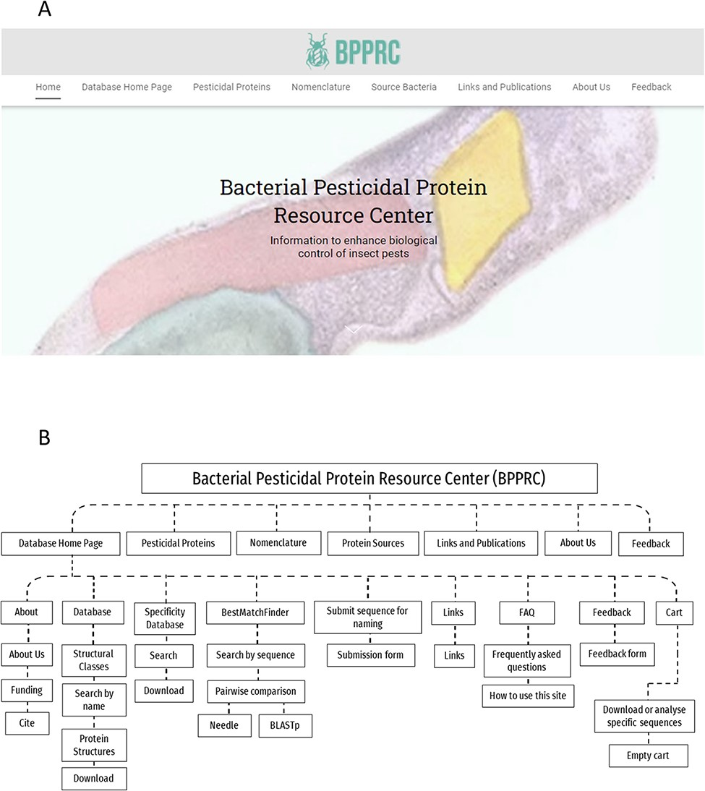
Figure 1. BPPRC website. A. BPPRC home page. B. Schematic of structure and utility of the website.
Notes:
Figure 1. BPPRC website. A. BPPRC home page. B. Schematic of structure and utility of the website.
Unless provided in the caption above, the following copyright applies to the content of this slide: © The Author(s) 2022. Published by Oxford University Press.This is an Open Access article distributed under the terms of the Creative Commons Attribution License (https://creativecommons.org/licenses/by/4.0/), which permits unrestricted reuse, distribution, and reproduction in any medium, provided the original work is properly cited.

Slide 2
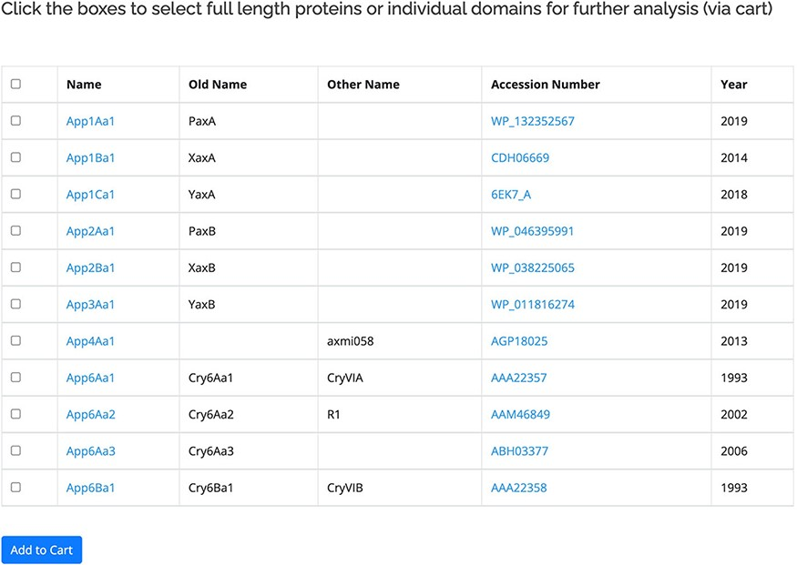
Figure 2. Primary user interface accessed via the Search by name option showing list of pesticidal proteins (App ...
Notes:
Figure 2. Primary user interface accessed via the Search by name option showing list of pesticidal proteins (App proteins in this example), along with old nomenclature and Accession numbers.
Unless provided in the caption above, the following copyright applies to the content of this slide: © The Author(s) 2022. Published by Oxford University Press.This is an Open Access article distributed under the terms of the Creative Commons Attribution License (https://creativecommons.org/licenses/by/4.0/), which permits unrestricted reuse, distribution, and reproduction in any medium, provided the original work is properly cited.

Slide 3
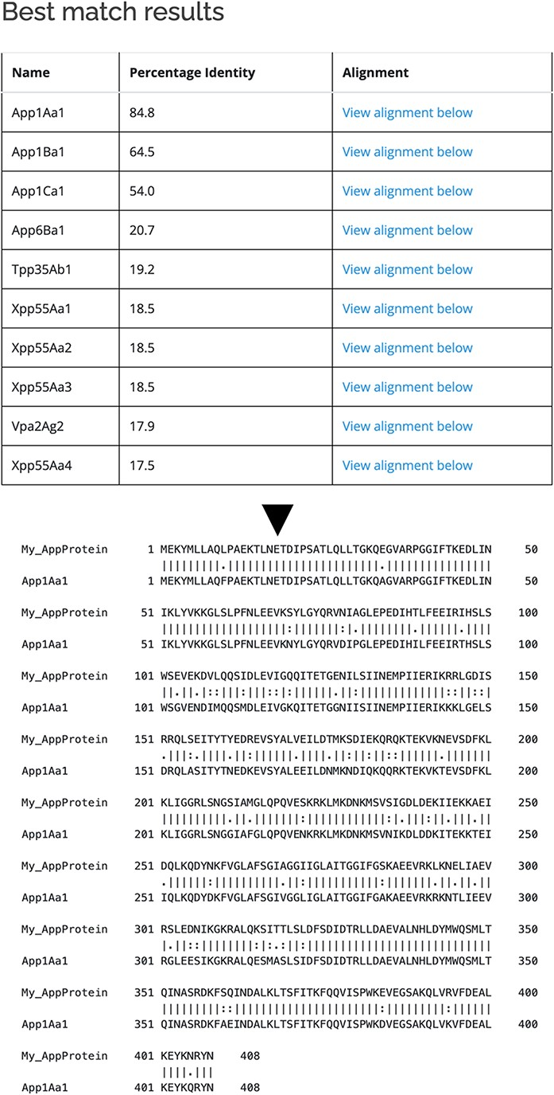
Figure 3. Use of BestMatchFinder tool with the Search by sequence option.
Notes:
Figure 3. Use of BestMatchFinder tool with the Search by sequence option.
Unless provided in the caption above, the following copyright applies to the content of this slide: © The Author(s) 2022. Published by Oxford University Press.This is an Open Access article distributed under the terms of the Creative Commons Attribution License (https://creativecommons.org/licenses/by/4.0/), which permits unrestricted reuse, distribution, and reproduction in any medium, provided the original work is properly cited.

Slide 4
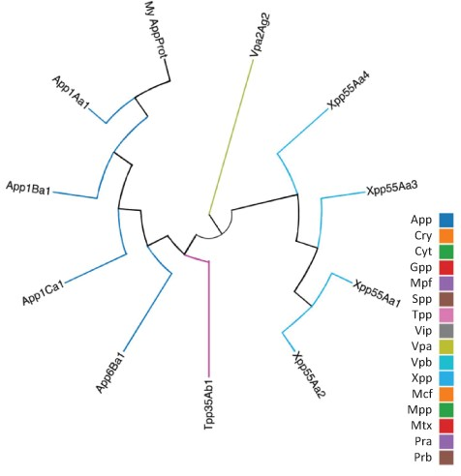
Figure 4. Guide tree showing relationships between a custom protein (My App protein) and proteins selected from the ...
Notes:
Figure 4. Guide tree showing relationships between a custom protein (My App protein) and proteins selected from the BPPRC database by the user.
Unless provided in the caption above, the following copyright applies to the content of this slide: © The Author(s) 2022. Published by Oxford University Press.This is an Open Access article distributed under the terms of the Creative Commons Attribution License (https://creativecommons.org/licenses/by/4.0/), which permits unrestricted reuse, distribution, and reproduction in any medium, provided the original work is properly cited.

