Slide 1
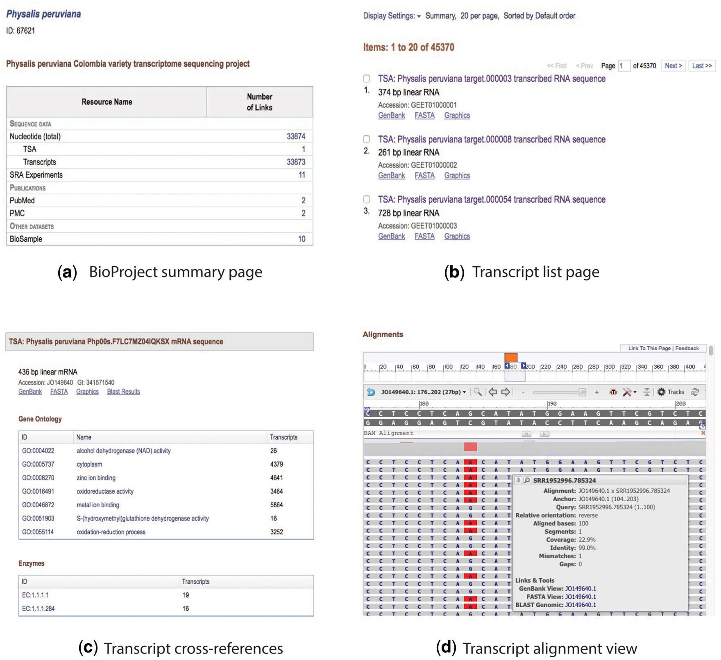
Figure 2. Collage of the content view for the BioProject and transcript pages. (a) BioProject summary page, (b) ...
Notes:
Figure 2. Collage of the content view for the BioProject and transcript pages. (a) BioProject summary page, (b) transcript list page, (c) description and cross-referenced blocks, and (d) alignment view.
Unless provided in the caption above, the following copyright applies to the content of this slide: Published by Oxford University Press 2017. This work is written by US Government employees and is in the public domain in the US.

