Slide 1
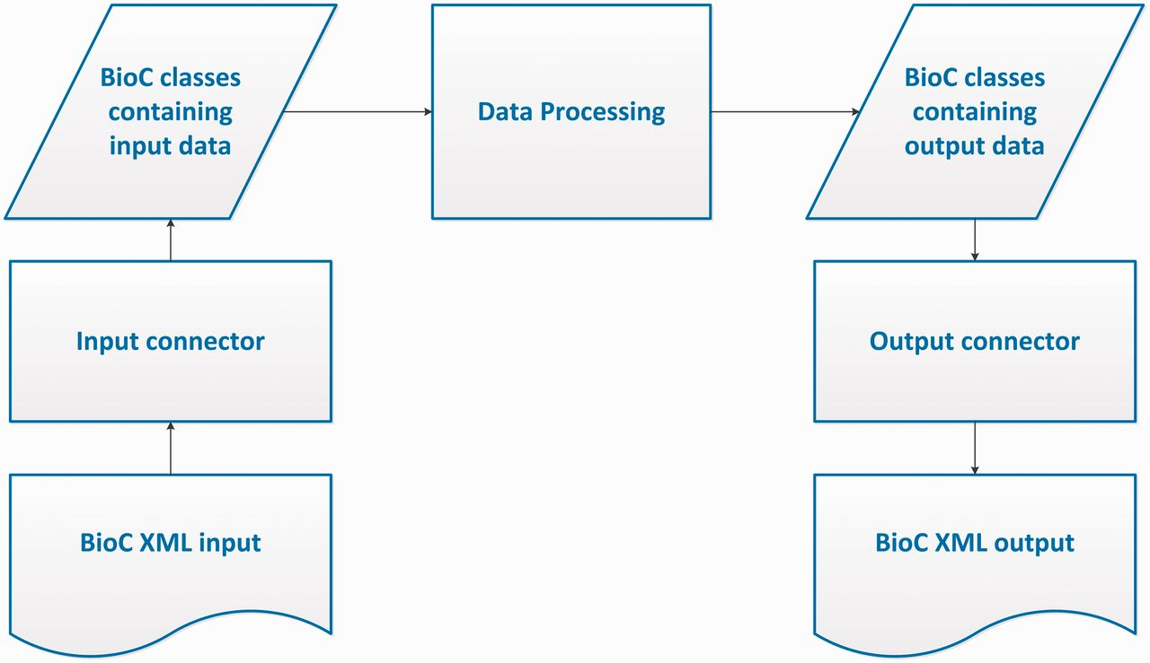
Figure 1. BioC process sequence.
Notes:
Figure 1. BioC process sequence.
Unless provided in the caption above, the following copyright applies to the content of this slide: Published by Oxford University Press 2013. This work is written by US Government employees and is in the public domain in the US.

Slide 2
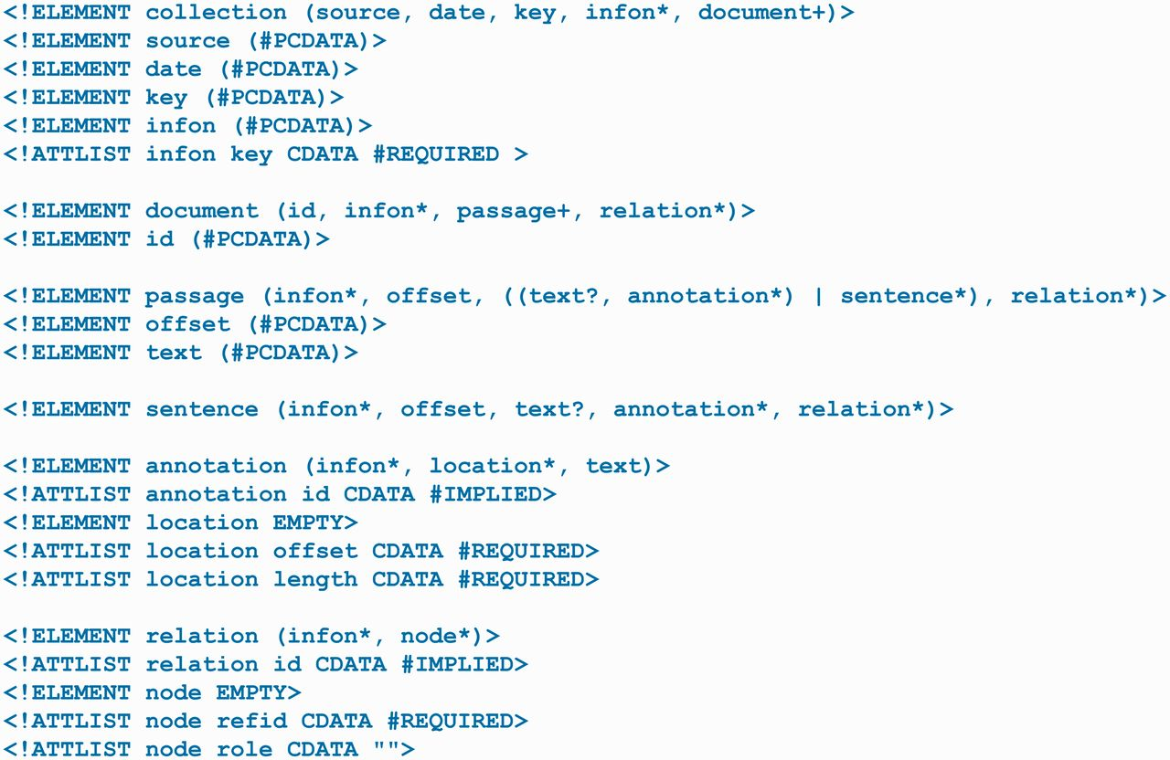
Figure 2. BioC.dtd.
Notes:
Figure 2. BioC.dtd.
Unless provided in the caption above, the following copyright applies to the content of this slide: Published by Oxford University Press 2013. This work is written by US Government employees and is in the public domain in the US.

Slide 3
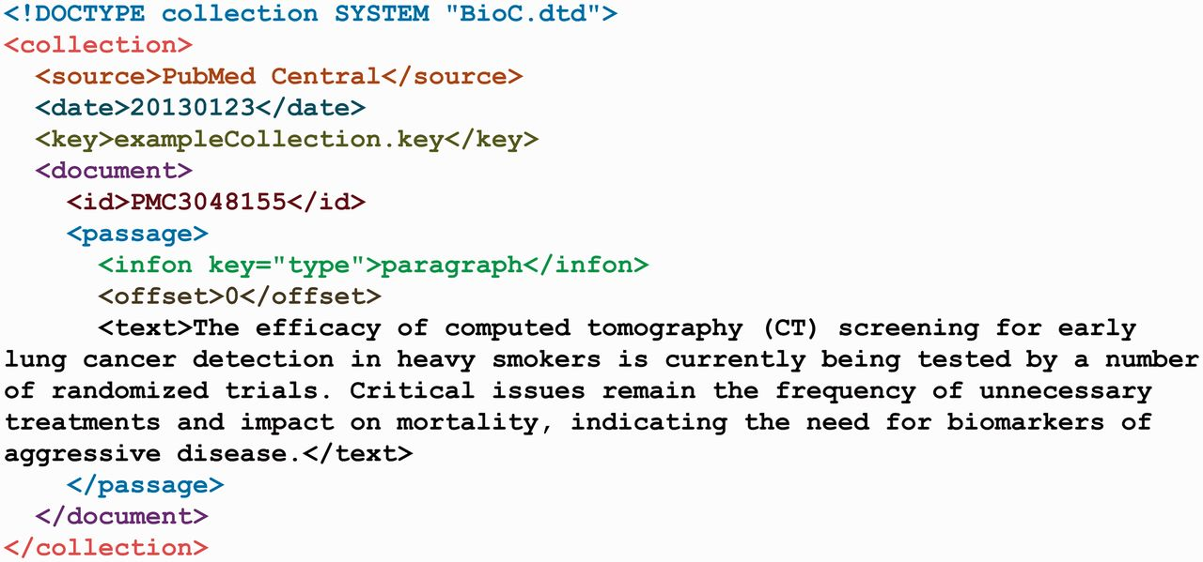
Figure 3. The exampleCollection.xml.
Notes:
Figure 3. The exampleCollection.xml.
Unless provided in the caption above, the following copyright applies to the content of this slide: Published by Oxford University Press 2013. This work is written by US Government employees and is in the public domain in the US.

Slide 4
Figure 4. The exampleCollection.key file describing the elements of the exampleCollection.xml file.
Notes:
Figure 4. The exampleCollection.key file describing the elements of the exampleCollection.xml file.
Unless provided in the caption above, the following copyright applies to the content of this slide: Published by Oxford University Press 2013. This work is written by US Government employees and is in the public domain in the US.

Slide 5
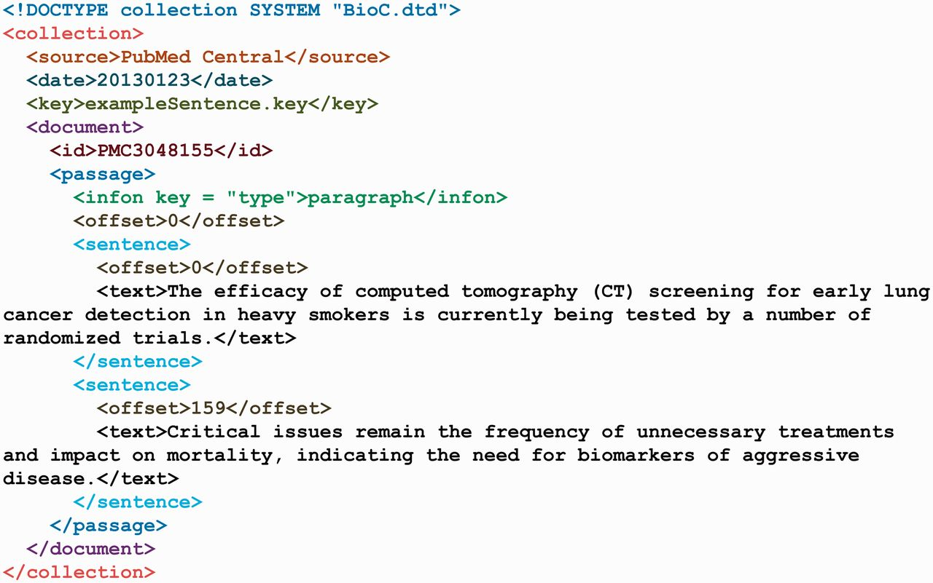
Figure 5. The exampleSentence.xml.
Notes:
Figure 5. The exampleSentence.xml.
Unless provided in the caption above, the following copyright applies to the content of this slide: Published by Oxford University Press 2013. This work is written by US Government employees and is in the public domain in the US.

Slide 6
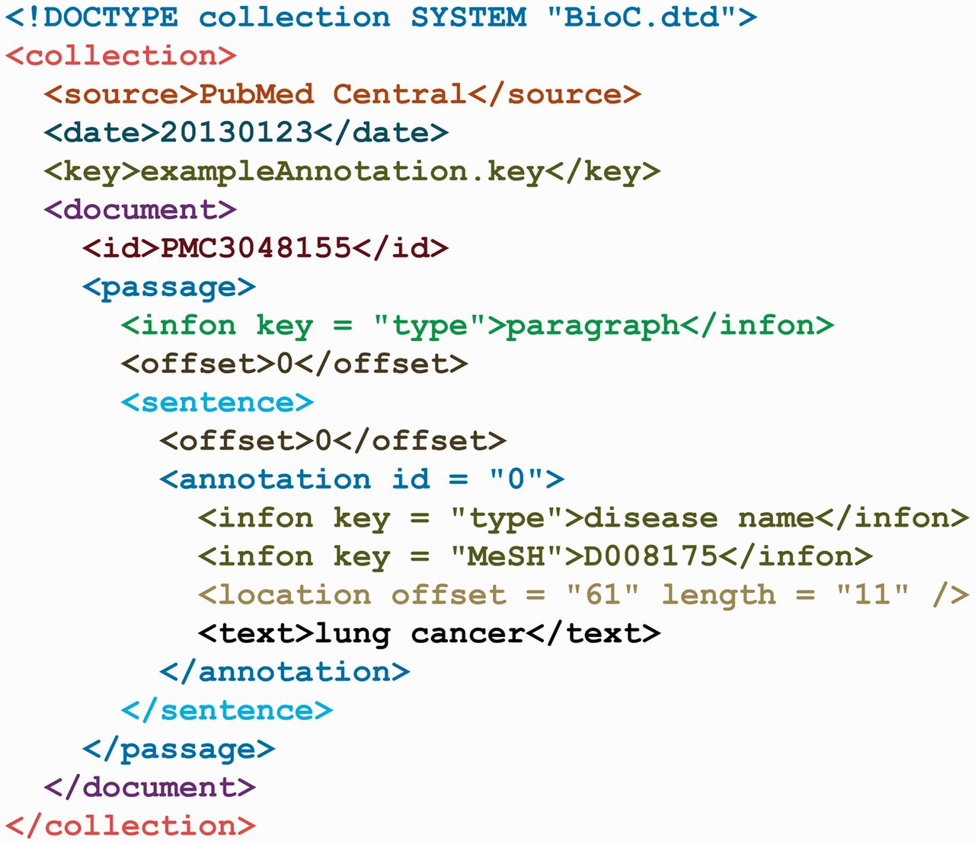
Figure 6. The exampleAnnotation.xml.
Notes:
Figure 6. The exampleAnnotation.xml.
Unless provided in the caption above, the following copyright applies to the content of this slide: Published by Oxford University Press 2013. This work is written by US Government employees and is in the public domain in the US.

