Slide 1
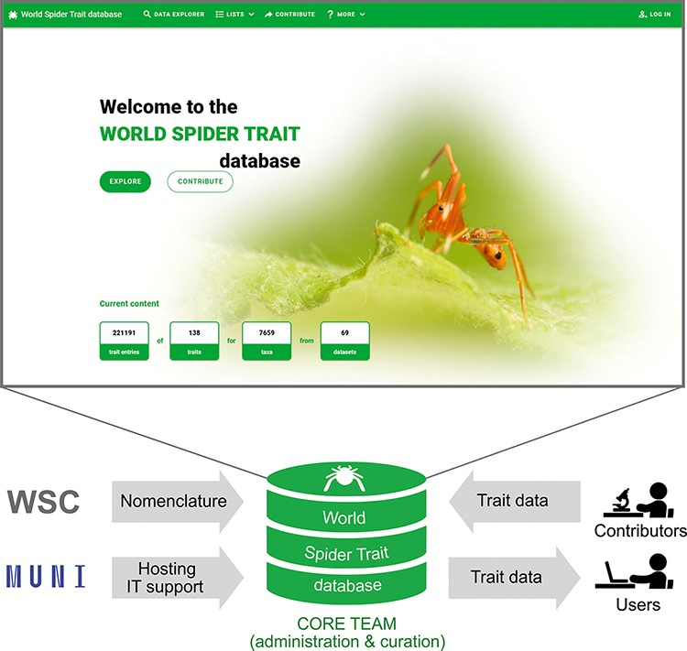
Figure 2. The scheme of the World Spider Trait database application, depicting the role of contributing bodies and the ...
Notes:
Figure 2. The scheme of the World Spider Trait database application, depicting the role of contributing bodies and the frontpage of the webpage (https://spidertraits.sci.muni.cz/, accessed on 5 March 2021). WSC stands for World Spider Catalog, MUNI stands for Masaryk University.
Unless provided in the caption above, the following copyright applies to the content of this slide: © The Author(s) 2021. Published by Oxford University Press.This is an Open Access article distributed under the terms of the Creative Commons Attribution License (https://creativecommons.org/licenses/by/4.0/), which permits unrestricted reuse, distribution, and reproduction in any medium, provided the original work is properly cited.

