Slide 1
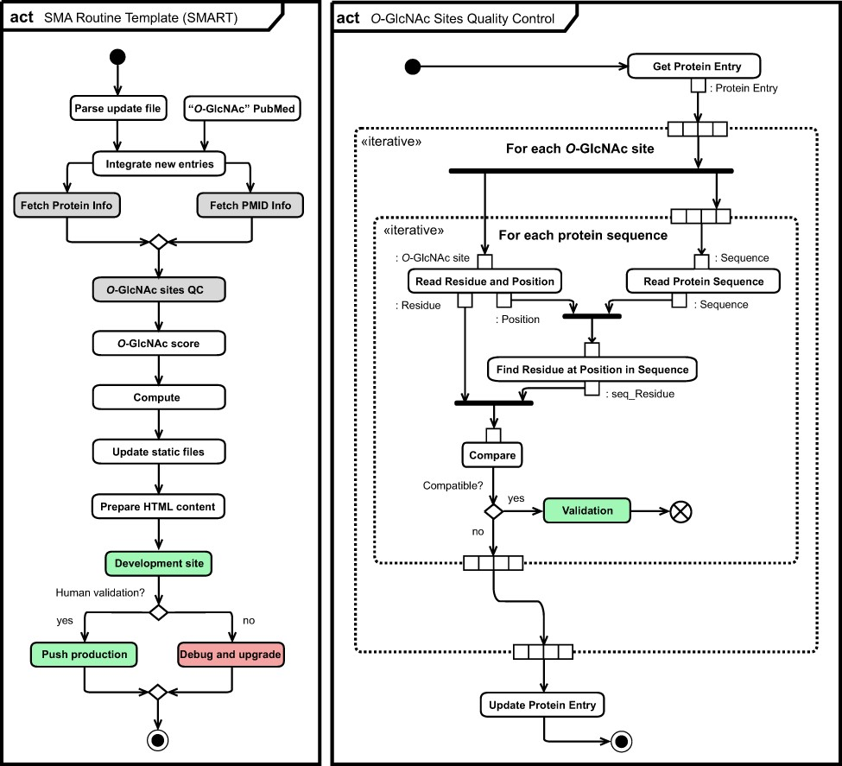
Figure 6. Unified Modeling Language (UML) (11) activity diagram (act) of the O-GlcNAc automatization and ...
Notes:
Figure 6. Unified Modeling Language (UML) (11) activity diagram (act) of the O-GlcNAc automatization and self-maintenance library. Initial state (black circle), actions (rounded rectangle), list objects (rectangle), fork and join (bold bars), decision and merge (diamond), break (crossed circle) as well as final state (black circle) are highlighted per UML conventions. Normal (green) and error (red) completion actions are also highlighted, together with actions for which specific activity diagrams for O-GlcNAc sites quality control (right panel) and for collection of information related to protein and literature are given (Figure S6).
Unless provided in the caption above, the following copyright applies to the content of this slide: © The Author(s) 2021. Published by Oxford University Press.This is an Open Access article distributed under the terms of the Creative Commons Attribution License (http://creativecommons.org/licenses/by/4.0/), which permits unrestricted reuse, distribution, and reproduction in any medium, provided the original work is properly cited.

