Slide 1
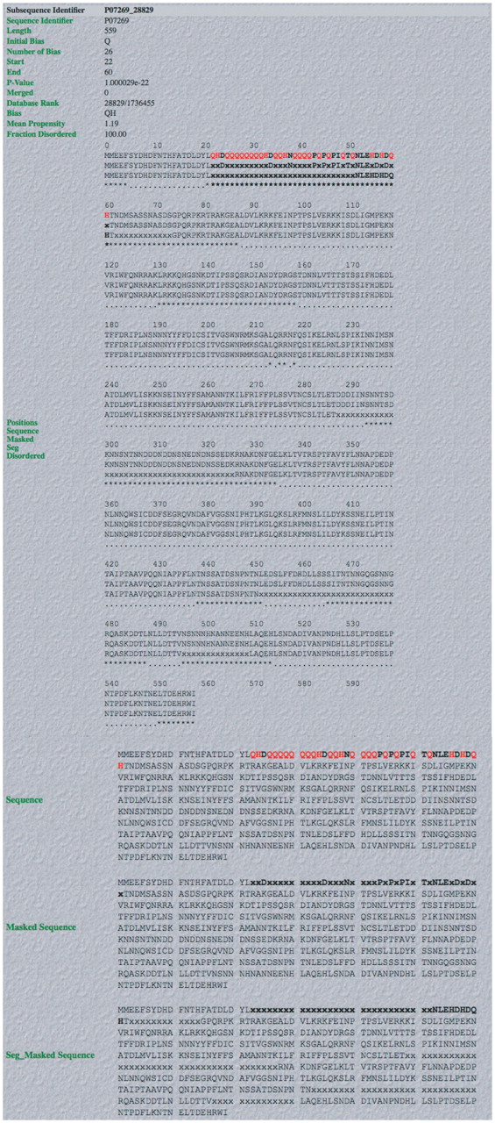
Figure 3. Screenshot of example of output from database. An example of a complete LPS-annotate Database entry (as ...
Notes:
Figure 3. Screenshot of example of output from database. An example of a complete LPS-annotate Database entry (as described in the main text, and in the downloadable Database Help page). This is for the QH region from PHO2 of budding yeast.
Unless provided in the caption above, the following copyright applies to the content of this slide: © The Author(s) 2011. Published by Oxford University Press.This is Open Access article distributed under the terms of the Creative Commons Attribution Non-Commercial License (http://creativecommons.org/licenses/by-nc/2.5), which permits unrestricted non-commercial use, distribution, and reproduction in any medium, provided the original work is properly cited.

