Slide 1
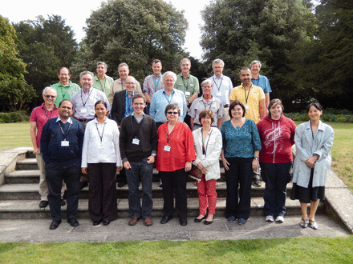
Figure 1. Group photo of the participants at the Protein Bioinformatics and Community Resources Retreat. The name of ...
Notes:
Figure 1. Group photo of the participants at the Protein Bioinformatics and Community Resources Retreat. The name of each participant is followed by the short name of their protein resource or resources in parentheses. Back row: David Landsman (Histone database), Dan Haft (TIGRFAMS), Bernard Henrissat (CAZy), Rob Finn (InterPro and Pfam), David Craik (ConoServer and CyBASE), Arnaud Chatonnet (ESTHER), Neil Rawlings (MEROPS); Middle row: Amos Bairoch (neXtProt), Gerard Manning (Kinase.com), Michael Spedding (IUPHAR), Gert Vriend (GPCRDB), Milton Saier (TCDB), Pantelis Bagos. (OMPdb); Front row: Narayanaswamy Srinivasan (KinG), Ramanathan Sowdhamini (PASS2), Alex Bateman. (Pfam & UniProt), Patsy Babbitt (SFLD), Kim Pruitt (RefSeq), Claire O’Donovan (UniProt), Gemma Holliday (MACiE) and Nozomi Nagano (EzCatDB).
Unless provided in the caption above, the following copyright applies to the content of this slide: © The Author(s) 2015. Published by Oxford University Press. This is an Open Access article distributed under the terms of the Creative Commons Attribution License ( http://creativecommons.org/licenses/by/4.0/ ), which permits unrestricted reuse, distribution, and reproduction in any medium, provided the original work is properly cited.

