Slide 1
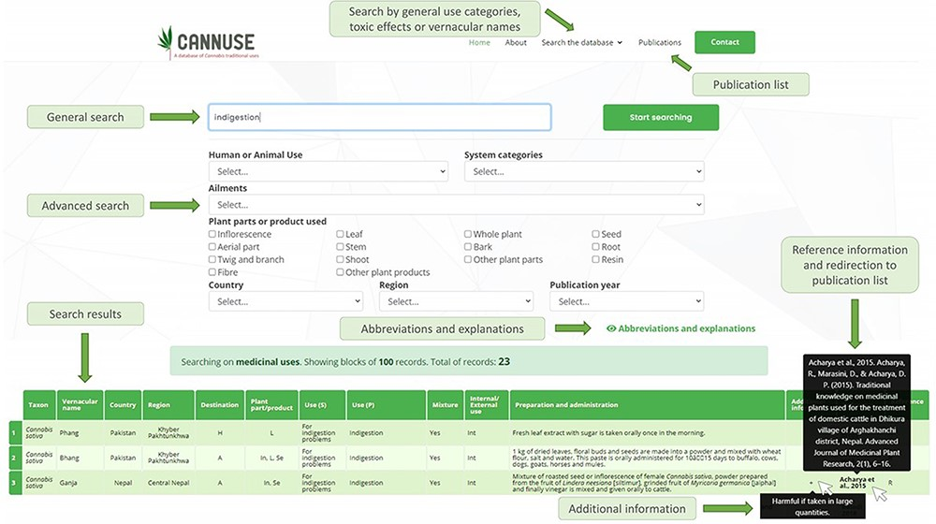
Figure 4. User interface of the Search the database function. The data can be filtered out using general search (search ...
Notes:
Figure 4. User interface of the Search the database function. The data can be filtered out using general search (search by key words) or by advanced search, where user is selecting the filters for the search.
Unless provided in the caption above, the following copyright applies to the content of this slide: © The Author(s) 2021. Published by Oxford University Press.This is an Open Access article distributed under the terms of the Creative Commons Attribution License (http://creativecommons.org/licenses/by/4.0/), which permits unrestricted reuse, distribution, and reproduction in any medium, provided the original work is properly cited.

