Slide 1
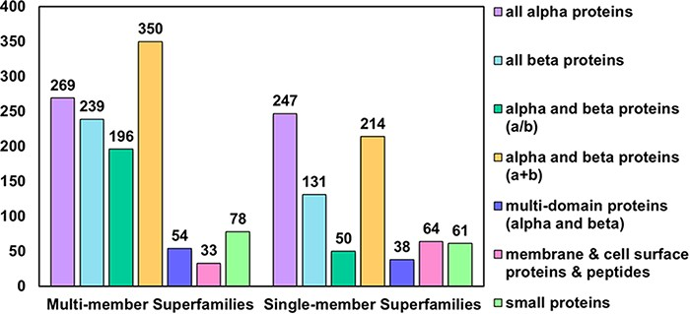
Figure 1. Distribution of MMS and SMS considered in PASS2.7 across the seven classes of SCOPe. The most represented ...
Notes:
Figure 1. Distribution of MMS and SMS considered in PASS2.7 across the seven classes of SCOPe. The most represented class as in the case of MMS is that of alpha and beta proteins (a+b) followed by all-alpha proteins, while in the case of SMS, the reverse holds.
Unless provided in the caption above, the following copyright applies to the content of this slide: © The Author(s) 2022. Published by Oxford University Press.This is an Open Access article distributed under the terms of the Creative Commons Attribution License (https://creativecommons.org/licenses/by/4.0/), which permits unrestricted reuse, distribution, and reproduction in any medium, provided the original work is properly cited.

Slide 2
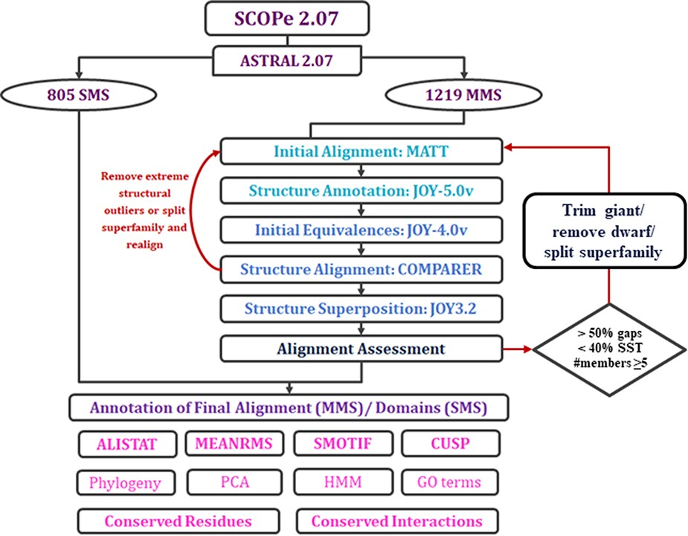
Figure 2. Workflow of PASS2.7 alignment and/or annotation of superfamily member(s). The newly added alignment ...
Notes:
Figure 2. Workflow of PASS2.7 alignment and/or annotation of superfamily member(s). The newly added alignment improvement step involves the identification of MMS with at least five members whose alignments possess >50% gap positions and <40% conservation of secondary structural elements. Clusters are identified for such cases based on a machine learning algorithm, on basis of which the alignment is improved. The additional feature available for MMS in this update is the conserved interactions.
Unless provided in the caption above, the following copyright applies to the content of this slide: © The Author(s) 2022. Published by Oxford University Press.This is an Open Access article distributed under the terms of the Creative Commons Attribution License (https://creativecommons.org/licenses/by/4.0/), which permits unrestricted reuse, distribution, and reproduction in any medium, provided the original work is properly cited.

Slide 3
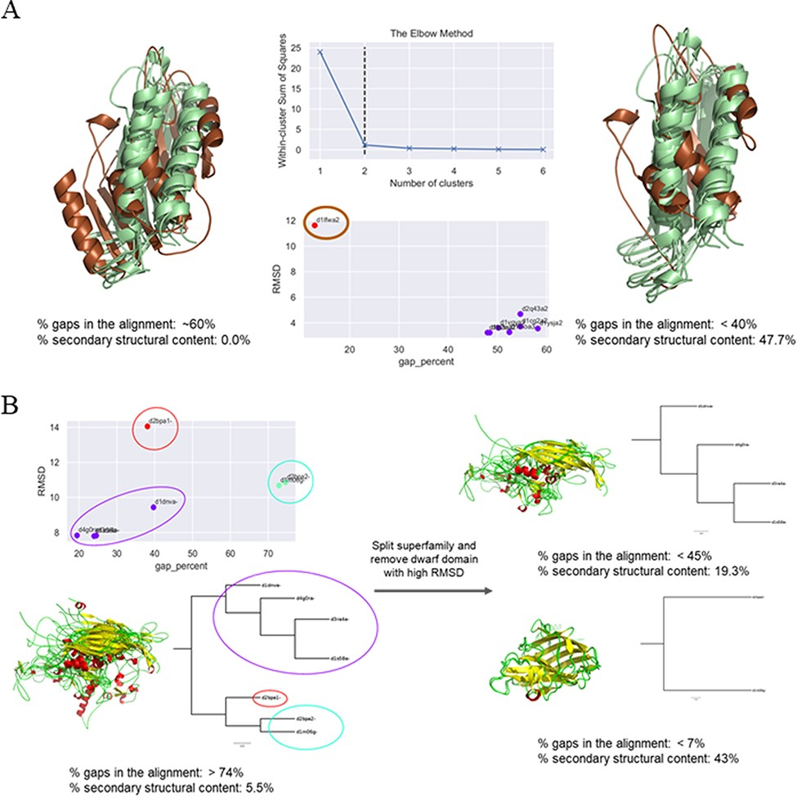
Figure 3. Examples of clustering method-based improvement of alignment. (A) For the superfamily bacterial exopeptidase ...
Notes:
Figure 3. Examples of clustering method-based improvement of alignment. (A) For the superfamily bacterial exopeptidase dimerization domain (SCOPe ID 55031), the domain d1lfwa2 (brown) was found to be a giant member, which had RMSD >10 Å to other members and this led to a large number of gaps in the alignment. The overhang region of this domain was trimmed and the members realigned. This significantly improved the secondary structural conservation of the alignment and reduced the number of gaps. (B) Three clusters were predicted for the MMS ssDNA viruses (88645), and the alignment was found to be highly ‘gappy’ (>70% gaps). The MMS was split into two, and a dwarf domain that was the lone member of the third cluster was removed to obtain an improved alignment with a significantly lesser number of gaps in alignment of each split MMS and higher secondary structural conservation.
Unless provided in the caption above, the following copyright applies to the content of this slide: © The Author(s) 2022. Published by Oxford University Press.This is an Open Access article distributed under the terms of the Creative Commons Attribution License (https://creativecommons.org/licenses/by/4.0/), which permits unrestricted reuse, distribution, and reproduction in any medium, provided the original work is properly cited.

Slide 4
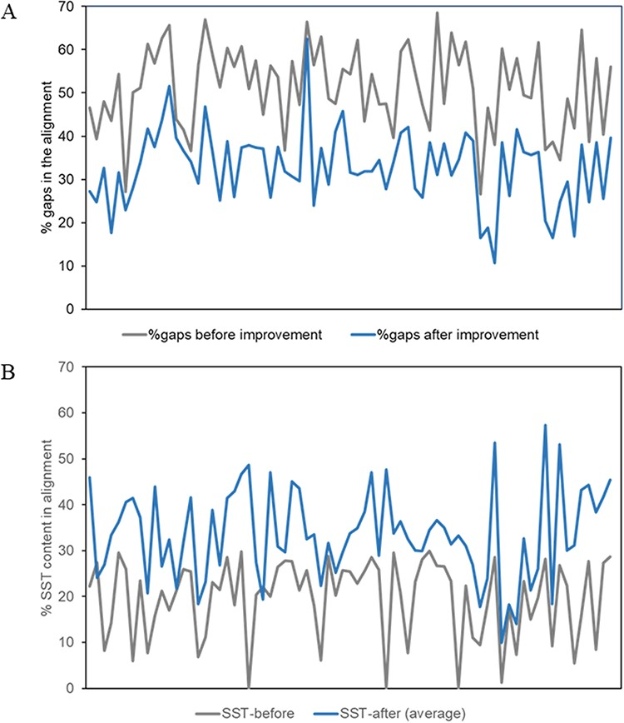
Figure 4. Plots of alignment statistics showing a decrease in the number of gaps in the alignment and an increase in ...
Notes:
Figure 4. Plots of alignment statistics showing a decrease in the number of gaps in the alignment and an increase in conserved secondary structural positions. (A) Percentage of gaps, averaged over members of a superfamily, in the alignment before and after the improvement of alignment. (B) Equivalent secondary structural positions (SST) in the alignment of about 80 superfamilies, before and after the improvement of alignment.
Unless provided in the caption above, the following copyright applies to the content of this slide: © The Author(s) 2022. Published by Oxford University Press.This is an Open Access article distributed under the terms of the Creative Commons Attribution License (https://creativecommons.org/licenses/by/4.0/), which permits unrestricted reuse, distribution, and reproduction in any medium, provided the original work is properly cited.

Slide 5
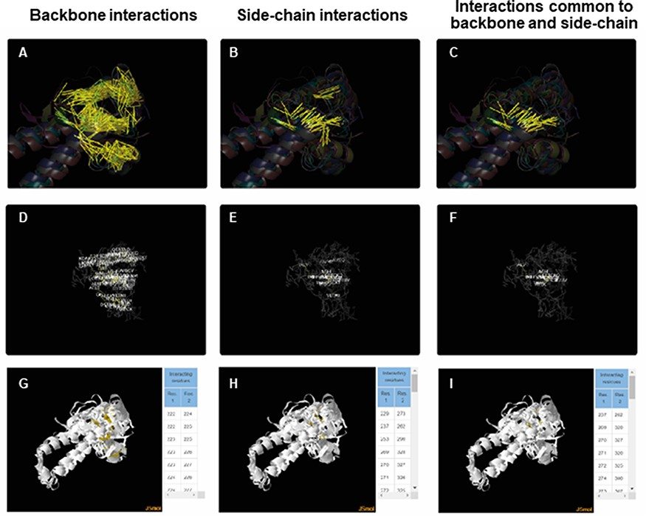
Figure 5. ACIs plotted on superposed structures for the Tubulin C-terminal domain-like superfamily (SCOPe ID 55307). ...
Notes:
Figure 5. ACIs plotted on superposed structures for the Tubulin C-terminal domain-like superfamily (SCOPe ID 55307). The top panel (A–C) consists of figures showing ACIs on superposed structures for backbone, side chain and those common to both of them. The middle panel (D–F) consists of figures showing ACI networks with possible residues at respective positions on the representative structure of the superfamily. The bottom panel (G–I) shows the interactive views available for the three types of ACIs.
Unless provided in the caption above, the following copyright applies to the content of this slide: © The Author(s) 2022. Published by Oxford University Press.This is an Open Access article distributed under the terms of the Creative Commons Attribution License (https://creativecommons.org/licenses/by/4.0/), which permits unrestricted reuse, distribution, and reproduction in any medium, provided the original work is properly cited.

