Slide 1
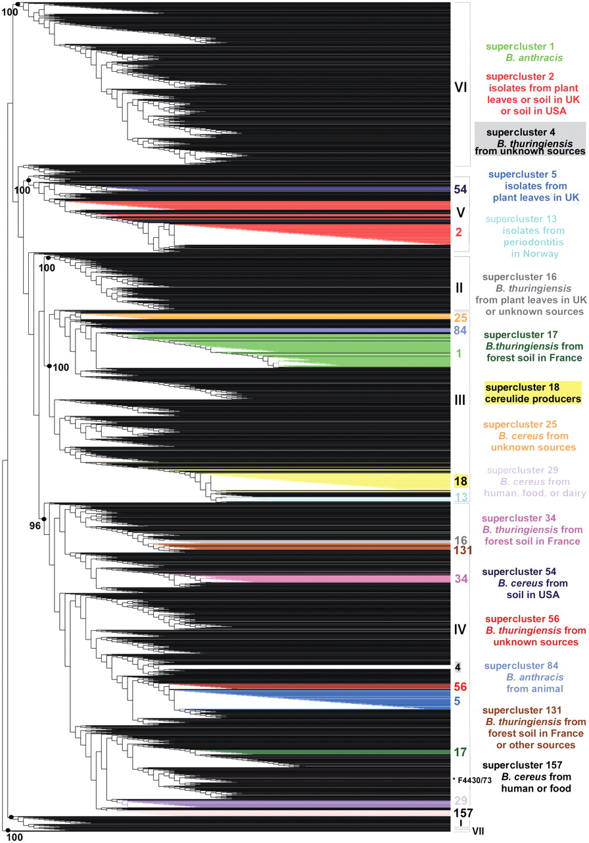
Figure 1. Weighted supertree of 2143 B. cereus group isolates based on phylogenetic information from five MLST schemes ...
Notes:
Figure 1. Weighted supertree of 2143 B. cereus group isolates based on phylogenetic information from five MLST schemes and three AFLP studies available in HyperCAT. The supertree was inferred following the MRP strategy, with a weight of 40 or 68 given to the AFLP studies and a weight of 1 given to each of 26 MLST genes. For the sake of legibility, isolate names are not shown. The seven major phylogenetic subdivisions of the B. cereus group defined by ref. (10) are designated by roman numerals (I–VII) and their branch support values (based on aLRT probabilities) are indicated when >95%. Superclusters of genetically closely related isolates (sharing identical MLST or AFLP profiles) that have been computed independently using a recursive approach and that contain 10 or more isolates have been mapped onto the supertree and are listed on the right (the supercluster descriptions apply to most isolates of the superclusters, not necessarily all). Isolates belonging to a given supercluster are drawn in the same color. As can be seen, isolates from the same supercluster are closely related in the tree. One exception is indicated by an asterisk and corresponds to strain B. cereus F4430/73 of supercluster 157. The image was generated using TreeDyn (44).
Unless provided in the caption above, the following copyright applies to the content of this slide: © The Author(s) 2010. Published by Oxford University Press.This is Open Access article distributed under the terms of the Creative Commons Attribution Non-Commercial License (http://creativecommons.org/licenses/by-nc/2.5), which permits unrestricted non-commercial use, distribution, and reproduction in any medium, provided the original work is properly cited.

