Slide 1
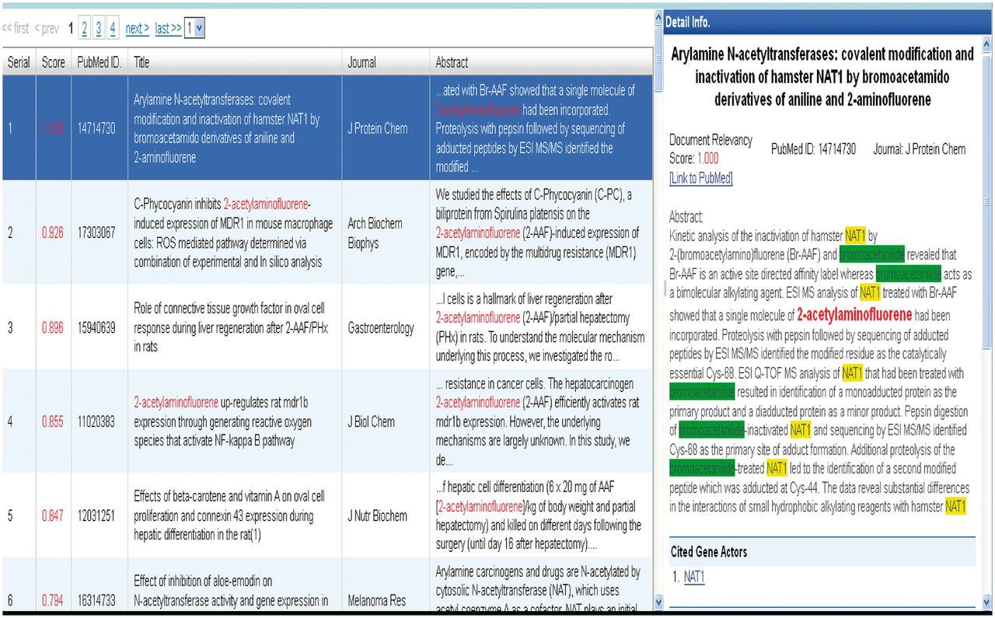
Figure 9 Group 133 web interface. A screenshot of Group 133’s web interface.
Notes:
Figure 9 Group 133 web interface. A screenshot of Group 133’s web interface.
Unless provided in the caption above, the following copyright applies to the content of this slide: © The Author(s) 2012. Published by Oxford University Press.This is an Open Access article distributed under the terms of the Creative Commons Attribution License (http://creativecommons.org/licenses/by-nc/3.0/), which permits non-commercial reuse, distribution, and reproduction in any medium, provided the original work is properly cited. For commercial re-use, please contact journals.permissions@oup.com.

