Slide 1
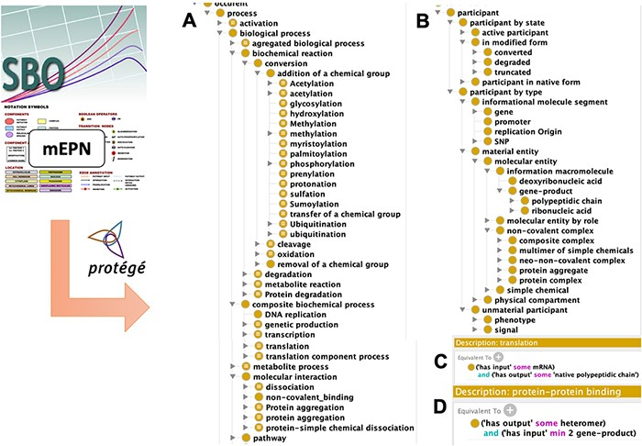
Figure 2. Disease Map Ontology (DMO) model design. Term of classes were extracted from the Systems Biology Ontology ...
Notes:
Figure 2. Disease Map Ontology (DMO) model design. Term of classes were extracted from the Systems Biology Ontology (SBO) and the modified Edinburg Pathway Notation format (mEPN) into Protégé. Classes were hierarchized as subclasses of process (A) or participant (B). Using property terms from the Relation Ontology (RO), classes were formally defined in description logic, as illustrated in the case of transcription (C) and protein complex formation (D) processes.
Unless provided in the caption above, the following copyright applies to the content of this slide: © The Author(s) 2021. Published by Oxford University Press. All rights reserved. For permissions, please e-mail: journals.permissions@oup.comThis article is published and distributed under the terms of the Oxford University Press, Standard Journals Publication Model (https://academic.oup.com/journals/pages/open_access/funder_policies/chorus/standard_publication_model)

