Slide 1
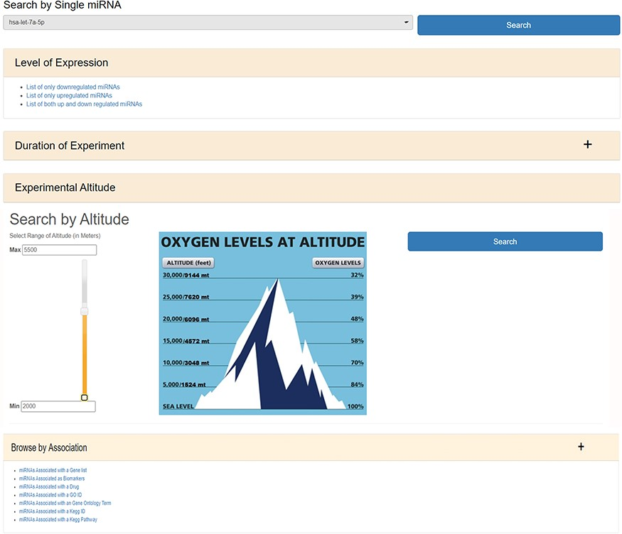
Figure 2. The web image of HAHmiR.DB—‘Browse’ option allows the user to browse differentially expressed (DE) miRNA ...
Notes:
Figure 2. The web image of HAHmiR.DB—‘Browse’ option allows the user to browse differentially expressed (DE) miRNA during HA acclimatization using multiple filters, i.e. level of expression, duration of experiment, experimental altitude and browse by associations that includes filters such as miRNAs Associated with a Gene List, miRNAs Associated as Biomarkers, miRNAs Associated with a Drug, miRNAs Associated with a GO ID/term, miRNAs Associated with a KEGG ID/Pathway.
Unless provided in the caption above, the following copyright applies to the content of this slide: © The Author(s) 2020. Published by Oxford University Press.This is an Open Access article distributed under the terms of the Creative Commons Attribution License (http://creativecommons.org/licenses/by/4.0/), which permits unrestricted reuse, distribution, and reproduction in any medium, provided the original work is properly cited.

