Slide 1
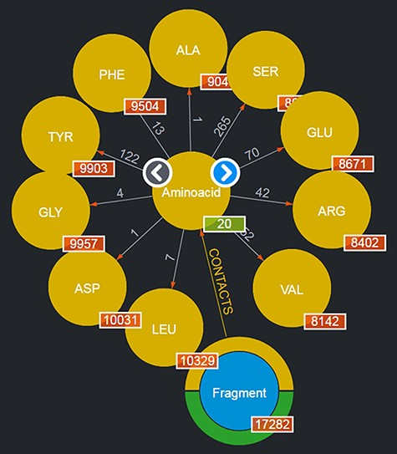
Figure 2. Entities of type ‘Aminoacids’ shown after clicking on the corresponding entity type node. The view shows up ...
Notes:
Figure 2. Entities of type ‘Aminoacids’ shown after clicking on the corresponding entity type node. The view shows up to 10 entities and allows users to browse for more by using the left/right arrows in the center. The numbers displayed on the edges, in this case, correspond to the total number of Fragments featured in the DB contacting the given amino acid.
Unless provided in the caption above, the following copyright applies to the content of this slide: © The Author(s) 2022. Published by Oxford University Press.This is an Open Access article distributed under the terms of the Creative Commons Attribution-NonCommercial License (https://creativecommons.org/licenses/by-nc/4.0/), which permits non-commercial re-use, distribution, and reproduction in any medium, provided the original work is properly cited. For commercial re-use, please contact journals.permissions@oup.com

