Slide 1
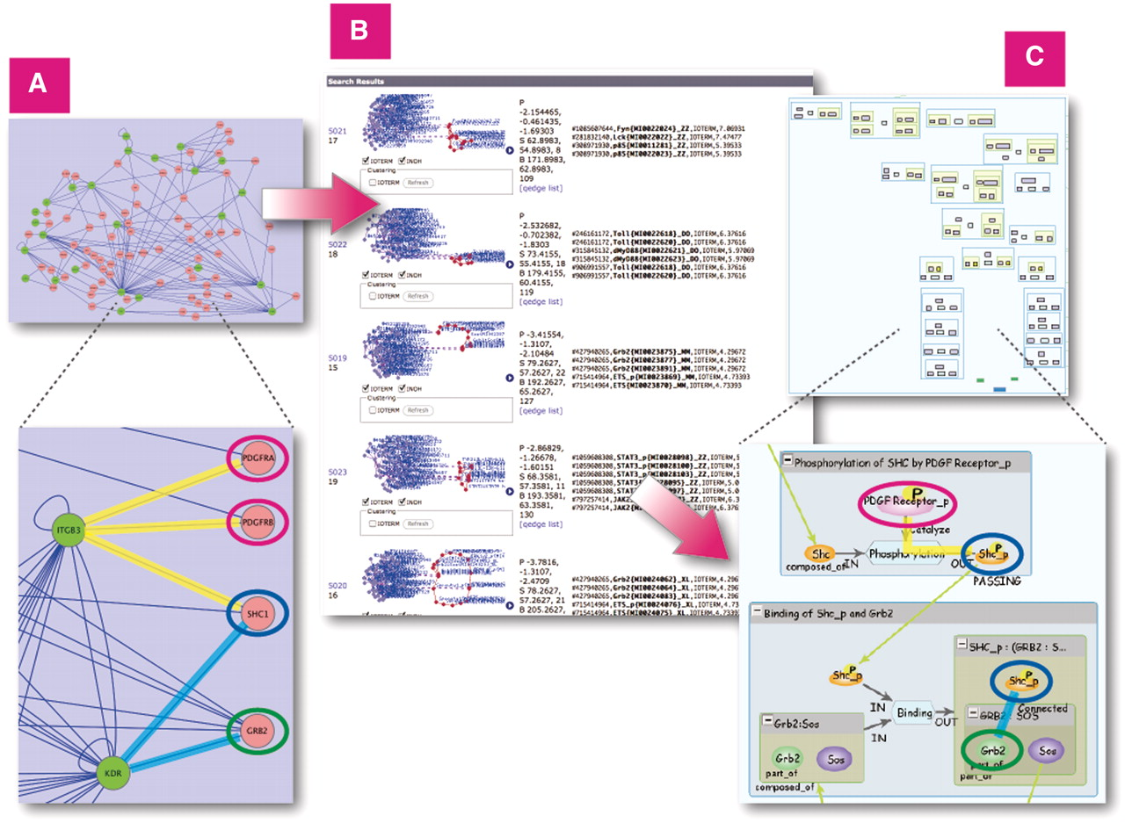
Figure 8. Similarity Search on all INOH pathways using large protein–protein network query. (A) Protein–protein network ...
Notes:
Figure 8. Similarity Search on all INOH pathways using large protein–protein network query. (A) Protein–protein network related to acute allergic diseases displayed in Cytoscape. (B) Results of similarity search on INOH pathways using network as query. (C) Example of INOH pathways that have similar molecules and interactions in protein–protein network dataset. Similar molecules and interactions are highlighted with same colors in (A) and (C). These results can be found here. http://www.inoh.org/similarity-search/project.php?session=1&pid=526.
Unless provided in the caption above, the following copyright applies to the content of this slide: © The Author(s) 2011. Published by Oxford University Press.This is an Open Access article distributed under the terms of the Creative Commons Attribution Non-Commercial License (http://creativecommons.org/licenses/by-nc/3.0), which permits unrestricted non-commercial use, distribution, and reproduction in any medium, provided the original work is properly cited.

