Slide 1
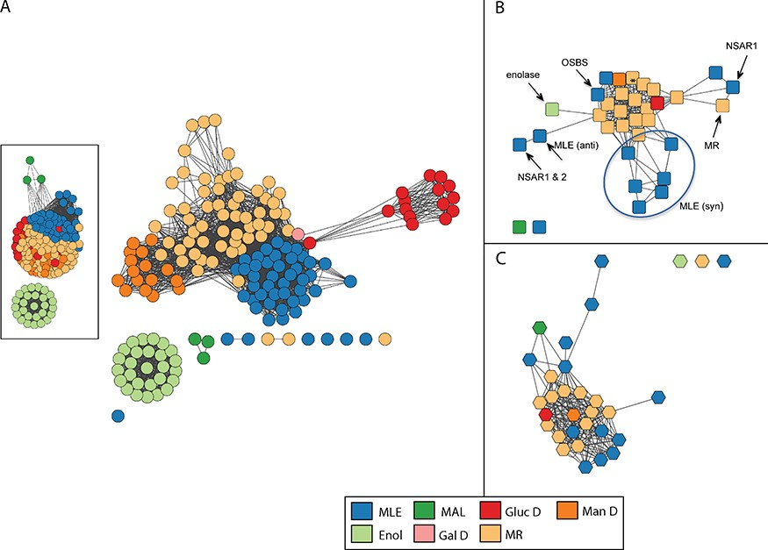
Figure 4 Similarity networks for the enolase superfamily colored by SFLD subgroup. Network visualization uses the ...
Notes:
Figure 4 Similarity networks for the enolase superfamily colored by SFLD subgroup. Network visualization uses the organic layout provided by the Cytoscape software (66). In this layout, edges are drawn between nodes if the similarity score is ≥ a statistical significance threshold pertinent to the comparison metric; edge lengths correlate with the degree of connectivity. (A) Structure similarity network computed from all-by-all pairwise comparisons of 170 nonredundant structures using the TM-Align algorithm. Edges represent pairwise structural alignments with a TMScore of at least 0.85 (main network) or at least 0.73 (inset). (A TM-Align score of 0.5 is considered statistically significant (72).) Nodes with similarity scores below these thresholds appear as disconnected from main clusters. Each circular node corresponds to a representative structure of the superfamily and is colored according to the SFLD subgroup to which it is assigned based on a careful curation protocol (34). Subgroups are muconate cycloisomerase (MLE), methylaspartate ammonia lyase (MAL), glucarate dehydratase (GlucD), mannonate dehydratase (ManD), enolase (Enol), galactarate dehydratase (GalD) and mandelate racemase (MR). Although all members of the superfamily share conserved active site machinery associated with the conserved fundamental partial reaction they all catalyze (28), they perform different overall chemical reactions using different substrates. Within the superfamily, while some subgroups are monofunctional and others include multiple reactions, each is named for a single experimentally characterized `founder’ reaction assigned to it by SFLD curators. For example, the MR subgroup includes the mandelate racemase reaction as well as many acid sugar dehydratases. The other subgroup containing several different overall reactions, the MLE subgroup, contains a reaction of the same name as well reactions that include dipeptide epimerases, n-acyl amino acid racemases and others. (B) Reaction similarity network computed from all-by-all pairwise comparisons of 33 overall superfamily reactions. Each square node represents a superfamily reaction colored according to the SFLD subgroup of the enzymes that catalyze it. Edges represent pairwise reaction center similarity scores of at least 0.17. The starred node designates a reaction found in both the MR and GalD subgroups, with three distinct families catalyzing the dehydration of galactarate (73–75). Labeled nodes designate reaction families discussed in the text or figures. The circle distinguishes enzymes from the MLE (syn) sub-subgroup, the members of which differ in substrate specificity rather than in overall reaction. (C) Substrate similarity network. Each hexagonal node corresponds to a known substrate involved in a reaction catalyzed by an enolase superfamily enzyme colored by the subgroup of the corresponding enzyme. Edges represent Tanimoto scores of at least 0.54. The starred node designates a substrate found in both the MR and GalD subgroups.
Unless provided in the caption above, the following copyright applies to the content of this slide: © The Author(s) 2020. Published by Oxford University Press.This is an Open Access article distributed under the terms of the Creative Commons Attribution License (http://creativecommons.org/licenses/by/4.0/), which permits unrestricted reuse, distribution, and reproduction in any medium, provided the original work is properly cited.

