Slide 1
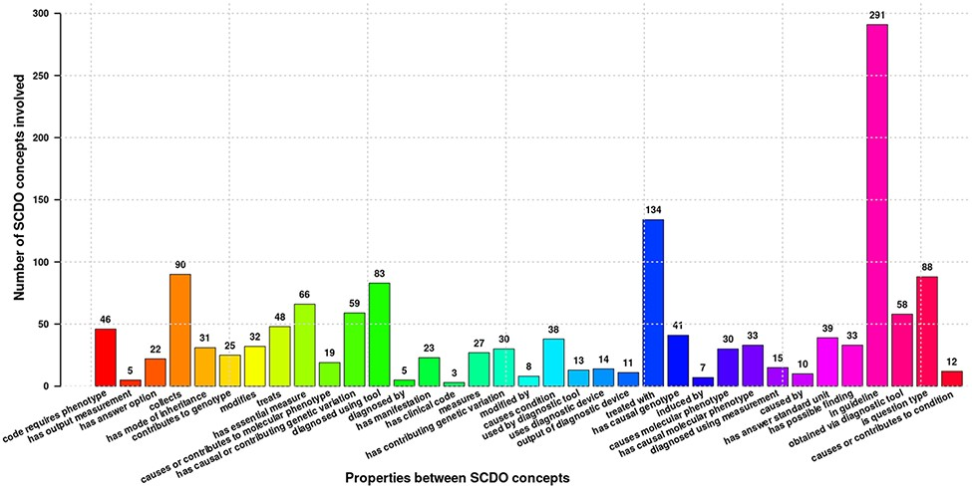
Figure 2. Different properties defined between SCDO concepts mapping the current SCD knowledge. Numbers at the top of ...
Notes:
Figure 2. Different properties defined between SCDO concepts mapping the current SCD knowledge. Numbers at the top of bars represent the frequency of occurrence of the association in the ontology.
Unless provided in the caption above, the following copyright applies to the content of this slide: © The Author(s) 2022. Published by Oxford University Press.This is an Open Access article distributed under the terms of the Creative Commons Attribution License (https://creativecommons.org/licenses/by/4.0/), which permits unrestricted reuse, distribution, and reproduction in any medium, provided the original work is properly cited.

