Slide 1
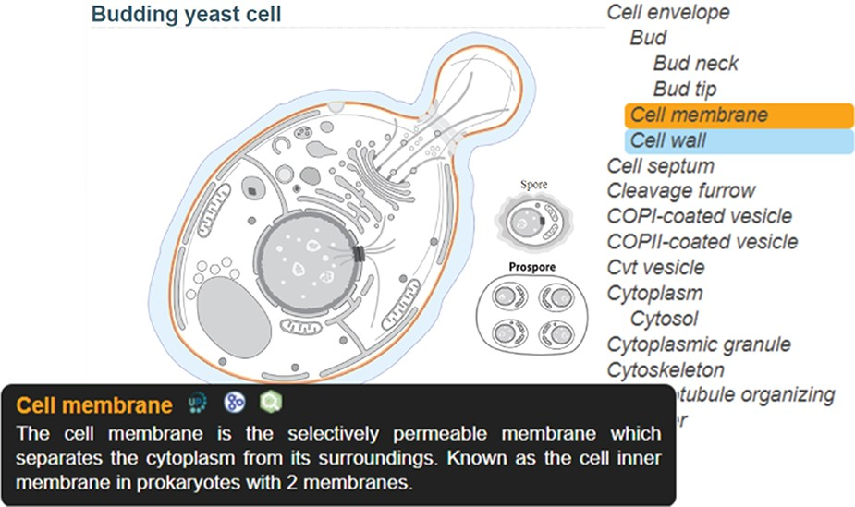
Figure 2. SwissBioPics page for budding yeast cell; The ‘Cell membrane’, selected on the sidebar list, is colored ...
Notes:
Figure 2. SwissBioPics page for budding yeast cell; The ‘Cell membrane’, selected on the sidebar list, is colored orange, with a tooltip showing a description of the organelle and links to the UniProt, AmiGO and QuickGO websites; The mouse is hovering on ‘Cell wall’ in the list, coloring this part blue.
Unless provided in the caption above, the following copyright applies to the content of this slide: © The Author(s) 2022. Published by Oxford University Press.This is an Open Access article distributed under the terms of the Creative Commons Attribution License (https://creativecommons.org/licenses/by/4.0/), which permits unrestricted reuse, distribution, and reproduction in any medium, provided the original work is properly cited.

