Slide 1
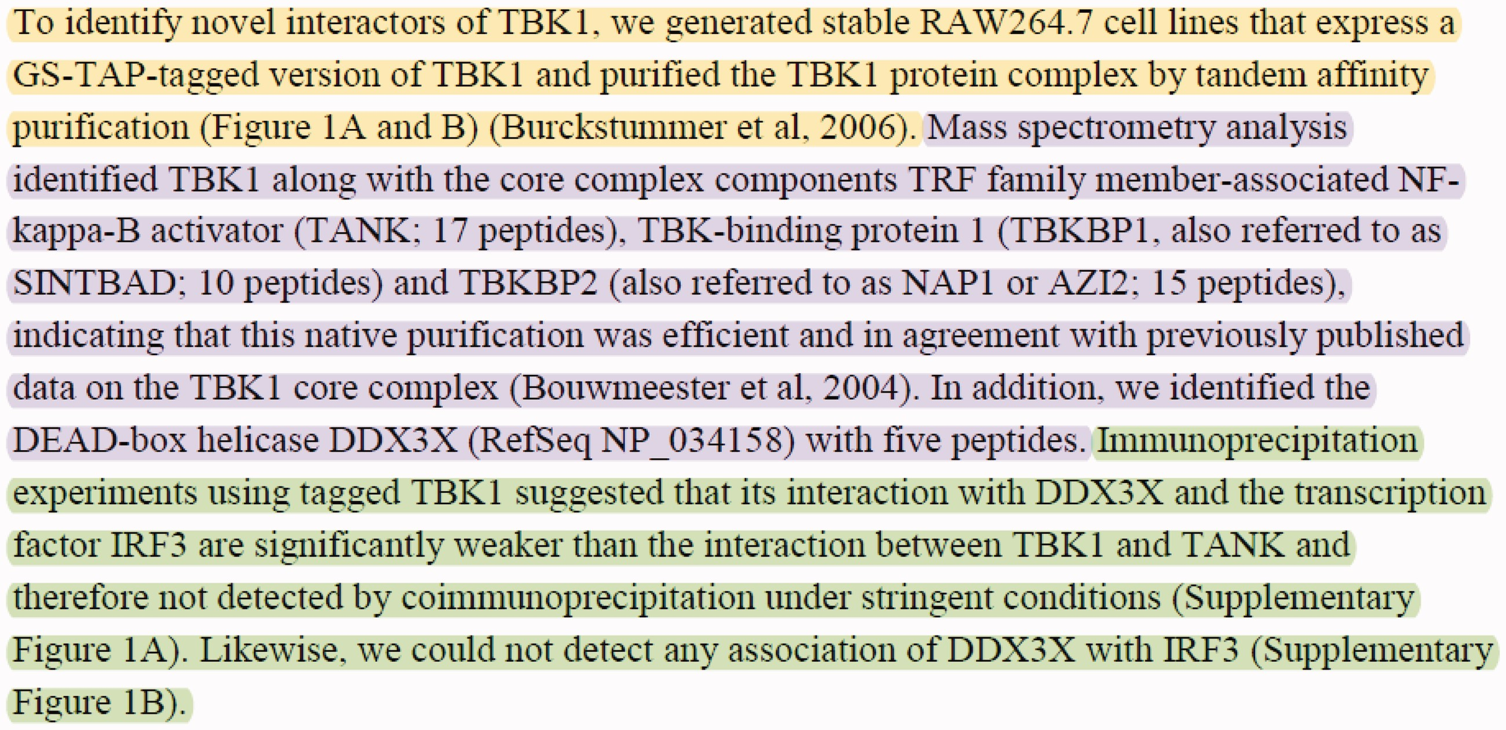
Figure 1. Sample text with multiple PPIs and experimental methods taken from the Results section of (30). The text ...
Notes:
Figure 1. Sample text with multiple PPIs and experimental methods taken from the Results section of (30). The text describes three experimental interaction detection methods used to identify the proteins interacting with the ‘TBK1’ protein. The passages describing the experimental interaction detection methods ‘tandem affinity purification’ (MI:0676), ‘mass spectrometry studies of complexes’ (MI:0069), and ‘coimmunoprecipitation’ (MI:0019) are highlighted with yellow, purple and green, respectively.
Unless provided in the caption above, the following copyright applies to the content of this slide: © The Author(s) 2017. Published by Oxford University Press.This is an Open Access article distributed under the terms of the Creative Commons Attribution License (http://creativecommons.org/licenses/by/4.0/), which permits unrestricted reuse, distribution, and reproduction in any medium, provided the original work is properly cited.

