Slide 1
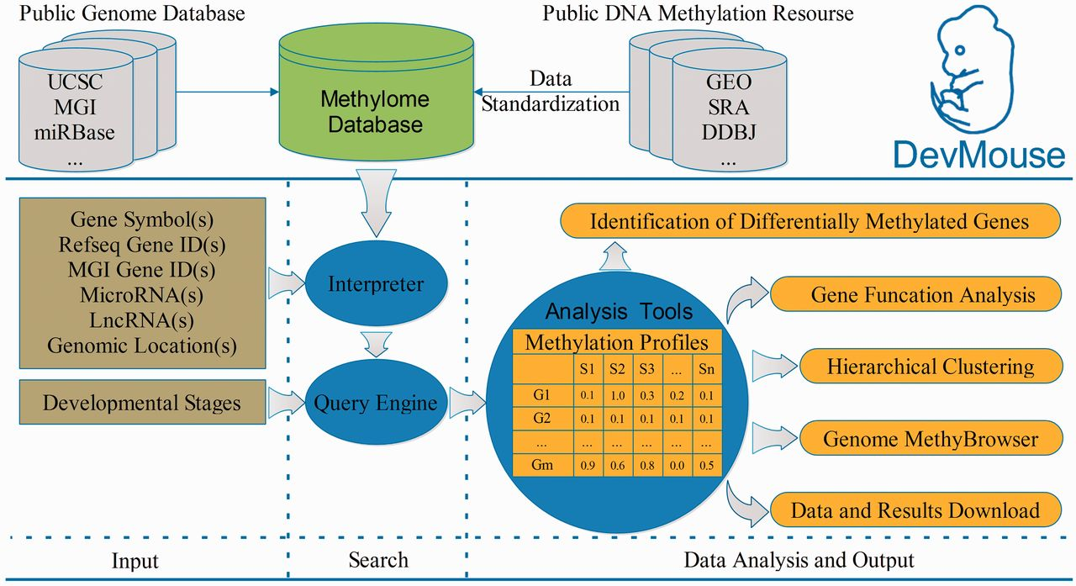
Figure 1. Overview of building and workflow of DevMouse. DevMouse integrates DNA methylomes of mouse development from ...
Notes:
Figure 1. Overview of building and workflow of DevMouse. DevMouse integrates DNA methylomes of mouse development from public DNA methylation resources and the mouse genome information. Users can input multiple genome items to the query engine to gain the methylation profiles of genes/regions in different developmental stages. The analysis tools enable users to carry out online analysis on the methylation profiles, including identification of differentially methylated genes/regions, gene function analysis, hierarchical clustering and visualization in MethyBrowser. All search and analysis results can be downloaded as flat format for further analysis.
Unless provided in the caption above, the following copyright applies to the content of this slide: © The Author(s) 2014. Published by Oxford University Press.This is an Open Access article distributed under the terms of the Creative Commons Attribution License (http://creativecommons.org/licenses/by/3.0/), which permits unrestricted reuse, distribution, and reproduction in any medium, provided the original work is properly cited.

Slide 2
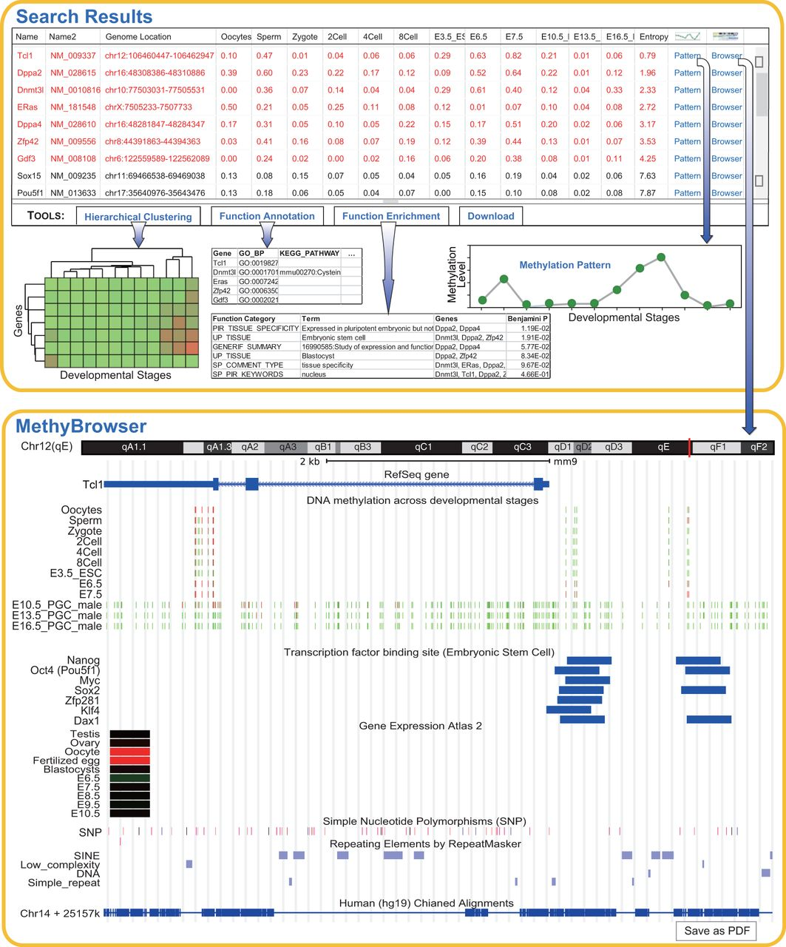
Figure 2. Search and analysis results on 19 genes during sperm development. Shown at the top is the default table and ...
Notes:
Figure 2. Search and analysis results on 19 genes during sperm development. Shown at the top is the default table and view generated by the query and analysis tools. The table shows the methylation profiles of 19 genes across 13 developmental stages and the sorted entropy values representing the methylation variation. The genes in red are differentially methylated across multiple stages. Using the buttons in the toolbar, the user can easily carry out online analysis including hierarchical clustering, gene function annotation and enrichment. The analysis results are shown as images or tables. The methylation pattern can be shown in a pop-up panel after clicking ‘Pattern’ link. When the ‘Browser’ link is clicked, the gene-centric methylation profile of gene Tcl1 and related genomic information are viewed in MethyBrowser as shown at the bottom.
Unless provided in the caption above, the following copyright applies to the content of this slide: © The Author(s) 2014. Published by Oxford University Press.This is an Open Access article distributed under the terms of the Creative Commons Attribution License (http://creativecommons.org/licenses/by/3.0/), which permits unrestricted reuse, distribution, and reproduction in any medium, provided the original work is properly cited.

