Slide 1
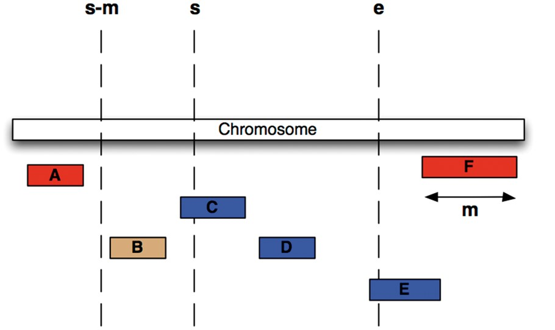
Figure 3. Efficient Searching of genomic features To find all features between coordinates s and e (i.e. C, D and E) in ...
Notes:
Figure 3. Efficient Searching of genomic features To find all features between coordinates s and e (i.e. C, D and E) in the situation were the maximum length of a feature for this coordinate system is m (i.e. the length of feature F), we extract all features whose start lies between s – m and e, then exclude B, since it ends before s.
Unless provided in the caption above, the following copyright applies to the content of this slide: © The Author(s) 2017. Published by Oxford University Press.This is an Open Access article distributed under the terms of the Creative Commons Attribution License (http://creativecommons.org/licenses/by/4.0/), which permits unrestricted reuse, distribution, and reproduction in any medium, provided the original work is properly cited.

