Slide 1
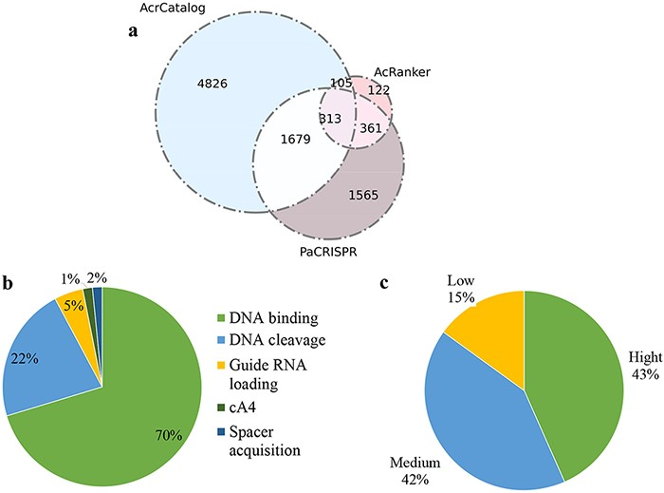
Figure 5. Data statistics in Anti-CRISPRdb v2.2. (a) Venn diagram of the predicted results from three algorithms ...
Notes:
Figure 5. Data statistics in Anti-CRISPRdb v2.2. (a) Venn diagram of the predicted results from three algorithms including PaCRISPR, AcRanker and AcrCatalog; (b) Distribution of inhibitory mechanisms; (c) Distribution of Acr inhibitory activity levels.
Unless provided in the caption above, the following copyright applies to the content of this slide: © The Author(s) 2022. Published by Oxford University Press.This is an Open Access article distributed under the terms of the Creative Commons Attribution License (https://creativecommons.org/licenses/by/4.0/), which permits unrestricted reuse, distribution, and reproduction in any medium, provided the original work is properly cited.

