Slide 1
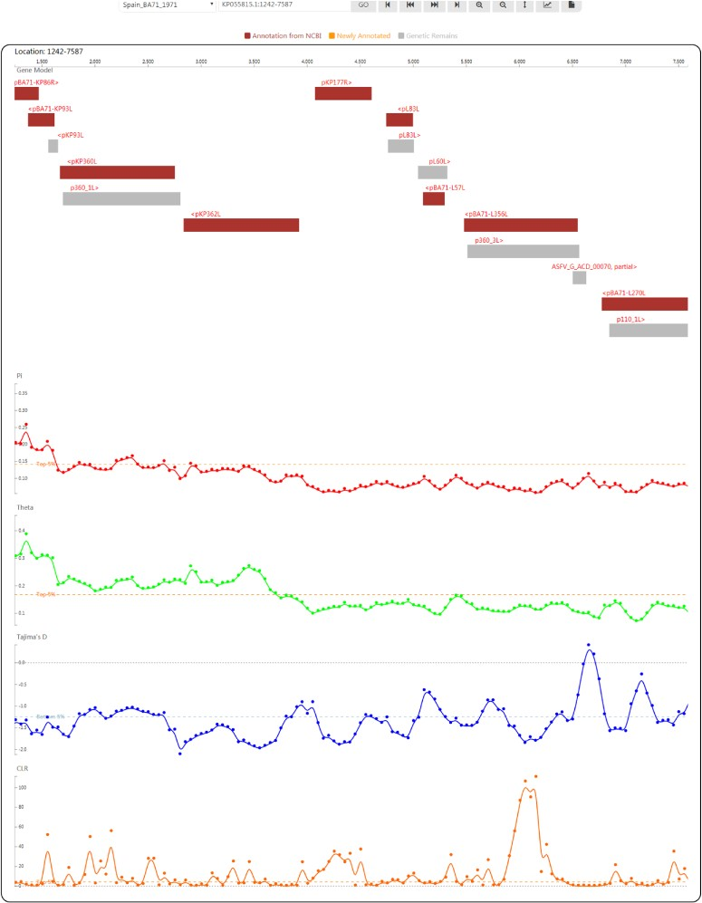
Figure 4 Genome browser view used to display ASFV genes and population genetic test statistics.
Notes:
Figure 4 Genome browser view used to display ASFV genes and population genetic test statistics.
Unless provided in the caption above, the following copyright applies to the content of this slide: © The Author(s) 2020. Published by Oxford University Press.This is an Open Access article distributed under the terms of the Creative Commons Attribution License (http://creativecommons.org/licenses/by/4.0/), which permits unrestricted reuse, distribution, and reproduction in any medium, provided the original work is properly cited.

Slide 2
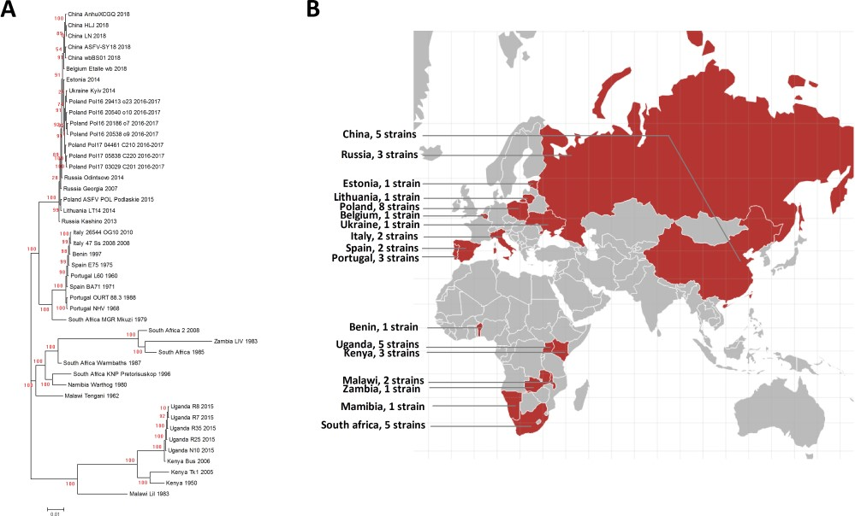
Figure 3 A. Phylogenetic tree of the ASFV strains in ASFVdb. The numbers marked in red are the marginal likelihoods of ...
Notes:
Figure 3 A. Phylogenetic tree of the ASFV strains in ASFVdb. The numbers marked in red are the marginal likelihoods of the tree. B. The distribution of strains in ASFVdb according to country.
Unless provided in the caption above, the following copyright applies to the content of this slide: © The Author(s) 2020. Published by Oxford University Press.This is an Open Access article distributed under the terms of the Creative Commons Attribution License (http://creativecommons.org/licenses/by/4.0/), which permits unrestricted reuse, distribution, and reproduction in any medium, provided the original work is properly cited.

Slide 3
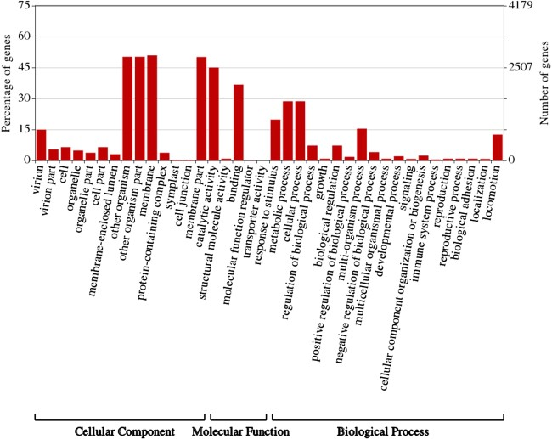
Figure 2 Gene ontology (GO) Enrichment of individual ASFV genes. This figure was created by WEGO (57).
Notes:
Figure 2 Gene ontology (GO) Enrichment of individual ASFV genes. This figure was created by WEGO (57).
Unless provided in the caption above, the following copyright applies to the content of this slide: © The Author(s) 2020. Published by Oxford University Press.This is an Open Access article distributed under the terms of the Creative Commons Attribution License (http://creativecommons.org/licenses/by/4.0/), which permits unrestricted reuse, distribution, and reproduction in any medium, provided the original work is properly cited.

Slide 4
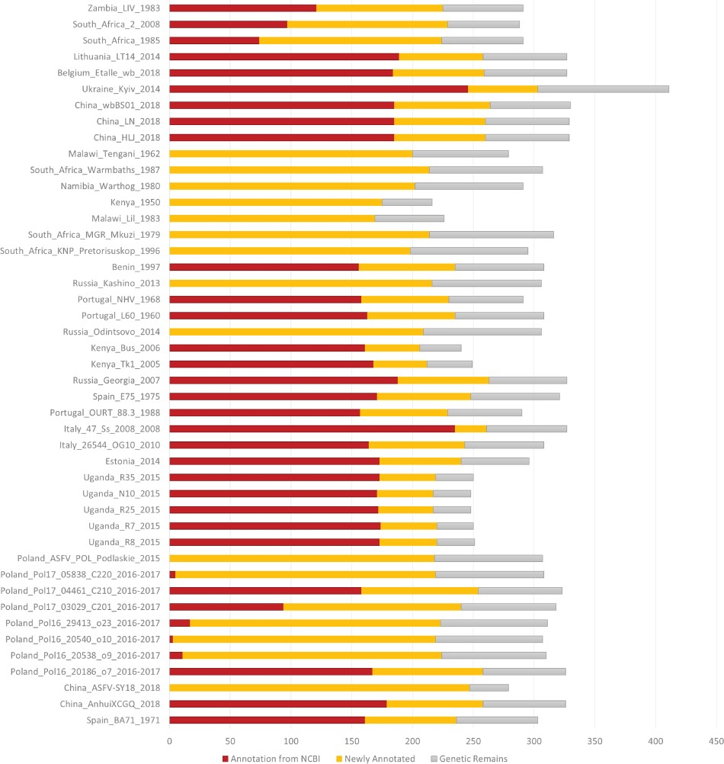
Figure 1 Number of annotated genes in all the ASFV strains. NCBI annotated genes, newly annotated genes and genetic ...
Notes:
Figure 1 Number of annotated genes in all the ASFV strains. NCBI annotated genes, newly annotated genes and genetic remains are marked in deep red, orange and grey, respectively.
Unless provided in the caption above, the following copyright applies to the content of this slide: © The Author(s) 2020. Published by Oxford University Press.This is an Open Access article distributed under the terms of the Creative Commons Attribution License (http://creativecommons.org/licenses/by/4.0/), which permits unrestricted reuse, distribution, and reproduction in any medium, provided the original work is properly cited.

