Slide 1
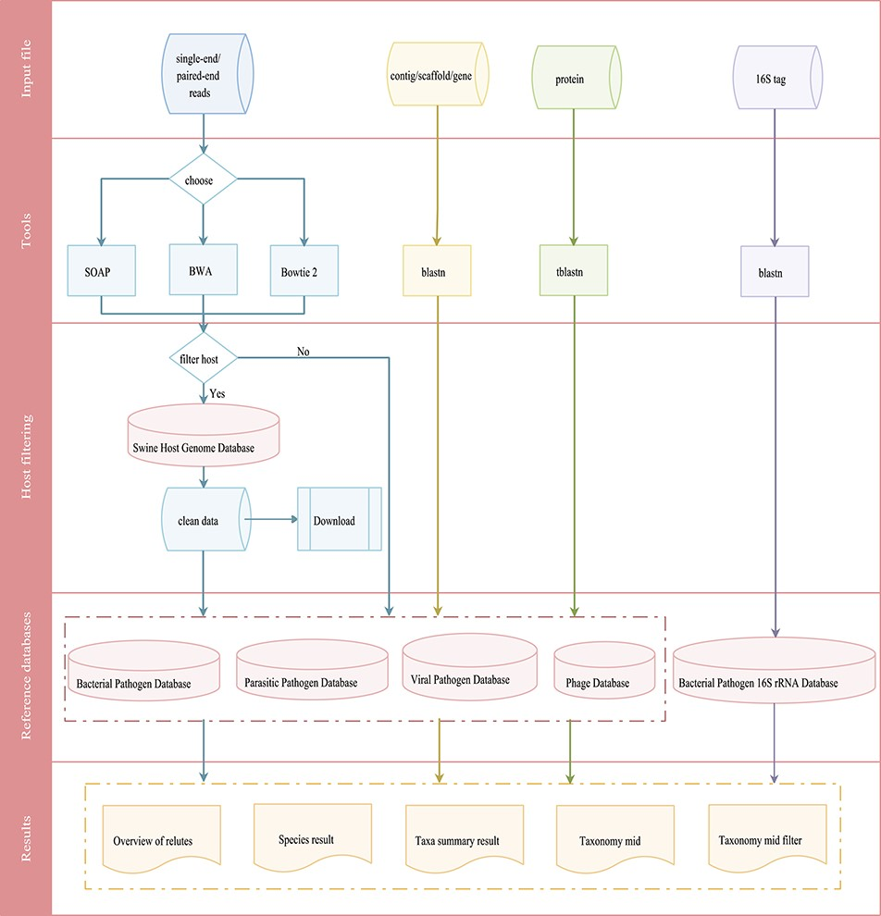
Figure 4 Integrated workflows for a pathogen screening tool. The workflows are shown in different colors based on ...
Notes:
Figure 4 Integrated workflows for a pathogen screening tool. The workflows are shown in different colors based on input data (reads in blue, contig/scaffold/gene in yellow, protein in green and 16S tag in purple).
Unless provided in the caption above, the following copyright applies to the content of this slide: © The Author(s) 2020. Published by Oxford University Press.This is an Open Access article distributed under the terms of the Creative Commons Attribution License (http://creativecommons.org/licenses/by/4.0/), which permits unrestricted reuse, distribution, and reproduction in any medium, provided the original work is properly cited.

