Slide 1
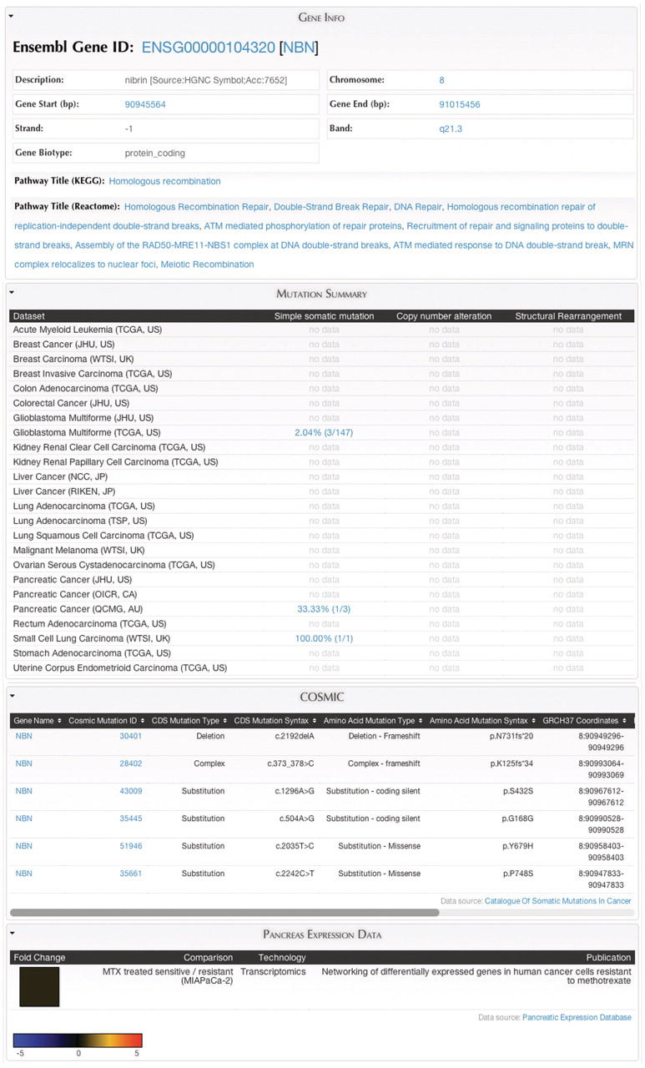
Figure 9. MartReport. ‘MartReport’ presents detailed information about a single data entry such as a cancer sample, a ...
Notes:
Figure 9. MartReport. ‘MartReport’ presents detailed information about a single data entry such as a cancer sample, a gene or a point mutation. MartReport allows data from multiple data sources to be presented in a single report page. In this example, data about the NBN gene are retrieved and integrated from Ensembl, KEGG, Reactome, ICGC, COSMIC and the Pancreatic Expression Database.
Unless provided in the caption above, the following copyright applies to the content of this slide: © The Author(s) 2011. Published by Oxford University Press.This is Open Access article distributed under the terms of the Creative Commons Attribution Non-Commercial License (http://creativecommons.org/licenses/by-nc/2.5), which permits unrestricted non-commercial use, distribution, and reproduction in any medium, provided the original work is properly cited.

