Slide 1
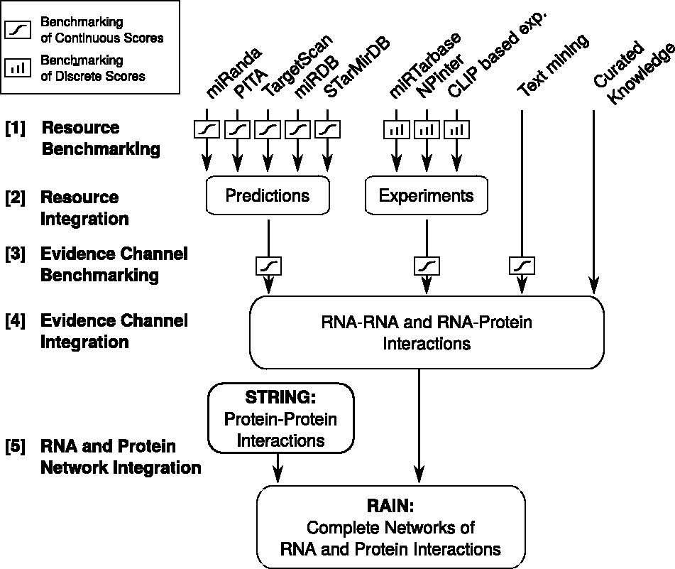
Figure 1 Flow chart illustrating the development of the RAIN database, ranging from establishing scoring schemes for ...
Notes:
Figure 1 Flow chart illustrating the development of the RAIN database, ranging from establishing scoring schemes for the individual sources of evidence, through integration of resources to evidence channels, to finally defining functional molecular networks.
Unless provided in the caption above, the following copyright applies to the content of this slide: © The Author(s) 2017. Published by Oxford University Press.This is an Open Access article distributed under the terms of the Creative Commons Attribution Non-Commercial License (http://creativecommons.org/licenses/by-nc/4.0/), which permits non-commercial re-use, distribution, and reproduction in any medium, provided the original work is properly cited. For commercial re-use, please contact journals.permissions@oup.com

