Slide 1
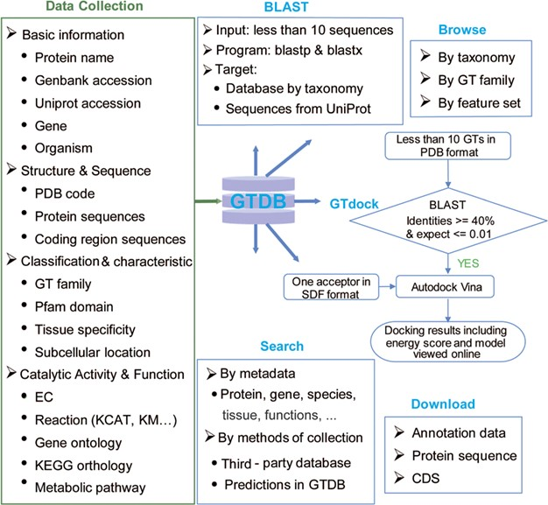
Figure 2 Content and services in GTDB. The left panel is the database content, which includes a variety of information ...
Notes:
Figure 2 Content and services in GTDB. The left panel is the database content, which includes a variety of information on GTs from well-known databases and predictions. The right panel is the web service provided by GTDB, including Search, Browse and Download models that can be used to access the database flexibly, as well as two useful tools for searching similar GTs by sequence (BLAST) or performing GT docking (GTdock).
Unless provided in the caption above, the following copyright applies to the content of this slide: © The Author(s) 2020. Published by Oxford University Press.This is an Open Access article distributed under the terms of the Creative Commons Attribution License (http://creativecommons.org/licenses/by/4.0/), which permits unrestricted reuse, distribution, and reproduction in any medium, provided the original work is properly cited.

