Slide 1
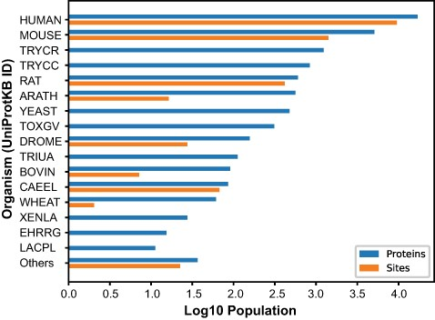
Figure 2. Number of O-GlcNAcylated proteins and sites. O-GlcNAcylated proteins (blue) and O-GlcNAc sites (orange) for ...
Notes:
Figure 2. Number of O-GlcNAcylated proteins and sites. O-GlcNAcylated proteins (blue) and O-GlcNAc sites (orange) for each organism cataloged in the O-GlcNAc Database. The Others category summarized proteins and sites from 26 organisms with <10 protein entries.
Unless provided in the caption above, the following copyright applies to the content of this slide: © The Author(s) 2021. Published by Oxford University Press.This is an Open Access article distributed under the terms of the Creative Commons Attribution License (http://creativecommons.org/licenses/by/4.0/), which permits unrestricted reuse, distribution, and reproduction in any medium, provided the original work is properly cited.

