Slide 1
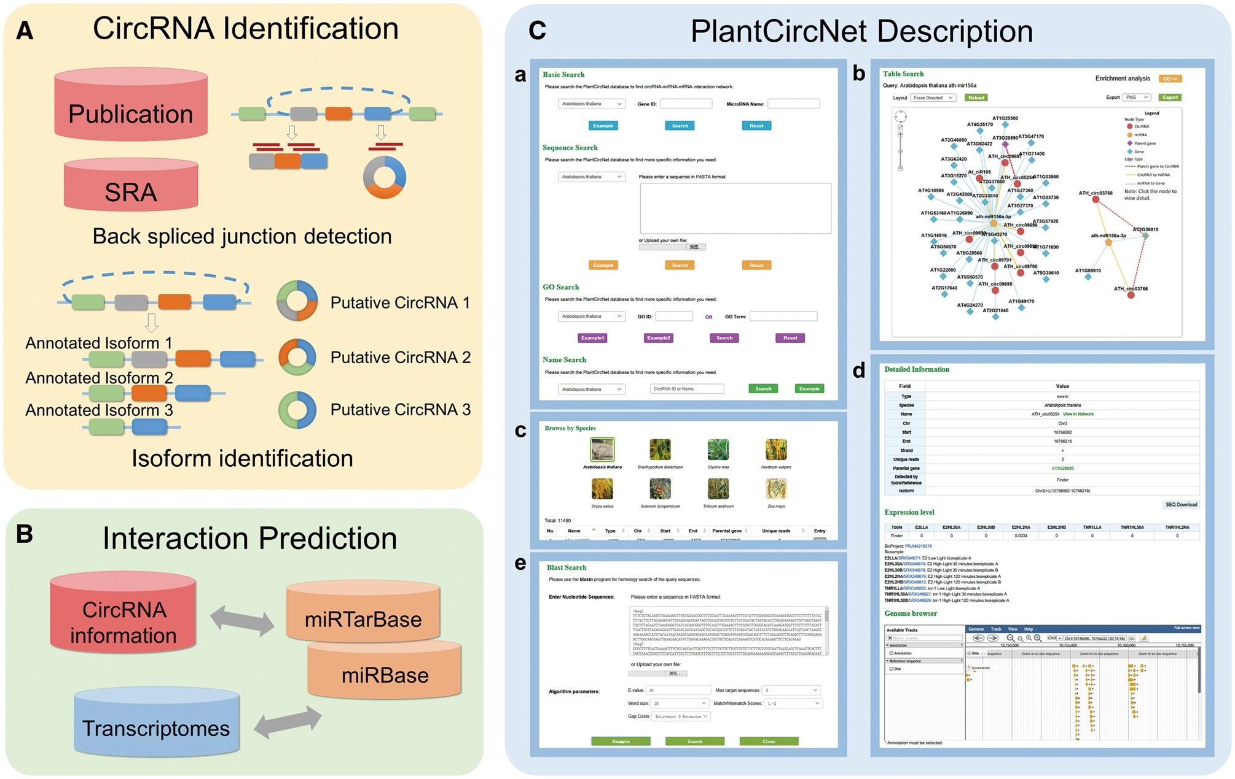
Figure 1. Overview of PlantCircNet workflow. (A) Identification of plant circRNAs. (B) Prediction of circRNA–miRNA–mRNA ...
Notes:
Figure 1. Overview of PlantCircNet workflow. (A) Identification of plant circRNAs. (B) Prediction of circRNA–miRNA–mRNA interactions. (C) Features of PlantCircNet, (Ca) search page, (Cb) network visualization, (Cc) browse page, (Cd) detail page and (Ce) blast search.
Unless provided in the caption above, the following copyright applies to the content of this slide: © The Author(s) 2017. Published by Oxford University Press.This is an Open Access article distributed under the terms of the Creative Commons Attribution License (http://creativecommons.org/licenses/by/4.0/), which permits unrestricted reuse, distribution, and reproduction in any medium, provided the original work is properly cited.

Slide 2
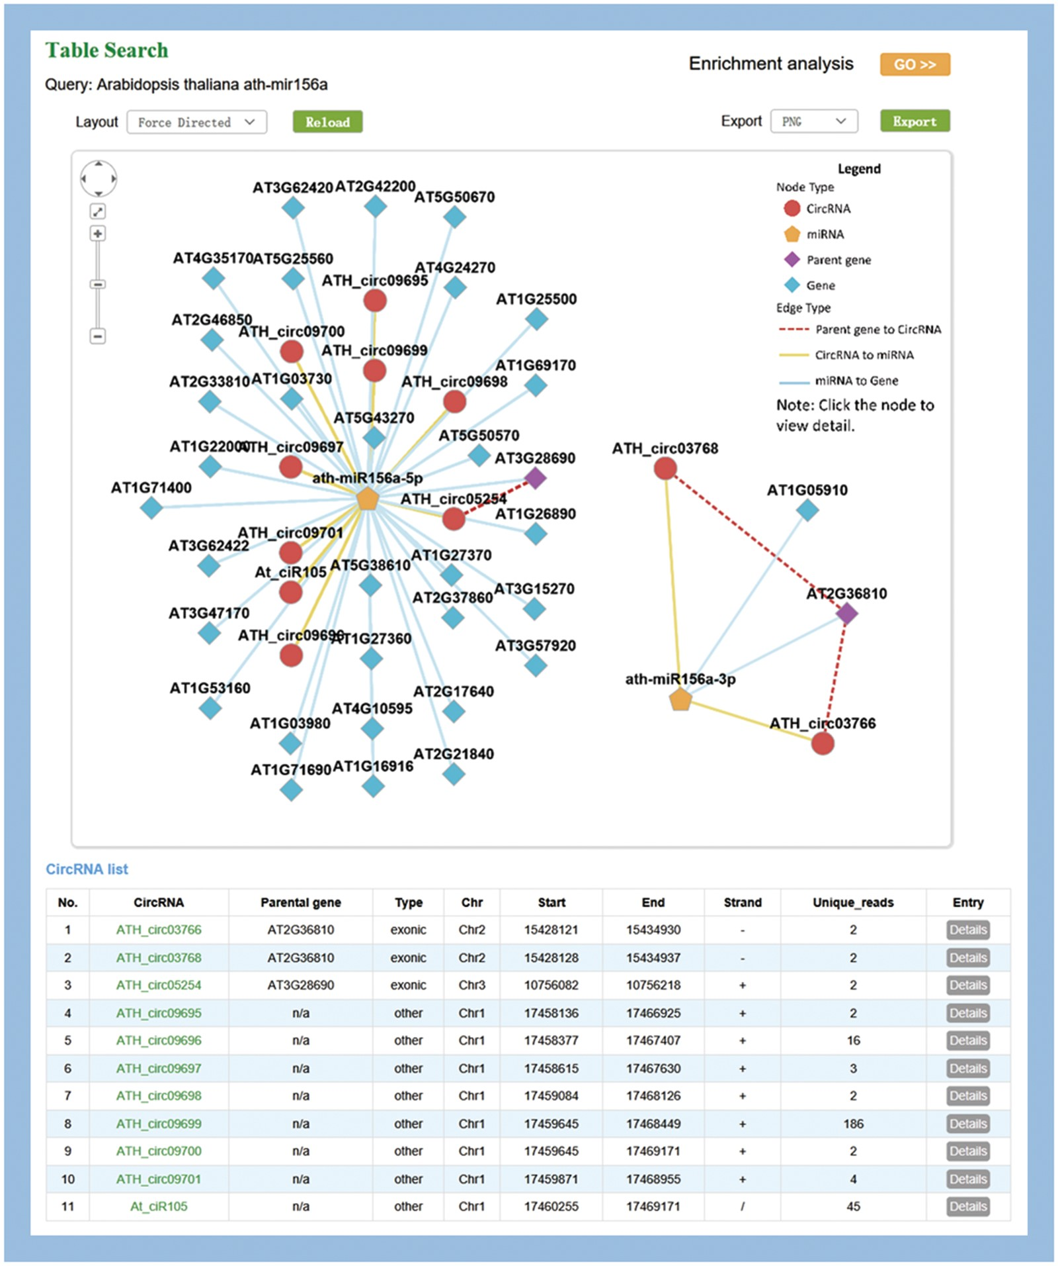
Figure 2. Visualization of miR156a-related circRNA–miRNA–mRNA network. The output contains two independent subnetworks ...
Notes:
Figure 2. Visualization of miR156a-related circRNA–miRNA–mRNA network. The output contains two independent subnetworks of the miRNAs, ath-miRNA156a-5p and ath-miRNA156a-3p, by a fuzzy search.
Unless provided in the caption above, the following copyright applies to the content of this slide: © The Author(s) 2017. Published by Oxford University Press.This is an Open Access article distributed under the terms of the Creative Commons Attribution License (http://creativecommons.org/licenses/by/4.0/), which permits unrestricted reuse, distribution, and reproduction in any medium, provided the original work is properly cited.

Slide 3
Figure 3. AT5G59720-subnetwork as an example to interpret the potential significance of the putative regulatory ...
Notes:
Figure 3. AT5G59720-subnetwork as an example to interpret the potential significance of the putative regulatory networks. (A) Screenshots of circRNAs–miR414–AT5G59720 regulatory network. (B) Expression level of AT5G59720 and related circRNAs among different light treatments. Samples (from left to right) repre-sent for E2 (ELIP2 promoter) low light A, E2 high-light 30 min A, E2 high-light 30 min B, E2 high-light 120 min A, E2 high-light 120 min B, tnr-1 (tanorexia-1) low light A, tnr-1 high-light 30 min A and tnr-1 high-light 120 min A. (C) Expression level of AT5G59720 and related circRNAs among different stress treatments. Samples (from left to right) represent for mix tissue, control 3 h, cold 3 h, cold 12 h, heat 3 h, heat 12 h, salt 3 h, salt 12 h, drought 3 h, drought 12 h.
Unless provided in the caption above, the following copyright applies to the content of this slide: © The Author(s) 2017. Published by Oxford University Press.This is an Open Access article distributed under the terms of the Creative Commons Attribution License (http://creativecommons.org/licenses/by/4.0/), which permits unrestricted reuse, distribution, and reproduction in any medium, provided the original work is properly cited.

